Slide 1

Welcome to UCC Innovation
2023 Staff Orientation
Creating impact from your research through commercial engagement
Commercial Awareness and Knowledge Transfer

Slide 2
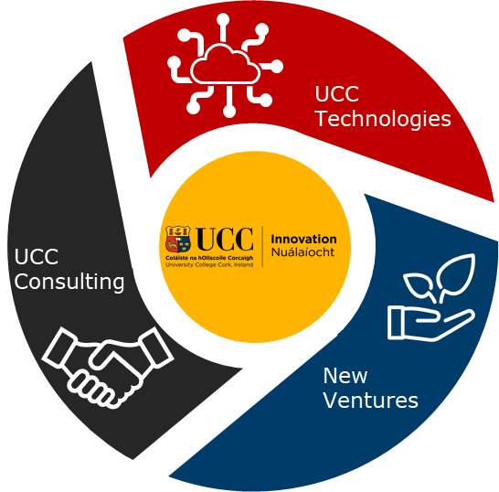
About Us
Getting UCC's ideas and expertise to the
commercial arena to
  benefit society,
  impact on the economy
  provide a return to the university to further advance its research mission
National Leader in Licenses, Inventions
Active spinout establishment and development programme

Slide 3

Research and innovation make a real and positive impact across society, the economy and the environment, both domestically and internationally.
Enterprises, particularly SMEs, start, succeed and transform through innovation, knowledge exchange, research commercialisation and access to highly skilled people.
Research excellence is enabled by a world class, accessible environment supported by a clear Strategy architecture and institutional landscape.
Research and innovation contribute to a shared island and an innovative Europe through strong North-South, European and global R&I collaborations.
Investment in research and innovation is increasing, with investment rising to at least 2.5% of the domestic economy before end 2030.
Research talent is supported at all career stages, and excellence and impact are rewarded

Slide 4

UCC Innovation
Ideas
Technology Commercialisation
New Ventures
Expertise
UCC Consulting

Slide 5
What we do
New Ventures
Relationship opportunity
UCC Consulting
Technology Commercialisation
Incubation
Start Up Programmes
Spinout Formation
Identify
Protect
Market
Transfer
Negotiate Terms
Billing & Invoicing

Slide 6





Benefiting Society & Economy
€113.3 m Research Expenditures
57
Invention Disclosures
29
Spinouts Still Operational as of FY2021
Research & Development
Invention
2 Spinouts
4 start ups
Formed
Public Use & Economic Growth
Technology Transfer Life Cycle
2021
Technology
Transfer Life Cycle 2021
Evaluation
Product Development
IP Protection
5
New Products Created
Licensing
Marketing
14
New Patent Applications Filed
31
Licenses & Options Executed
39 Consultancy relationships
7 Patents Issued

Slide 7
Technology Commercialisation Process
Identify
Evaluate
Protect
Market
Deal
Relationship
Internal marketing
Researcher meeting
IDF Prep
IDF submission
Customer Readiness Level (CRL)
Technology Readiness Level (TRL)
Business Readiness Level BRL)
IPR Level (IPRL)
Team Readiness Level (TMRL)
Funding Readiness Level (FRL)
Write profile
Promote
Online
In print
Phone
Valuation
Term sheet
Template agreements
Sign off
Annual royalty report
Technology "forward due diligence"
Research collaboration
Royalty audit
Patent
Copyright
Know-How
Priority
PCT
Nationalise

Slide 8
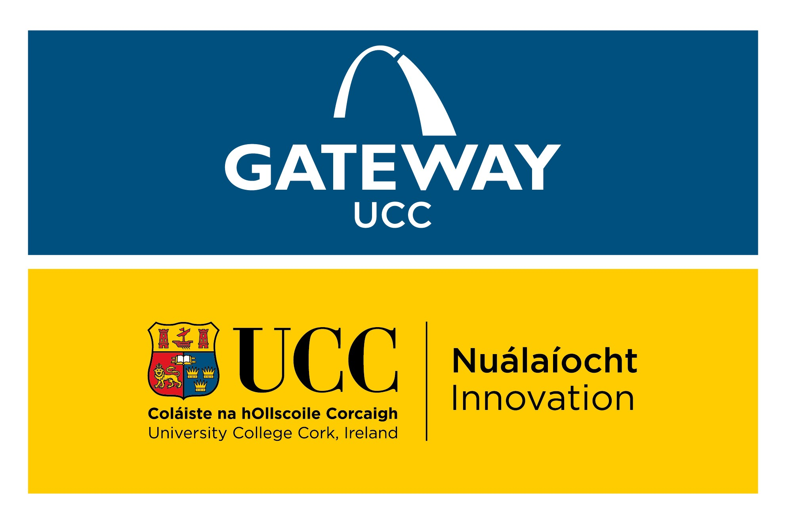
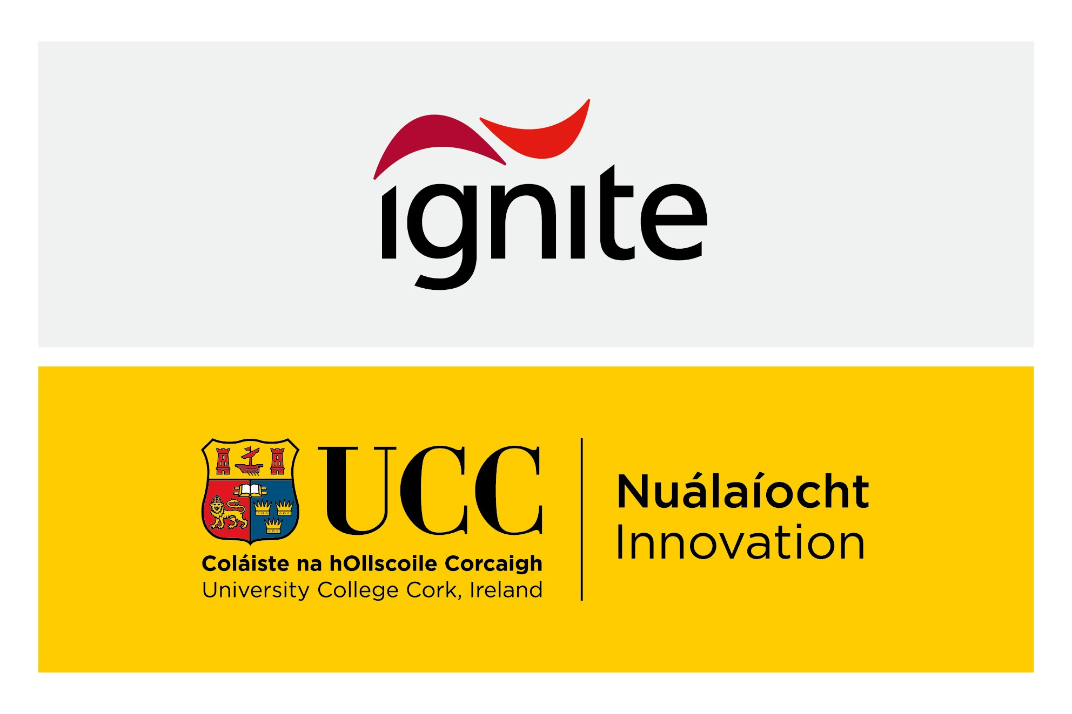




Company Formation
IP
Money
New Venture
Team
Addressable Market

Slide 9
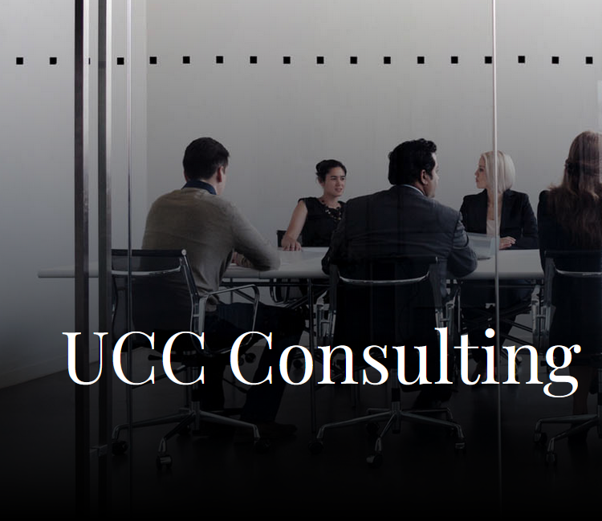
Consultancy
Focus on Expertise
Not developing new knowledge
Currently policy focus on academic staff only

Slide 10
The Team
Director of Innovation
Sally Cudmore
Executive Assistants
Marie Healy/Anne McSweeney
Kevin Dalton
Karen McCarthy
Anthony Morrissey
Emer O’Shea
Sharon Sheahan

Slide 11
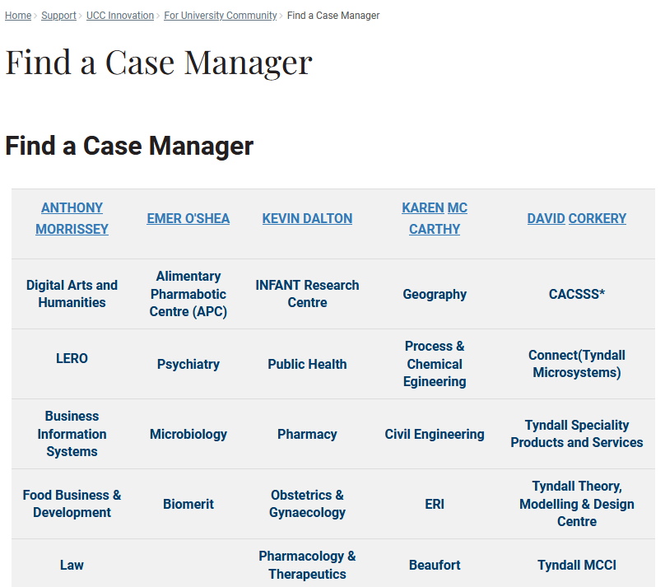

Slide 12
The Team
Director of Innovation (Interim)
Sally Cudmore
Executive Assistants
Marie Healy/Anne McSweeney
Kevin Dalton
Karen McCarthy
Anthony Morrissey
Emer O’Shea
Sharon Sheahan
Micheal Collins – Spinout
Myriam Cronin - Incubation (incl Sprint Programme)
Eamon Curtin - Ignite Programme
Ruth Hargrove-Administrator
Rachel O’Leary-Head MCS
Central Operational Support
David Corkery – Operations
Georgina Murray – Solicitor
Sarah Nolan –Marketing & Communication
Julianne Quinlan - Finance

Slide 13

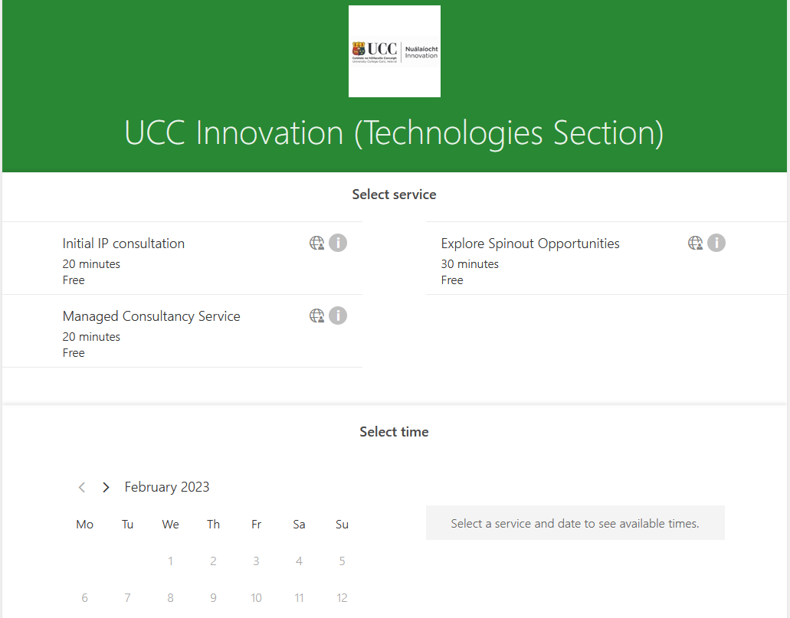
Contact Us
www.ucc.ie/innovation
uccinnovation@ucc.ie
+353-21-4205880 (team members)
Linkedin
Twitter
Book a Meeting

Slide 14
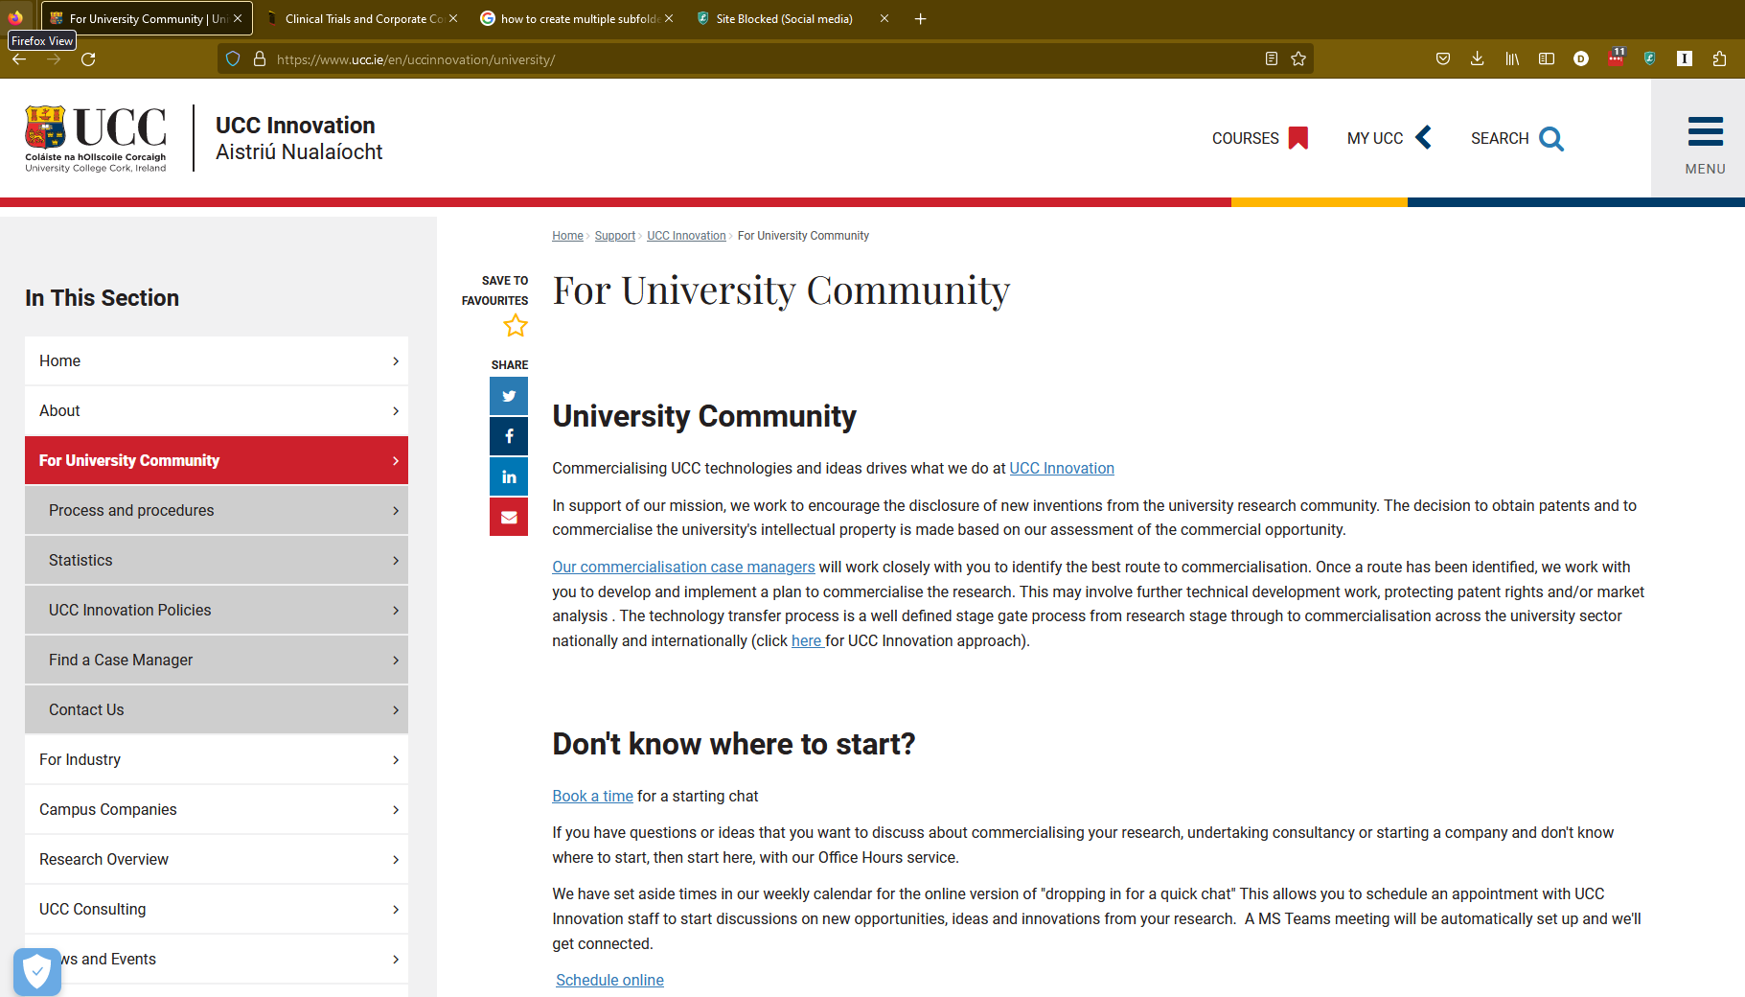
Contact Us

