Slide 1
2021/22 Q2 Energy Review

Slide 2
Q 2 21/22 Energy Performance
Scope | 2021/22 Q2 | 2018/19 Baseline
Electrical GWh | 4.89 | 5.22
Gas GWh | 7.1 | 7.2
Total | 12.0 | 12.4

Slide 3
21/22 Electrical Performance Statement
Scope | 21/22 YTD | 20/21 | 19/20 | 18/19 Baseline
Electrical GWh | 10.1 v 10.2 forecast | 8.8 | 10.1 | 10.5
Cost (€ mill) | €1.43 | €1.27 | €1.23 | €1.20
All in unit charge Cent
% Year Gone | 50%
% of electrical forecast used | 46%
Electrical Use forecasted 21,980,000 kWh.-10% increase

Slide 4
21/22 SEU Electrical Energy YTD
Most SEU’s back to normal consumption profiles.
WGB running below.
Boole / Kane running above baseline period.

Slide 5
Current Electrical Performance – 94% of UCC’s Electrical Use

Slide 6
Electrical Energy Projects Update
Lighting Upgrades:
Boole emergencyexits.-
Boole lecture hall & PC labs/ Pharmacy / Kane Lecture .
HVAC:
Ventilation upgrades / install (Civil Eng / West Wing / Connolly).- In progress.
Boole Heat Recovery.- @ Design – Summer 23- BEC grant.
Audits:
Glasshouse lighting upgrades.
Appointment of Powertherm under EEOS to complete Technical Audits of SEU's.-
Glucksman GSHP- Construction stage.
ERI GSHP- to start
ORB ASHP- M&V stage
Controls / Metering:
ERI / BSI (AHU) BMS migration.- ERI tendering
Glucksman / Boole BMS Tender. – Glucksman awarded to progress to design only.
Block A FSB BMS replacement.- Construction
ResourceKraft - Metering validation / platform expansion.
Renewables
PV Tender exercise for pay as you generate model.
Optimise ORB Arrays.
WGB Atria presence / lux control.
CB rooms – Elderwood plus others
Boole & WGB complete Q2
FSB Technicians AHU
ORB Basement / PC labs
Filter / HVAC Contract.
Capital Projects
Enterprise Deep Retrofit.
Mardyke Squad Room.
CUBs
New – BHSC Corridoor LED replacement – 42,000 kWh savings
Total YTD -85,000 kWh reduction in lighting.
BHSC Audit Complete Q1.
CAUL / Arena / Pharmacy Q3
Cooperage out to tender
Boole Lecture Halls to go to tender.
Floodlighting for Arena / Farm.

Slide 7
21/22 Gas Performance Statement
Scope | 21/22 YTD | 20/21 | 19/20 | 18/19 Baseline
Gas GWh | 14.6 | 17.4 | 15.5 | 13.9
No of HDD | 1159 | 1459 | 1474 | 1282
kW / HDD | 12,585 | 11,935 | 10,506 | 10,894
Cost | €715,000 | €736,000 | €651,500 | € 704,000
% Year Gone | 50%
% of gas forecast used | 41%

Slide 8
21/22 SEU Gas Use YTD
Close management and reduced running times.
Increased heating load due to ventilation controls.
14% increase in kWh / HDD.

Slide 9
Current Gas Performance – 85% of UCC’s Gas Use

Slide 10
Gas Projects Update
Equipment:
Audits:
ERI GSHP replacement – .
Appointment of Powertherm under EEOS to complete Technical Audits of SEU’s.
Controls / Metering:
Continue to optimise systems to run at 50-55 degrees.
Glucksman / Boole BMS Tender.- Gallery out to tender
Block A FSB BMS replacement.- construction
ResourceKraft - Metering validation / platform expansion- Steam meters validated. Adding Main Rest / St Vincents to RK.
Glucksman GSHP replacement- Construction.
Block A Food Science replacement. -Construction
ORB ASHP completion.- M&V
Roadmap for decarbonisation of heating systems.
Expand control platform to houses / other accounts
Projects
New – Boole Heat Recovery Project.
House electrification – new.
New – BHSC Frost stat logic

Slide 11
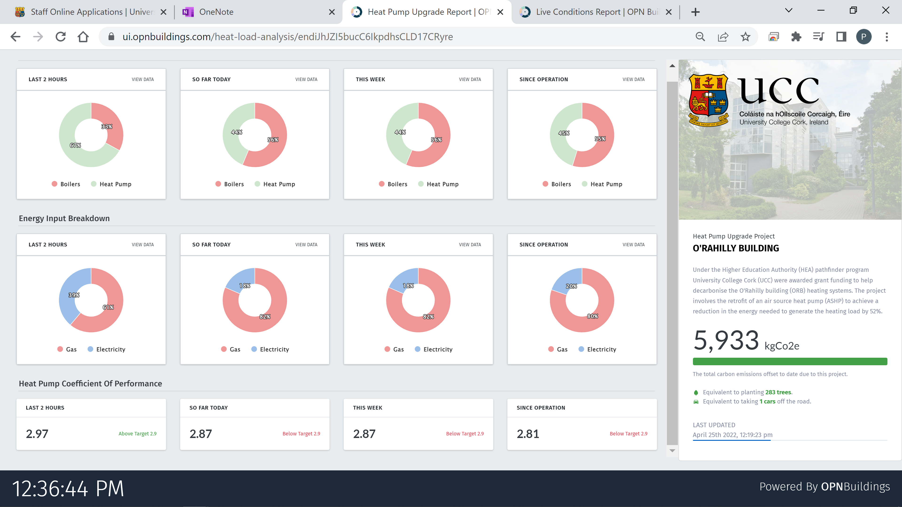
ORB Pathfinder
The ASHP supplied 39% of the heating load verses a target of 50%.
The Coefficient of Performance for the system averaged 2.8 v a target of 2.9.
Boiler Efficiency of 94% v target of 90%.
Excess space heating load due to COVID protocols estimated at 53,646 kWh.
152,000 kWh of gas use avoided (based on old equipment)
23,450 kgCO2 avoided through the operation of the ASHP/ new boilers.
€2,400 electrical cost v €3,200 gas cost avoided.
(Reporting period Feb – Mar 22)

Slide 12
Audit Progress
Audit | Observations | Comment.
Legal / Other Register | Add recently approved CAP. Communicate Impact of Part L on refurbishments | CAP addressed. For all major renovations (more than 25% of the surface area of the building envelope undergoes renovation) the building must be brought up to cost optimal level, which is defined in the building regulations as: Upgrade Heating System more than 15 years’ old Upgrade Cooling and Ventilation Systems more than 15 years’ old Upgrade Lighting more than 15 years old
Boole | 6 ESO’s identified | 250K , saving 28K, €2,083 T/CO2 abated
WGB | 6 ESO’s identified | 285K, saving 40K, €1,755 T/CO2 abated
BHSC | 7 ESO’s identified | 650K, saving 28K, €2,495 T/CO2 abated

Slide 13
Research & Collaboration
Final Year Project support.
Detailed look at Boole v energy v occupancy.
Projects for AY 22/23
Space Utilisation with IT:
Boole Lecture Halls.
Cisco.
TRUcount.
Green Labs
LEAF certification commenced.- monthly audits.
Saver saves
Boole Version 2

Slide 14
SEAI Updates
M&R reporting for 2021 closing out end of April.
M&R business travel 2021 to be reported end of May. (New requirement).
Building Register pilot running – using the data for the HEA Space Survey – UCC log in sent on.
SRSS Study released – examines the cost / CO2 impact / finance approach to get PB to B rating. – Will attach summary to the minutes
EPBD – Moving from NZEB to ZEB (A rating)- From 2027 all new buildings to be ZEB and buildings above 2,000 m2 will need to account for embodied carbon.
Pathfinder Calls for 2023:
Request to feedback:
Can we identify a ESCO option – either building or heating:

