Slide 1
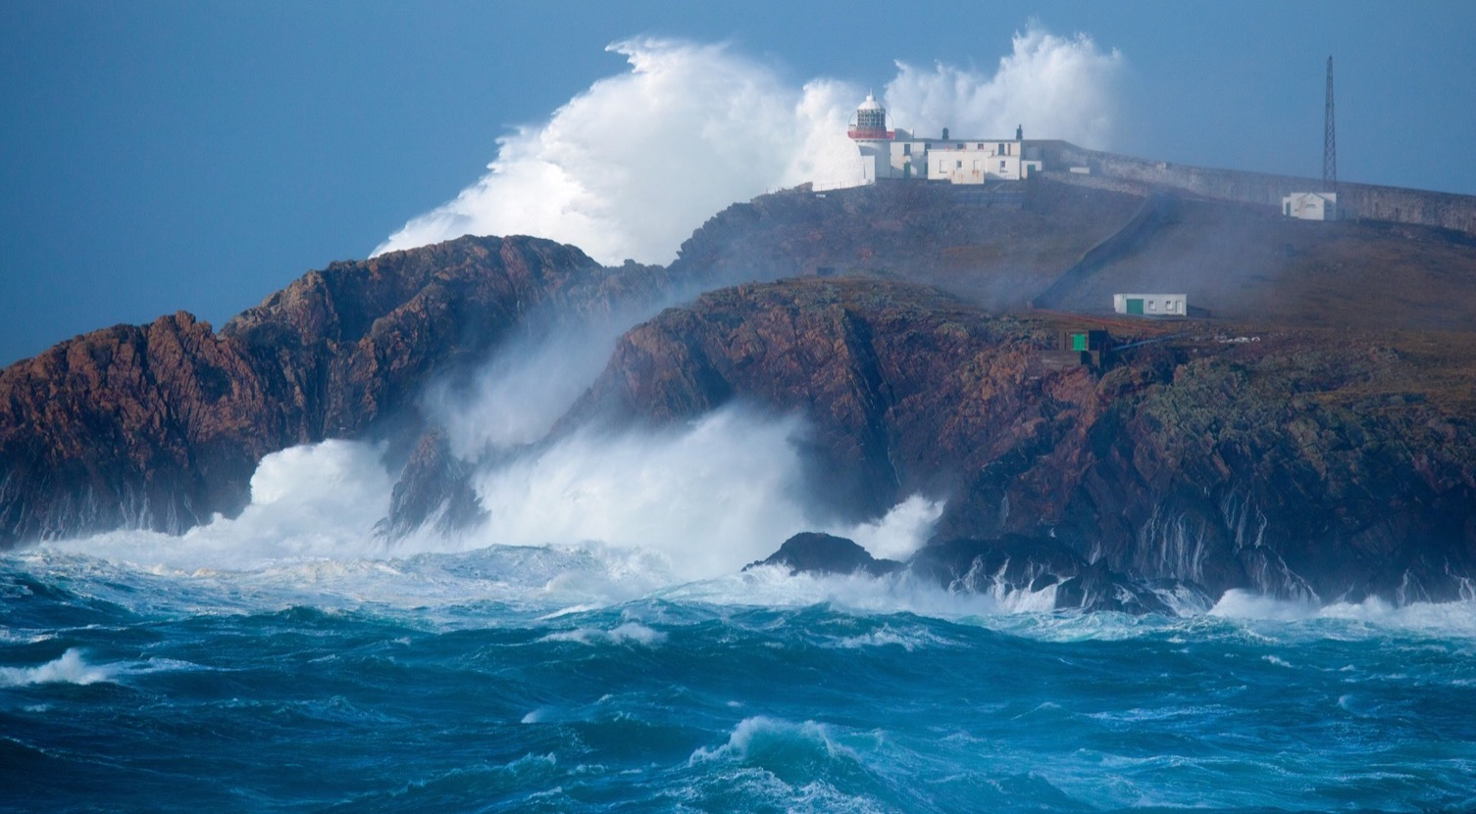



MaREI Centre for Marine and Renewable Energy
Dr Gordon Dalton
Senior Research Fellow @ MaREI
https://youtu.be/qBsTOrd2M9k
https://youtu.be/qBsTOrd2M9k
Two European H2020 projects
incorporating
Science, Responsibility, SDGs:
Engaging the wider Community
This project has received funding from the
European Union’s Horizon 2020 research and innovation
Programme under grant no 788503

Slide 2
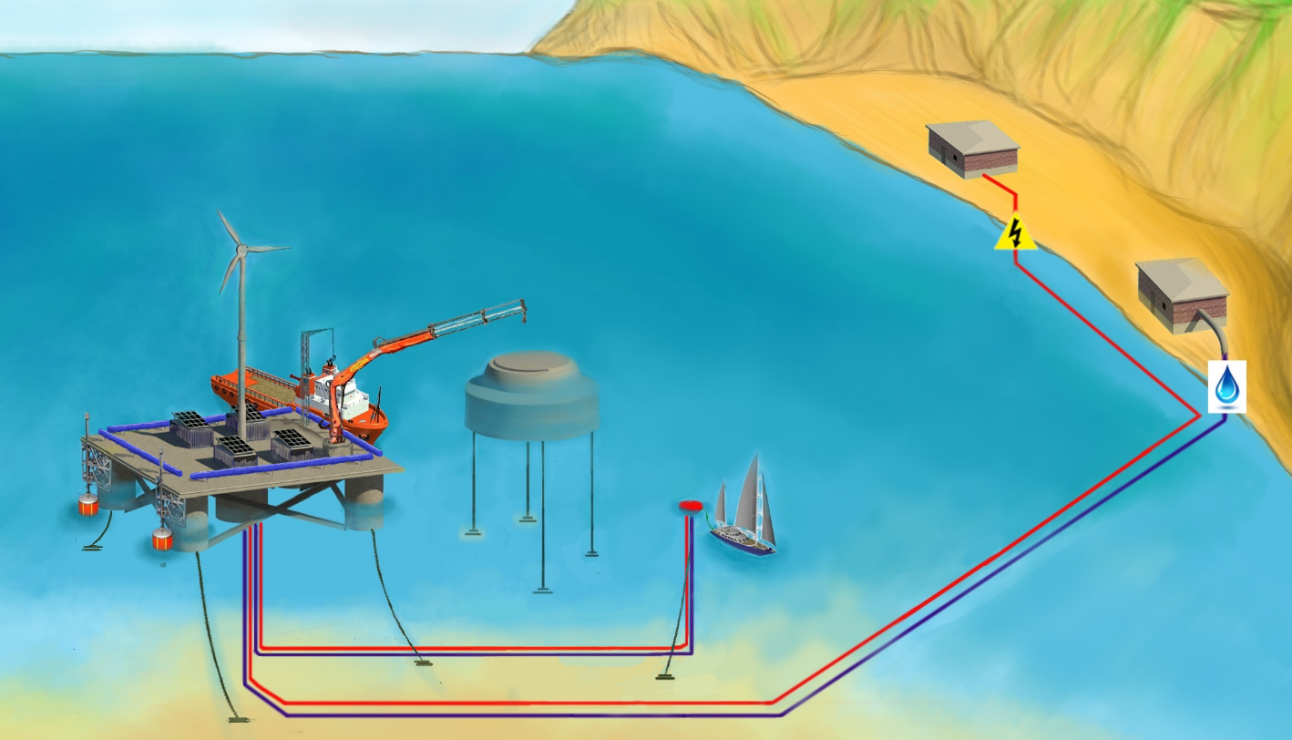
Substation
Wind
Turbine
Water storage
Desalination unit in container shed 1
Crane
Feeding Arm
EMS in container shed 1
Aquaculture
cage
PVx4
Wave Energy
Electric cable
HPES
Pressurised vessels x4
Floating refuelling station
Water pipe

Slide 3
17 Sustainable Development Goals |  | MUSICA contribution
Building a Living Economy
Goal 7 | Ensure access to affordable, reliable, sustainable and modern energy for all | MUSICA MUP will provide competitively priced renewable electricity for islanders
Goal 9 | Resilient infrastructure, inclusive, sustainable industrialization innovation | MUSICA provides one-stop shop sustainable and economical, energy Blue growth solution for small island.
Goal 12 | Ensure sustainable consumption and production patterns | MUSICA RES Smart DSM ensures islanders will become educated and sustainable energy efficient consumers.
Protecting capabilities and flourishing
Goal 1 | End poverty in all its forms everywhere | 1] provide more economical energy for small islands. 2] stimulate industry, new Blue Growth and tourism
Goal 2 | End hunger, achieve food security and promote sustainable agriculture | MUSICA MUP will provide new opportunities for offshore aquaculture, providing new food sources.
Goal 4 | Inclusive and equitable quality education , lifelong learning opportunities for all | WP6 is dedicated to RRI, public engagement and quadruple helix participation providing social innovation
Goal 5 | Achieve gender equality and empower all women and girls | WP6 will ensure Gender Equality and diversity is achieved in the project and business plans, and public engagement
Goal 16 | Peaceful and inclusive societies for sustainable development, | The MUSICA project will promote academic and industrial cooperation in the Aegean area, transnational cooperation,
Goal 17 | Strengthen implementation of global partnership for sustainable development | MUSICA innovation vision is global, assisting global endeavour in decarbonising , whilst promoting industry
Staying within Planetary Boundaries
Goal 6 | Ensure availability and sustainable management of water | MUSICA provides fresh water provision, renewably sustainably supplied, targeting water scare islands.
Goal 13 | Take urgent action to combat climate change and its impacts | MUSICA smart ICT ensures energy efficiency and smart energy consumption, renewably created fresh water
Goal 14 | Conserve and sustainably use the oceans, for sustainable development | MUSICA is a marine solution for islands, fosters marine Blue growth enterprises, sustainable RES , aquaculture

Slide 4
MUSICA Objective 7: Maximise the acceptance and use of RES and the decarbonisation plans by the islanders by embedding the principles of
  Responsible Research and Development(RRI).
  SDGs
  MUSICA will align its impacts to contribute to SDGs and Grand Challenges. World leaders adopted the 2030 Agenda for Sustainable Development (2030 Agenda) with the SDGs as its core. The EU was instrumental in shaping the global 2030 Agenda, which is fully consistent with Europe's vision and has now become the world's blueprint for global sustainable development. MUSICA will ensure it contributes to the SDGs for EU islands. MUSICA is directly relevant to Target 14 which refers to ocean energy and desalination from RES.

Slide 5
MUSICA T6.4 Internal RRI in MUSICA evaluation cycle and align MUSICA impacts with SDGs.
Adopting best practice from RRING and GRRIP projects, reflect and evaluate performance of MUSICA on
    5 RRI pillars: Ethics/integrity, open access, STEM, gender equality, public engagement.
    Align MUSICA impacts with SDGs by embedding the principles of RRI.

Slide 6
RRING T6.1 Align RRI to advance the UN SDGs
T6.1.1 Compile deliverables on SDG:
  WP3: Review the SDGs and initial reaction to RRI alignment concept including outcomes of 5 Geographic workshops
  WP4: Report on Global SDG and RRI comparative analysis and mutual learning opportunities. Outcomes of WP4 Global workshop and RRI relevance to SDG
  WP5: Review RRI competitive advantages, obstacles and relevance SDGs
T6.1.2 Position report on how RRI maps to SDG, geographic variations and recommendations to advance SDG and Grand challenges based on RRI.

Slide 7

Thank You

