Slide 1
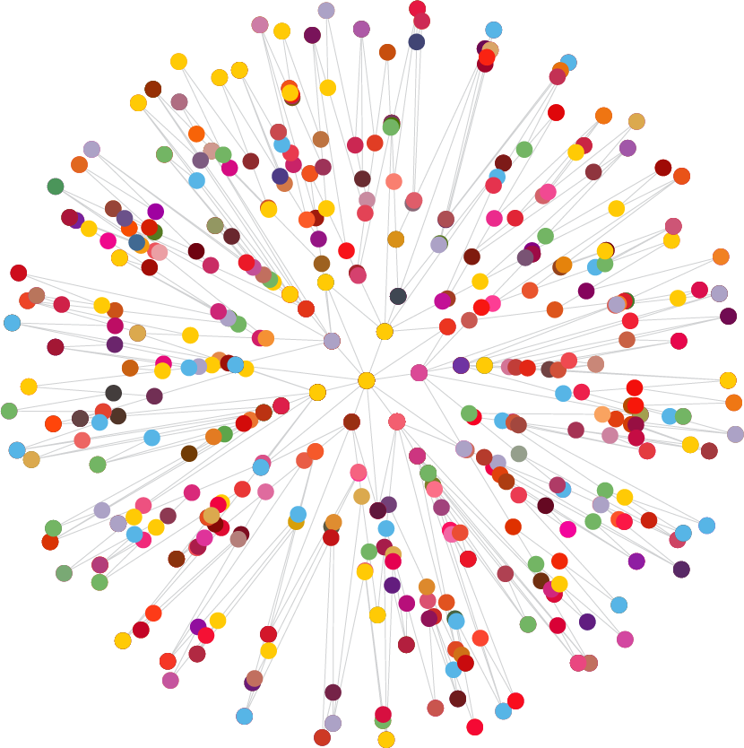

Slide 2

This is an
excellent report.
The analysis is of very high quality; the authors have been able to calculate
both economic and wider social impacts.
The report demonstrates that UCC is an engine of growth for the Irish economy.
Prof Sir Anton Muscatelli
Principal and Vice-Chancellor,
University of Glasgow

Slide 3
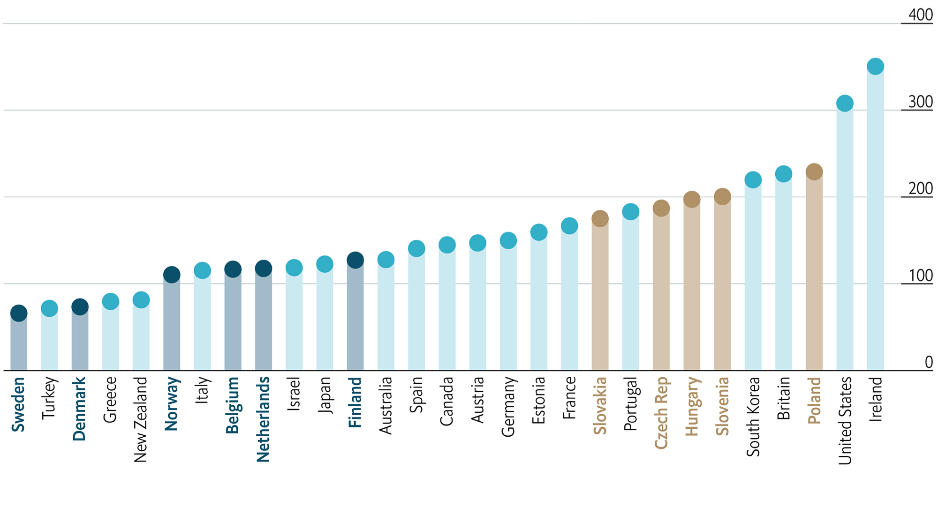
Former Eastern Bloc countries
Historical shortage of graduates
High demand for skilled labour
Net
Nordic & Benelux countries
Highly skilled population
High income
taxes
VALUE
Of a Degree
Lifetime Net Benefit of Getting a Degree
Compare with Non-Graduates, $’000 at PPP*
Sources: OECD, 201 (for the year 2010) *Purchasing power parity

Slide 4





UCC’s Impact at a Glance
€2.3 million generated by UCC every day for the economy.
€853 million - Total economic impact of UCC = €728 million in expenditure impact & €125 million in tax impact (incl social insurance contributions).
23% a leader in access to third level education.
over 23% of ucc’s undergraduate intake are mature students, students with disabilities or non-traditional college-goers.
ucc is a leader in
collaboration with industry.
……………………………………………..
UCC is changing the physical landscape of cork city for the better. UCC’s €241 million development plan is the largest planned by any organisation in Cork.
…………………………………………………….
UCC supports 1 in every 15 jobs in cork city & county.
......................................................
€10 million in R&D secured and invested by UCC’s industry partners.
………………………………………………………..
UCC’s €96 million investment in creation & discovery = leading irish university with regard to actively seeking and securing investment in research and development.
………………………………………………………
Employment rates of UCC graduates are at historic high levels at 94% for undergraduate level and 95% at postgraduate level.
…………………………………………...
Book of the year Atlas of the Irish revolution published by Cork University Press

Slide 5




……………………………………………………….
UCC has 58 clubs for its athletes operating from the Mardyke Arena. 103 different student-led interest societies run an average of 40 events per week.
……………………………………………………………
UCC is the primary academic partner supporting nine hospitals in the south west hospital group. UCC impacts the physical health of the nation as much as it improves the fiscal health of the citizens.
……………………………………………………
UCC’s irish students generate €135 million for the local economy this expenditure supports 3,675 jobs in the irish economy.
€30 million annual investment.
UCC’s international students generate €52.5 million for the local economy. This expenditure supports 1,421 jobs in the Irish economy.
………………………………………………..
.68
……………………………………………………
Tyndall National Institute - €30 million annual investment in creation and discovery is in itself greater than that of the entire r&d investment in 2 of the 7 irish universities
€5.68 return for every €1 of state investment in UCC.
€24.8 million in additional economic impact generated in the first year after graduation by graduates.

Slide 6
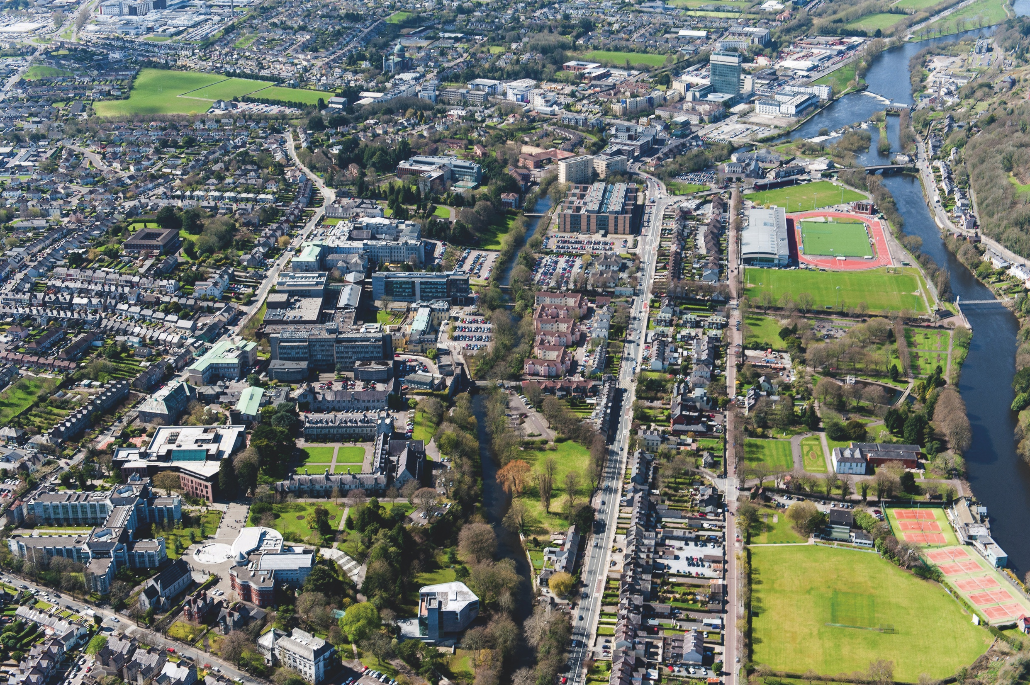

UCC’S
ECONOMIC
IMPACT
€ 2.3 MILLION
generated by UCC every day for the economy
€ 5.68 RETURN
FOR EVERY € 1
of state investment in UCC

Slide 7


UCC’S
WORKFORCE
DEVELOPMENT
IMPACT
BE WORLD READY
UNDERGRADUATE
94%
Employment rates of UCC graduates are at historic
high levels
GRADUATE
95%

Slide 8


UCC’S
BUSINESS
IMPACT
UCC’s students generate
€ 187.50 MILLION
for the local economy
in expenditure

Slide 9
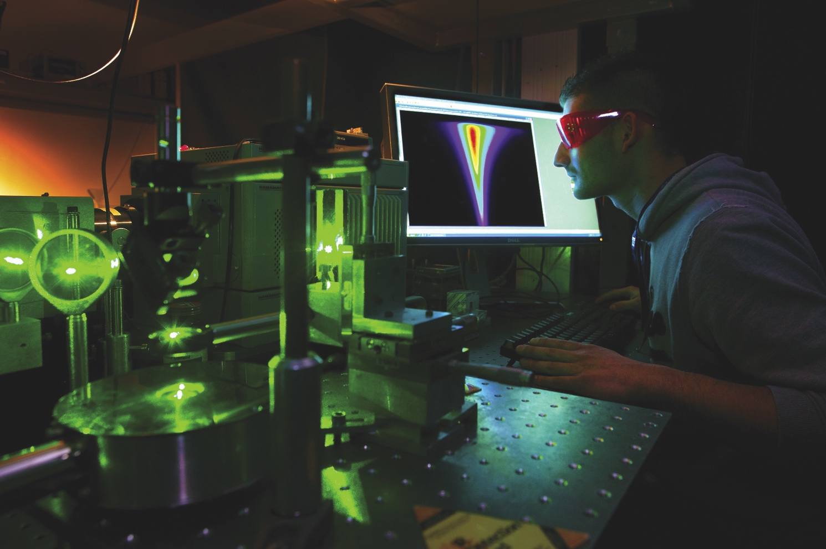

UCC’S CREATION & DISCOVERY IMPACT
€ 96 MILLION
Investment in Creation
& Discovery =
€ 10 MILLION
in R&D secured and invested by UCC’s Industry partners

Slide 10


UCC’s SOCIETAL IMPACT
OVER 23%
of UCC’s undergraduate intake are mature students, students with disabilities or non-traditional college-goers, reflecting the ethos of equality, diversity and inclusion for all.

