Slide 1


Self-care and Wellbeing during the COVID-19 pandemic
Prof Ella Arensman
April 2020

Slide 2

Overview
COVID-19, self-care and safety
Challenges related to COVID-19 and
possible impacts on mental health and wellbeing
Self-care
Stress management techniques
CBT techniques - Discussion
Relevant resources

Slide 3

COVID-19, self-care and safety
Definition COVID-19 is a disease caused by a coronavirus, a highly contagious virus that affects the respiratory tract. It is transmitted from one person to another.
A pandemic occurs when a new virus spreads throughout the world. Since humans are not protected against the new virus, a greater number of people become sick.
Transmission of the virus:
The coronavirus COVID-19 is very easily transmitted by tiny droplets that are expelled
into the air when an infected person coughs or sneezes.
If the person covers their nose and mouth when sneezing or coughing, the droplets will land in their elbow, upper arm, mask, facial tissue or handkerchief.

Slide 4
COVID-19, self-care and safety
Risk of becoming infected by the coronavirus (COVID-19) when:
We touch a contaminated object or surface with our hands then touch our face, symptoms develop on average from 5 to 7 days after contamination, but may appear between 2 and 12 days.
To be prudent, 14 days of isolation is recommended. Coronavirus propagates during close contact between people.
Close contact can occur when:
Someone lives in the same home as an infected person
Someone provides care to an infected person
People gather in public places, work settings and meetings; Therefore, social distancing (2 metres) is crucial

Slide 5
COVID-19, self-care and safety
80% of infected individuals recover without any special treatment.
Some groups of people are at risk of dying from severe respiratory complications of a coronavirus infection, such as pneumonia or acute respiratory syndrome.
The following groups of people infected by the coronavirus (COVID-19) are at risk of dying:
• People aged 70 and older
• People with the following underlying conditions:
Chronic heart diseases, chronic pulmonary diseases, cancer and immune deficiency, diabetes

Slide 6
COVID-19 symptoms
Symptoms of the coronavirus disease (COVID-19) can resemble the common cold or be much more like severe respiratory diseases.
Frequent symptoms:
Cough, fever, extreme fatigue
Severe symptoms (1 case out of 6):
Cough, difficulty breathing (dyspnea), fever, pneumonia
extreme fatigue

Slide 7
COVID-19 and health advice
Wash your hands OFTEN, in particular:
• Before touching your face (eyes, mouth, nose)
• After you cough, sneeze or blow my nose
• Before and after you provide care to a close friend or family member
• When my hands are visibly dirty or after I touch a dirty object
• Before and after you prepare meals
• Before and after you eat
• After using the toilet
• Before and after going to a public place
What to use: It is recommended to wash hands with lukewarm water and soap or with a 60%-70% alcohol-based gel, foam or liquid.
Wearing a protective mask is recommended if you are coughing or sneezing around other people. The mask will help to prevent contaminating them.

Slide 8
Possible impacts on people’s mental health
The COVID-19 pandemic is a new and challenging event. Some people might find it more worrying than others.
Most people’s lives will change in some way over a period of days, weeks or months, but people also move into a ‘new routine’:
You may experience some of the following:
increased anxiety
feeling stressed
finding yourself excessively checking for symptoms, in yourself, or others
becoming irritable more easily
feeling insecure or unsettled
fearing that normal aches and pains might be the virus

Slide 9
Possible impacts on people’s mental health ctd.
having trouble sleeping, nightmares
feeling helpless or a lack of control
having irrational thoughts
being unable to handle intense feelings or physical sensations
use/misuse of alcohol or drugs
feeling numb and empty
major changes in eating patterns
While some of these symptoms, may be a ‘normal reaction’ to an ‘abnormal situation’, if one or more of these symptoms persist over more than 2 weeks, it would be important to seek professional support.

Slide 10
Understanding reactions and emotions related to COVID-19
Recognise that feelings such as loneliness, fear of contracting the disease, anxiety, stress, panic and boredom are normal reactions to a stressful situation such as a disease outbreak.
Even if a family member is isolated or quarantined, realise this will be temporary.
When ensuring the ones closest to you are cared for, it’s important to not forget about taking care of yourself.

Slide 11
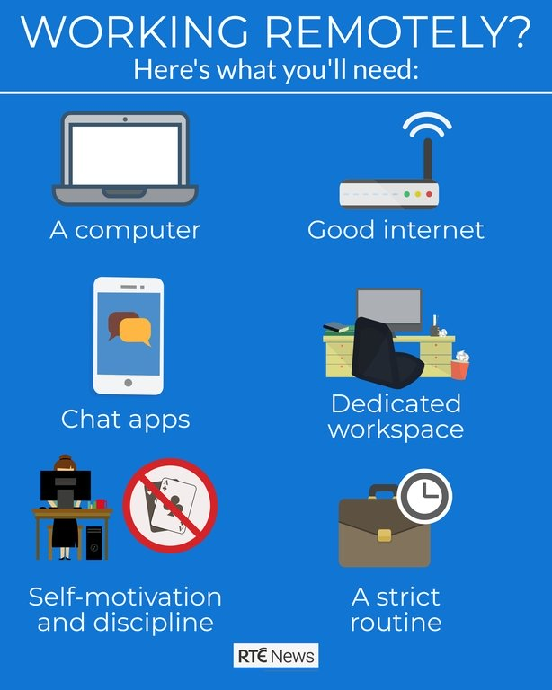
Aspects related to working from home
Setting up a new work-life routine at home/
different setting.
Combining work with the care for
family members
Combining work with the education of
children
Being remote from family and friends

Slide 12
Attention to self-care, minding yourself and others
Establish a daily routine in your home/different setting
Plan your week/day, including regular contact with your supervisor, colleagues, project team
Search for online exercise or yoga classes, concerts, dancing for you and/or your children
Improve your mood by doing something different/creative/helping out
Focus on supporting others
Talk about your worries
Try not to seek constant reassurance

Slide 13
Stay connected to others
During times of stress and fast changing developments, friends and families can be a good source of support. It is important to keep in touch with them and other people in your life.
If you need to restrict your movements or self-isolate, try to stay connected to people in other ways, such as WhatsApp, Zoom, Skype, e-mail etc.
Talking things through with someone on a regular basis can help to reduce worry or anxiety. You don't have to appear to be strong or to try to cope with things by yourself.

Slide 14

Putting thoughts relating to COVID-19, isolation and remoteness in perspective
Virtual discussion based on examples of experiences among staff

Slide 15
Cognitive restructuring
Cognitive Restructuring:
Challenging unhelpful thoughts: Cognitive Restructuring is an evidence based intervention, used to challenge unhelpful thoughts in low mood or anxiety.
It works by identifying negative or unhelpful thoughts and gathering evidence to the accuracy of the thought. This evidence then helps us to develop a more realistic and helpful thought.
The countering technique: CBT exercise which involves challenging a persistent thought the courtroom treatment, by confronting it with a rational counter-statement.
For example, if your persistent thought is something like “Everyone I love will die from this virus” you can counter it with factual statements such as “Actually, most people who get Covid-19 are likely to make a full recovery, and that’s assuming my partner and children will even catch it at all.”

Slide 16

Coping with loss and grief
Considerations with regard to potential loss and grief associated with COVID-19.
The Covid-19 pandemic has changed the traditional ways in marking grief, such as:
Changes to end of life rituals and limitations in providing support
when a person is faced with the death of family member, friend
or colleague.
Alternative ways of providing support to people who
are bereaved
www.hospicefoundation.ie/wp-content/uploads/2020/03/Grieving-in-exceptional-times-.pdf

Slide 17
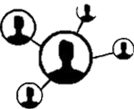




Self-care
The Goal
To feel vital and balanced, free from depression and anxiety
Spiritual self-care
(Meditation, meaning-making, prayer)
Mental/ emotional self-care
(e.g. processing emotions, challenging less adaptive thoughts, journalling)
Social support
(e.g. family, friends, professional support)
Physical self-care
(e.g. nutrition, sleep, exercise)
Lifestyle
Structure/ routine, goal-setting, fulfilling work, time in nature

Slide 18
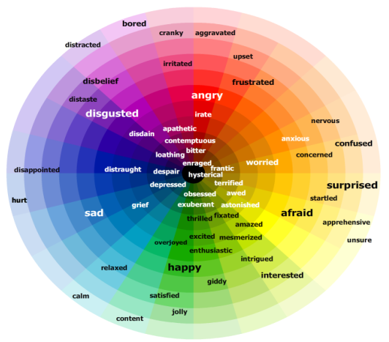
Stress management techniques
Day-to-day
Take regular breaks
Work regular hours (avoid working extensive hours)
In times of extreme stress
Try to distinguish between internal stress (e.g. feelings,
thoughts/intrusions) and external stress (e.g. negative
aspects of work environment)
Afterwards
Discuss stress related event with someone (e.g. peer support)
Communicate reflections on the experience (could discuss with supervisor)
Take time to do activities that you enjoy or find comfort in (e.g. music, film, sport, hobbies)

Slide 19
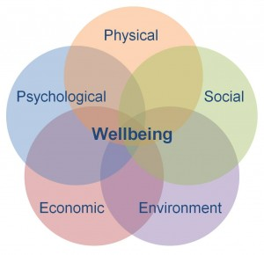

What can you do to improve your mental health and wellbeing?
Mindfulness and meditation
Yoga
Lifestyle – sleep, exercise and diet

Slide 20
Mindfulness based daily exercises (1)
Breathing exercise (use breath to verify your emotions):
Find a quiet space
Spend a few minutes noticing your breathing
Feel your breath entering and leaving your nose, chest and stomach

Slide 21
Mindfulness based daily exercises (2)
Body scan meditation to reduce strain and improve relaxation:
Find a quiet and comfortable space
Start with your breath as a focus, and then slowly move through each part of your body starting with the tips of your toes, paying particular attention to the way it feels and whether there’s any tension there
Take some breaths, and feel the muscles in that area relax
Move onto the next part of your body until you work all the way up to your facial muscles and top of your head

Slide 22
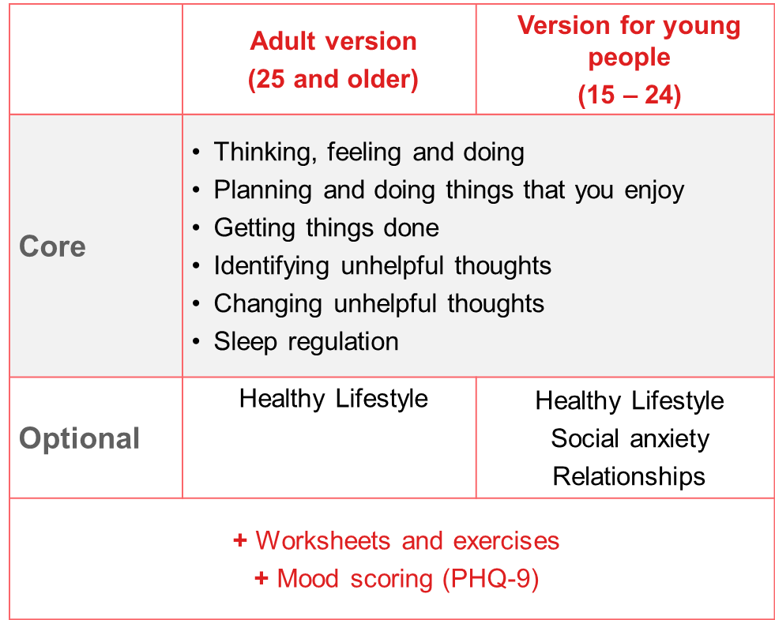
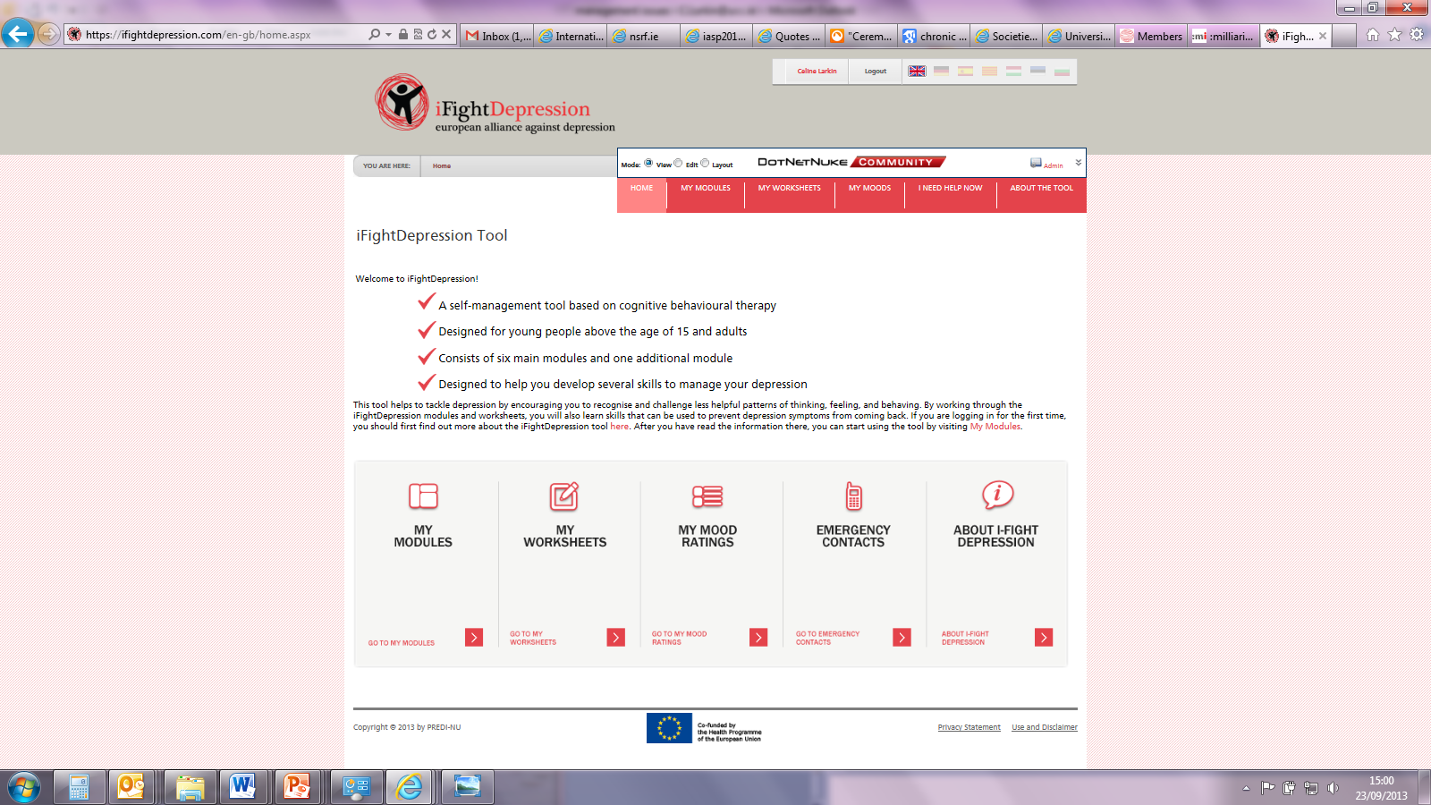
Online self-management for depressive symptoms and depression: The iFightDepression tool
https://ifightdepression.com/en/
Arensman et al, 2015;
Oehler et al, 2019

Slide 23
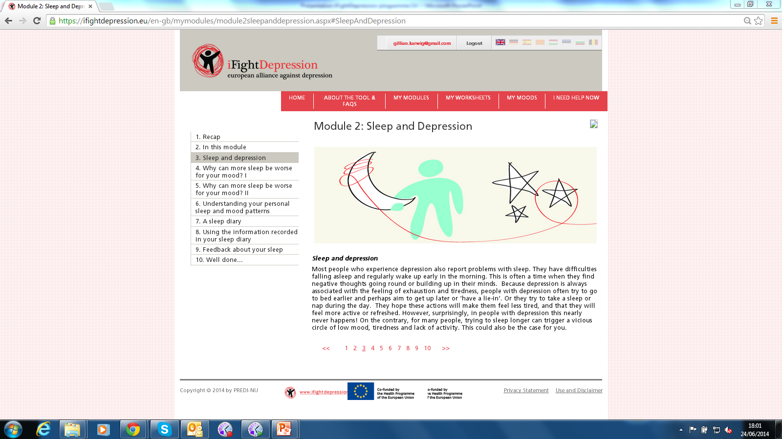
iFightDepression tool –
Example Module 2

Slide 24
Relevant resources
Information
World Health Organisation (WHO) - https://www.who.int/docs/default-source/coronaviruse/mental-health-considerations.pdf?sfvrsn=6d3578af_8
Health Service Executive (HSE) - https://www2.hse.ie/wellbeing/mental-health/minding-your-mental-health-during-the-coronavirus-outbreak.html
Mental Health Ireland - https://www.mentalhealthireland.ie/news-events/five-ways-tough-times/
Centre for Disease Control and Prevention - https://www.cdc.gov/coronavirus/2019-ncov/prepare/managing-stress-anxiety.html

Slide 25
Relevant resources
Infographics and Q&A session:
· Coping with stress during COVID-19: https://www.who.int/docs/default-source/coronaviruse/coping-with-stress.pdf?sfvrsn=9845bc3a_2
· For children during COVID-19: https://www.who.int/docs/default-source/coronaviruse/helping-children-cope-with-stress-print.pdf?sfvrsn=f3a063ff_2
· Q&A session with expert WHO HQ staff member on MHPSS aspects of COVID-19: https://twitter.com/WHO/status/1237372330696798208?s=20
Working from home:
Five tips for working at home during COVID-19: https://www.psychologytoday.com/intl/blog/digital-leaders/202003/5-tips-working-home-amid-covid-19

Slide 26
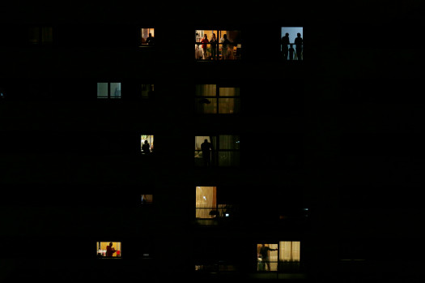


Stay well and Connected!

Slide 27
Professor Ella Arensman
National Suicide Research Foundation & School of Public Health
WHO Collaborating Centre on Surveillance and Research in Suicide Prevention
University College Cork, Ireland
International Association for Suicide Prevention
E-mail: ella.arensman@ucc.ie / fenella.ryan@ucc.ie

