Slide 1

Doing your best when it matters most: Optimising Study and Exam Performance with Lifematters uni-v

Slide 2

THE LIfeMatters APPROACH …..TAKE FIVE –
Body
-Exercise, sleep hygiene. Being physically well. EAT MOVE SLEEP
Mind
-Managing, thoughts emotions, cognitive load stress, mindset & cognitive learning strategies
- The way you think effects the way you feel. Use Healthy Thinking Strategies Step 2 in Handbook
Behaviour
-Active study techniques, tips on procrastination, Time management techniques and study plan
Environment
-Study/rest balance and preparation. Set up your study Environment. Make it easy to learn & retain
5. SPIRIT / Self
-Identifying personal values, principles & motivators

Slide 3
1. Body step 1 handbook
Benefits of Sleep
Exercise
Boosts energy levels and mood
Helps stress through regulating breathing and heart rate (Moving us out of survival mode)
Flushes out excess adrenaline in the body that would hinder our concentration.
Improves memory (clear head).
Exercise habit
-150 mins a week (5x30min sessions, 3x50min sessions)
-Build it up slowly over 30 days
-Fit it feasibly into weekly routine (morning vs evening, walk to college, take stairs, get off bus earlier).
-Pick exercise you enjoy: classes vs. gym, alone vs. company, intense vs. normal, indoors vs. outdoors
Better assimilation and recall of information
Makes us less stress reactive (restorative)
Greater problem solving, creativity and sustained attention.
Sleep hygiene
Keep sleep and wake times regular (7-9hrs)
Stop studying at least an hour before sleep
Develop bedtime routine (Wash face, clean room, read, meditate. Avoid use of phones).
(The National Sleep Foundation, 2015; Vandekerckhove & Cluydts, 2010)

Slide 4
2. Mind-Cognitive Performance…Step 2 handbook
Unhelpful or Detrimental thinking styles
Perfectionism
Imposter syndrome
Making comparisons with others
Toxic ten: All or nothing, catastrophising, should must and ought to statements, disempowering questions e.g. What is wrong with me?
Negative self talk can leave us feeling anxious, disempowered and unmotivated. These feelings can lead to unhelpful behaviours like procrastinating, withdrawing, wishful thinking and distracting oneself. How to address it?

Slide 5
Stress and Performance Yerkes-Dodson Law
Optimum Positive Stress
Performance
Bored & Frustrated
Negative Stress
Fatigue & Distress Negative Stress
-----Tension Level-----
The Stress of Working, D. Rainham
Notes:
5

Slide 6
Signals of Negative Stress
When we are in survival mode (fight or flight), energy is diverted from our brain, to our muscles, narrowing our attention, making it harder to think clearly, creatively and with perspective (Cottrell, 2019).
Physical
Negative Behavioural Responses
Mind is racing, finding it difficult to think clearly or concentrate
Intrusive worrying or ruminating
Can’t shut your brain off, especially at night
Knots in stomach, resulting in low appetite
Tension in certain muscle groups.
Difficulty sleeping
Pervasive low mood
Over or undereating
Procrastinating work related tasks
Overworking to keep up with workload
Sacrificing basic needs: Eating well, hygiene, sleep.
Having no worklife balance scheduled e.g. time with friends, days off.
Using substances to relax.
What are your personal signals of stress?
How do you usually respond to stress?

Slide 7
Stress management: how to preform under pressure
In order to be able to preform better in exams and with study we need to learn flexible techniques for managing stress.
Ways to respond:
Write down what is worrying you. What are your main fears? What is the likelihood of this happening? What will I do if this does happen? Is this a feeling or a fact ?
This helps to get ruminations out of your head and onto paper , when you see it all written down it will give you a different perspective – Use Healthy Thinking to problem solve
Start tasks early so you have time to deal with unforeseen issues.
Develop meditation, mindfulness, and breathing exercises.
Talk to others when you are feeling stressed
Look after basic needs: sleep, nutrition, exercise, time off.
Maintain a positive mindset: focus on what you can control

Slide 8
Visualisation: how to stay cool under pressure
The technique of visualisation is often used by athletes to help to remain calm under pressure and perform at their best. This technique comes from sports psychology.
It can also be used for other evaluative situations such as exams, interviews and practical exams. It involves visualisation yourself in the evaluative situation in detail. You go through each step of the process, imagining how you would like things go. It will help you to get in the zone and feel less anxious when you are in the real scenario.

Slide 9
Cognitive strategies
We remember 40% of what we see, 50% of what we say, 60% of what we do. 90% of what we read, hear, see, say and do.
When studying, it is wise to use integrative study techniques such as so that information is encoded in different ways such as: multisensory information processors
Watch videos, podcasts, online seminars and real life examples of topics
Read information, write information, speak information out loud to real or imagined person, record self, debate topic, draw diagram, pictures, seek out real life examples or controversies.
Keep study engaged, study actively
Rewrite concepts in your own words
Relate information to areas you already know
Group relate concepts together and develop a conceptual pyramid
Relate material to personal stories or emotional events
Encoding information in different ways will help you to remember it more clearly. Try to make topics interesting.

Slide 10

3.Behaviour…….step 3 handbook
Active study styles (Active vs. Passive)
Active: Engaging with material by rewriting it in your own words, linking information, thinking of real life examples, listing questions you want answered before study session/lecture, discuss with others, evaluate evidence, teach topic to someone, past exam questions.
Passive: Repeating or rote learning without understanding concepts, writing down every word the lecturer says, learning off essays, rewriting notes neatly rather than succinctly
Photo by energepic.com from Pexels

Slide 11
PQRST Method of reading
Preview-Skim read the whole chapter, each section, concluding points, figures
Question-Generate questions based on what you have read
Read-absorb meaning, connect to other areas
Summarise- main points/understanding in your own words, answer questions, key concepts
Test- write or say everything you know and check against notes/text
Thomas and H. A. Robinson, Spache and Berg and R. P .Robinson

Slide 12

Virtuous vs. Effective Study (study smart)
Virtuous
Effective
Reading books from cover to cover when not all information is relevant.
Reading several books on the same topic.
Writes detailed long winded notes.
Works for several hours in a row without breaks
Withdraws from classmates, friends and social events to put in more study.
Never asks for help or accesses resources
Select one high quality textbook and be selective about what sections to cover.
Rewrite notes in concise manner outlining the most important points.
Write down everything you know about the topic and research selectively to fill the gaps. What questions still need to be answered?
Work in groups to gain a new perspective.
Maintain a work life balance for wellbeing and sustainability.

Slide 13
Overall clear outcomes and study plan for semester, long term short terms study plan.
Pie 100%=final year end mark, different pieces of pie for different assessment methods, study plan to fit pie. E.g. OSCE, practical exams, short cases, long cases, MCQS, research project.

Slide 14
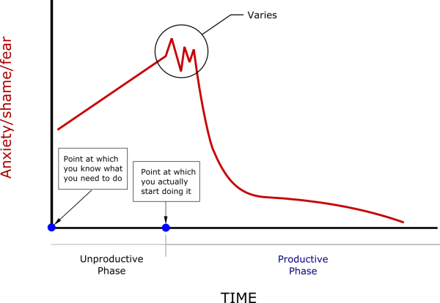

Cycle of Procrastination
David Cain (2015)

Slide 15
Managing procrastination
Identify why you are procrastinating? Overwhelmed by size, fears of not being capable, lack of interest in the task…
How do you normally trick yourself into putting things off? “I’ll just watch one episode on Netflix”, “I’ll just take a nap first”, “I’ll just start tomorrow when I feel more rested”… “I’ll do this other non priority thing first”
Tricking yourself into doing the task:
Commit to doing something small and easy (15mins): Read/understand question, brainstorm ideas, plan schedule for doing task. (you will probably end up doing more than you set out to).
Perfectionism: don’t wait for the perfect conditions, just start. Piece of paper and a pen
Break down the large overwhelming task into smaller manageable tasks (Chunk it), make daily, weekly goals.
Identify triggers for studying: answering emails, reading over notes, making to do list…
Commit to shorter periods of study at first with daunting tasks: 2hrs vs. 6 hrs.
Note down some of the benefits of completing the task? (helps you to focus on long term outcomes rather than short term distress)
Reward yourself after completing scheduled tasks. Turn distractions into rewards.
Forgive yourself for past procrastination (Lombardo, 2017, Psychology Today; Mel Robbins, 2018; Watchwellcast, 2012)

Slide 16
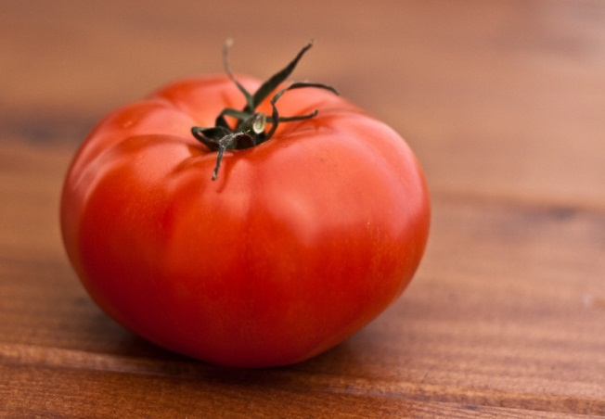
Time management: Pomodoro Technique
Photo by Kaboompics .com from Pexels
(Cirillo )
Involves:
Working for 25 minutes uninterrupted.
Use a timer.
Stop when the timer goes off and take a short break (5mins).
Take longer breaks every 4 Pomodoro's (20-30mins).
Keep track of the number of Pomodoro's you complete.

Slide 17
Time management
Where do you place your time currently?
Plan difficult tasks during peaks in energy (Morning vs. evening person)
Work in short bursts if you find long study blocks daunting.
Efficient breaks: have fewer but longer breaks if you find if difficult to settle back down. Have frequent but short breaks if you find it difficult to concentrate for extended periods.
Turn independent study into a routine: block out set times for study.
Set a goal/challenge for each individual study block.
Flexibility: vary study lengths depending on energy levels.
Avoid distractions: put phone on airplane mode/do not disturb during study block.
Make sure there is an end in sight… study for two hours and then stop.

Slide 18
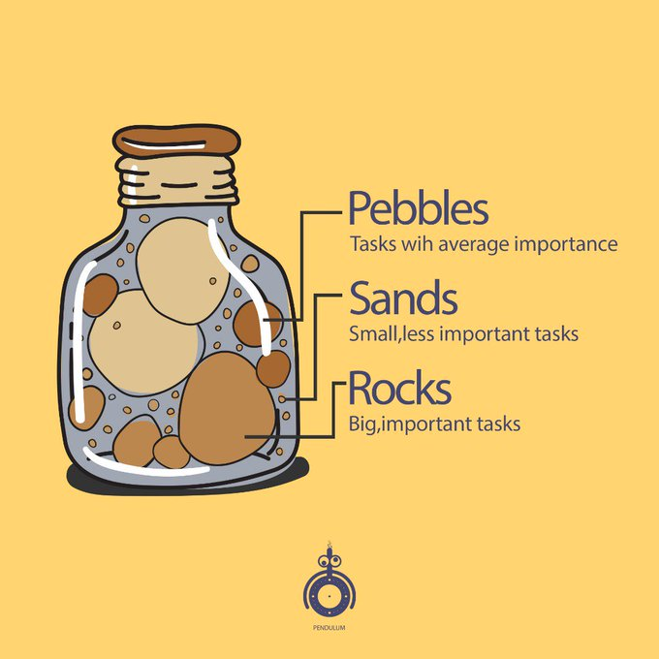
Study Plan, To do Lists
Make a schedule for the whole semester-plot when exams start, when certain assignments are due, how many hours are taken up by lectures, schedule in study periods, periods for working on assignments, time for exercise and time off. Knowing how much time you have and when you should be starting things can kick you into gear, kick start that healthy stress of working under pressure.
Set short terms, medium term, and long term gaols, e.g. daily, weekly, monthly
Break down large tasks into smaller daily or even hourly tasks
Schedule time for unforeseen circumstances e.g. getting sick, set backs etc..
Prioritise tasks: Tackle the rocks, then the pebbles, and finally the sand.

Slide 19
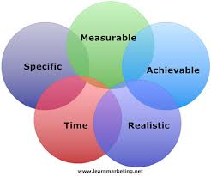
Take Great Care of Yourself with a PSP SMART PSP’s are ….
Specific
Measurable
Achievable
Realistic
Timescaled
Notes:
Go to insert > duplicate slide to add more slides

Slide 20
Exam Skills
Research shows that students who do best at problem solving spend longer than other students in working out exactly what the problem is before trying to solve it (Cottrell, 2019, p.70)
Preparation:
Get informed about exams early on, format of exams, credit weight of exam questions, Schedule accordingly
Practice answering exam questions before studying topic (will focus your study)
Mindset: focus on aspects you can control (sleep, study schedule, practicing exam questions)
See exams as a pleasant challenge rather than an ordeal (maintain perspective)
Write attractive concise notes after each topic (refer back), draw diagrams, essay plans
On the day:
Give your mind time to settle (put notes away half hour before exam starts or in the car/breath/listen to music)
Avoid talking to others before exam. Get familiar with exam setting.
Plot out timing for each question based on marks.
Get your thoughts rolling by making notes before exam officially starts
Devote time to selecting and defining the question/problem=better quality solutions/answers e.g. rephrase question

Slide 21
4. Environment…see step 4 handbook
-Study/Rest Balance-Developing decompression routine to replenish resources (Resilience)
-Strategic stopping to prevent burnout and sustain high performance
-Study friendly environment to support you (Clean, comfortable, alone vs. with others, home vs. library)
-Cut out distractions (putting phone on aeroplane mode during study)
-Social support and self care

Slide 22
5. SPIRIT/ Self… See step 5 HANDBOOK
-Clarifying your personal motivation for completing this year: ‘I’ve always wanted to be a doctor’. I am doing this because? Write down as many reasons as you can think of.
-Intrinsic vs. extrinsic motivation.
-Utilise unique strengths, creativity and interests to optimise study.
- Gratitude Practice –list 3 good things about your day at the end of each day
-

Slide 23

Handbooks Available

Slide 24


ebooks Now on Amazon

