Slide 1
VTS
School of Pharmacy

Slide 2
Overview
3rd year undergraduate pharmacy students (n=45)
3 x 1 hour classroom based sessions (Oct/Nov ‘12) (n=~22 per group)
1 x Gallery visit (Jan ‘13)
Facilitated (2 per session): Katie Ryan, Mairead O’Grady and Suzanne McCarthy

Slide 3
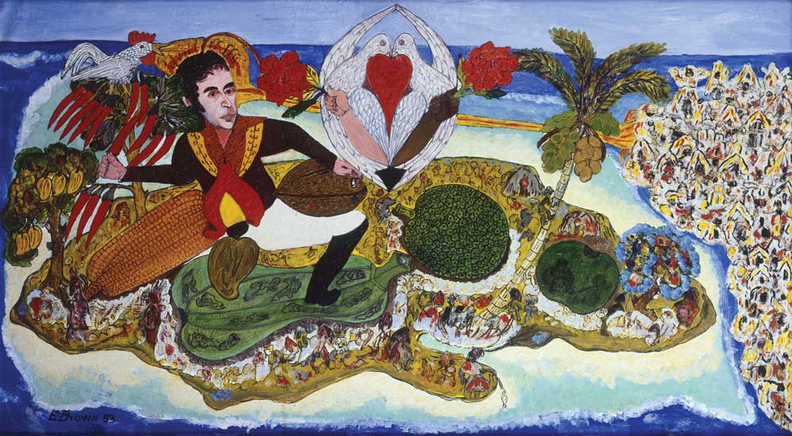
Method
4th Year
3rd Year
Benchmark (Paper-based written exercise: current 4th year students (n=43)
Pre-Test (Electronic-based written exercise (n=45))
3 Facilitated VTS Sessions with paintings/videos
Glucksman Art Gallery Visit
Post-Test
Notes:
THE ASCENSION OF SIMÓN BOLÍVAR ON MOUNT JAMAICA

Slide 4
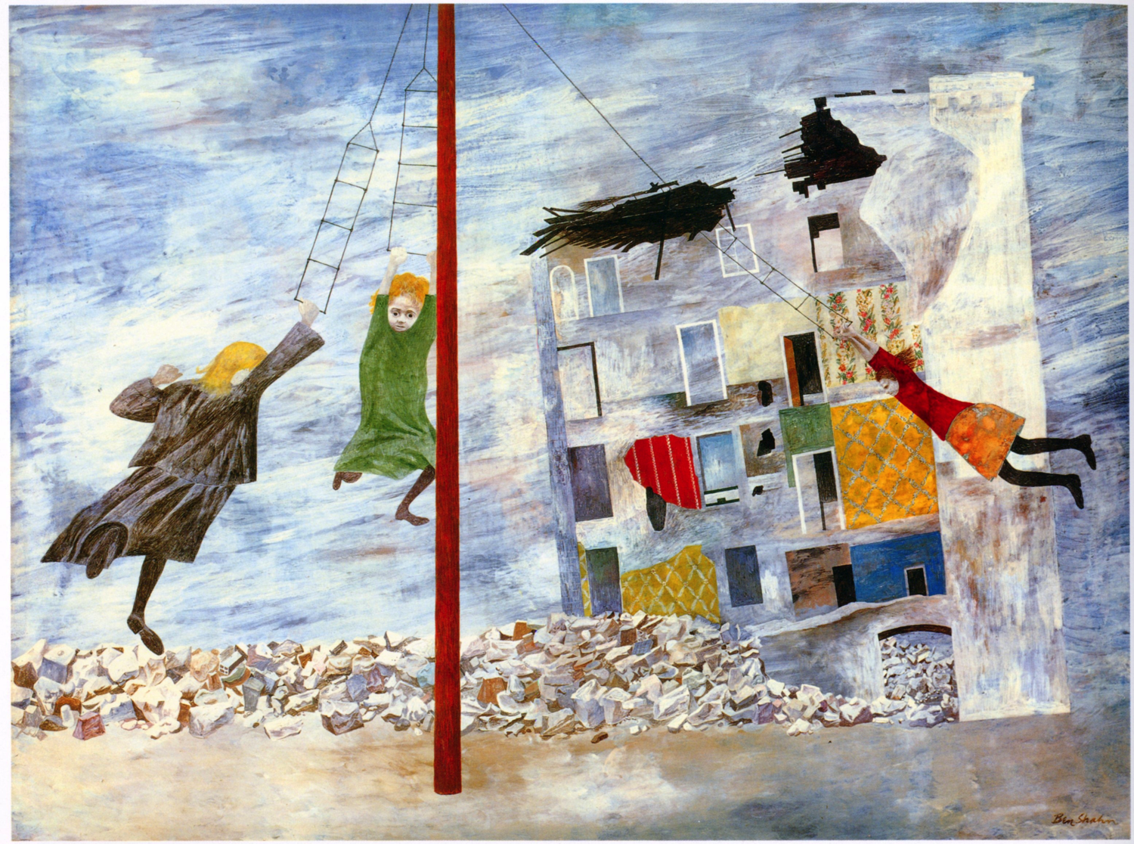
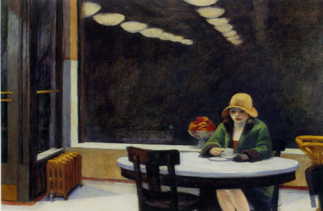
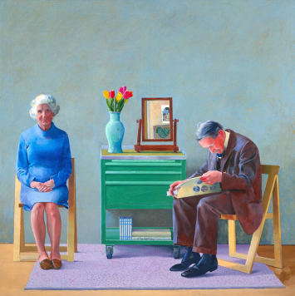
VTS Classroom Sessions
Session 1
VTS discussion on pre-VTS image
VTS discussion on image 2
Session 2
VTS discussion on image 3
VTS discussion on image 4
Videos: Alone (depression) and Age Action
Session 3
VTS discussion on image 3
VTS discussion on image 4
Videos: Role play in pharmacy (good and bad practice/interpersonal communication/observational skills)

Slide 5
VTS Glucksman Gallery
Class divided into 2 groups, each visiting on separate weeks; visit for 2 hours
Groups subdivided into 3 groups ~7/8 per group
VTS discussion: 2 images
1 image: written exercise

Slide 6
Post-VTS Evaluation
Written exercise from the Glucksman
Written exercise (electronic): same image from pre-VTS
Use of modified rubric to analyse data
Evaluation Sheet completed by students

Slide 7
Analysis of Pre- and Post-tests
Simple Observation e.g. “There are many types of fruits, vegetables and animals present in the picture.” (F11)
Complex Observation e.g. “Emerging from the doves are two hands, extending in either direction, holding bouquets of flowers.” (F14)
Observation supported by information in the image e.g. “It looks like this is a tropical island as it is in the middle of the ocean and we can see palm trees.” (F3)
Observation supported by information outside the image, or prior knowledge e.g. “The symbol represents harmony, love and peace between human races, animals and nature.” (M33)
Speculation e.g. “Perhaps this signifies that reality is never too far away.” (F11)

Slide 8
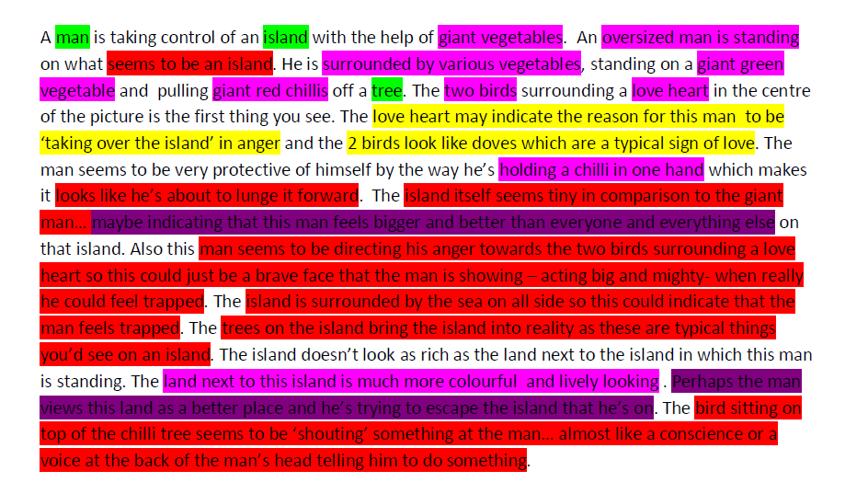
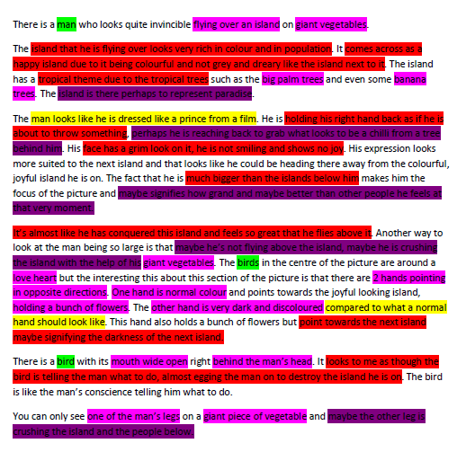
Pre-test Post-test

Slide 9
Most beneficial aspect
“Forcing yourself to observe and analyse a picture in order to find meaning in it”
“Gaining confidence in front of my peers will increase my confidence with the public and my communication skills”
“Hearing people’s different opinions to the same visual”
“Hearing the views of other people’s interpretations in comparison to my own views”
“I found discussing the images as a group most beneficial as it made me think of things I never would have thought of if someone hadn’t suggested it. Also, the analysing of pictures on my own made me think more”
“Forced me to see my career choice in a different manner”

Slide 10
Least beneficial aspect
“The first session of VTS, none of the paintings were linked to pharmacy”
“The size of the group was too large. The size of the group for the gallery i.e. 7-8 people was better as it put more pressure on everyone to speak up and voice their opinion”
“After a full hour of discussing what we thought was happening, we weren’t told what was actually going on in the images, therefore I didn’t find that this was beneficial”
“Completely unnecessary exercise. Gained nothing”
“In general, the workshops were not beneficial”
“Eating into more time on an already very heavy schedule”

Slide 11
Suggestions for the future
More feedback on how to apply what we learn clinically
More communication and dialogue scenarios to be used
Feedback to see if we were right with the interpretation!
Smaller groups so everyone’s idea can be heard
I liked how they were run
Start with 1st year students
Other information
The teamwork aspect benefited everyone – it was great that anyone could give their opinion, no matter what it was.
More pictures/videos in session as otherwise I felt I was getting bored of analysing the same picture for so long
The Glucksman visit was very pharmacy-relevant. However, some of the art pieces in the class sessions didn’t spark my interest

Slide 12
Application to role of pharmacist
No
Useless exercise. Did not teach communication, only how to analyse artistic interpretations.
It hasn’t changed my view as to the role of a pharmacist.
People’s feelings and interpreting them are important but at the end of the day, it is the clinical knowledge which is paramount.
Yes
It shows that we must take time to properly survey a situation and that how we deal with someone can vary person to person.
I will apply it regularly to my judgement of patients i.e. don’t judge without looking closely at someone/a situation. It’s important not to look at the individual medicines in a prescription in isolation, but as a whole and not rushing to make a judgement about what someone might have without thinking it through.
Absolutely. These workshops have completely opened up my mind and have allowed me to assess situations in a whole other level. I feel confident that I would be able to tackle these situations now.
A glance at a patient/prescription isn’t sufficient in making a complete evaluation.
You can’t base your impression of a patient solely on first impressions. It is important to take other people’s point of view into consideration. There are many ways to communicate.
Yes=37 No=4 Unsure=2

Slide 13
“Looking process”
Students were asked, following the Art Gallery Visit, what they had learned about their “looking process” through engagement in the VTS workshops.
The main themes that emerged were:
Not to judge based on first impressions
To look deeper and assess the situation before making a judgement
Listen to other people’s opinions and interpretations

Slide 14
Students’ Perceptions of the VTS Course

