Slide 1
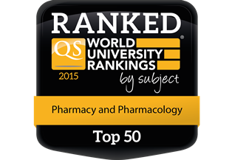

VTS summary – School of Pharmacy
Dr. Katie Ryan - July 2 2015

Slide 2
BPharm 3
Delivered to BPharm 3 (2012-2013 & 2013-2014)
  Module: PF3106 – Clinical Practice I
  45 students (2012-2013), 53 students (2013-2014)
  3 x 1h VTS sessions
  Glucksman gallery exhibition visit “The experience of illness in Art” (2012-2013)
Research assessment (2012-2013)
  Pre- & post-test evaluation
  Questionnaire of attitudes & thematic analysis
Poster presentation
  “Visual Thinking Strategies as a teaching and learning tool to develop pharmacy students’ skills in the affective domain”
  International Pharmaceutical Federation (FIP), World Congress of Pharmacy and Pharmaceutical Sciences, Dublin Sept 2013.

Slide 3
BPharm 1
Delivered to BPharm 1 (2014-2015)
  Module: PF1011 – Pharmacy Practice I
  65 students (2014-2015)
  4 VTS sessions
  1 session using poetry
Research assessment
  Shown 6 x images of pigmented lesions and asked to assign benign or malignant
  Match skin disorder description with images of dermatological conditions
  Questionnaire of attitudes & thematic analysis
Poster presentation
  “Using Art and Poetry to Develop Observation and Thinking Skills in Undergraduate Pharmacy Students”
  European Conference on Scholarship of Teaching & Learning (Euro SOTL), Cork June 2015.
  Awarded best poster prize.

