Slide 1
Improving Conceptualization Skills
Teaching and Learning for Graduate Studies (PG6003)
Traditional Challenge in Data Modelling Learning
Laleh Kasraian
BIS PhD Candidate – 3rd Year
l.Kasraian@ umail.ucc.ie
27th February 2014

Slide 2
Agenda
Introduction
Data Modeling Processes
Main Objective - Recognizing Key Concepts
Visual Thinking
Active Learning
Proposed Method
Interventions and Evidence
References

Slide 3
Introduction
Tutoring “Data Modeling and Database systems” for students at postgraduate level
Towards the resolution - Main steps
Learning how to solve the received problem as a narrative context
Specifying the main issues of the problem
Being able to solve the pointed problem by designing (visualizing) a conceptual model as the final resolution
 | Group A | Group B
ISBP | 40 | 44
EBus | 49

Slide 4
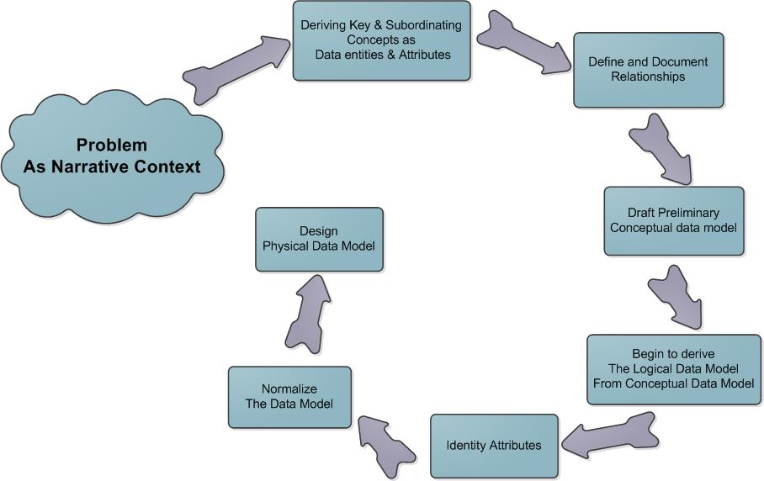
Data Modeling Processes

Slide 5
Main objective
With reference to teaching and learning literature review and researches;
How tutors may assist students to improve their skills to recognize the main key concepts towards the resolution as final conceptual model in Information systems (IS) domain?

Slide 6
Visual Thinking
Visual/spatial learning is a type of non-verbal thinking and relates to visual processing of things and the learner uses the part of the brain that is creative and organizes the information in a simultaneous manner (Deza & Deza, 2009)
Some students prefer to receive more visual information rather than verbal explanations
Some students also try to find out more about things in a relatively sequential manner
Or some of them may feel comfortable with concrete “real world” information which may guide them to abstract theories or symbolisms (Felder, 2010)

Slide 7
Active Learning
A teacher knows how to acquire a complete understanding of concepts including all the relevant aspects
A teacher also knows how to eliminate all irrelevant or distracting aspects
Who also knows well around the key insights that the students need to learn in order to be able to grasp the idea
Why not taking advantage of the reverse method …

Slide 8
Active Learning
A Pedagogical Approach as
“Learning by visualizing” (Hauswirth, 2012)
And ‘Active Involvement’ of students that is called “Active Learning”
The student will be an active participant instead of passive consumer of information
Many approaches to active learning would benefit from student-developed visualizations (Bonwell & Eison, 1991)

Slide 9
Proposed Method
Active Learning and Visual Thinking Urge students as Constant and Active participant for the proposed method as step by step intervention method …

Slide 10
Proposed Method – Students’ Active Participation
at tutoring sessions
Bolding the main key concepts via each technical narrative context as starting point
Then, asking the students to write down the bolded concepts as assumptions
Categorizing the derived main key concepts at next step
Classifying the other concepts as subordinate key levels of information
Drawing out the relationship between those main levels of concepts through a simple diagram
Finally, requesting students to find out the place of subordinate key comments and the relationships through the pointed simple diagram which finally they can identify the “Entity Relationship Conceptual model” as final resolution

Slide 11
Interventions & Evidence
Repeating the mentioned phases as an iterative manner for problem-based narratives
Students’ active participation simultaneously and step by step with tutors whom could easily traced their activities
Providing richer problem contexts with no bolded key concepts where students needed to analyze and visualize the concepts by themselves
Surprisingly the students were able to apply the practiced and proposed method and the knowledge they gained at the mentioned situations
The evidence of their understanding of whole processes was presented and introduced as a method to reach the conceptual model as final resolution …

Slide 12
References
Arnheim, R. (1969). Visual thinking. University of California Pr.
Bonwell, C. C., & Eison, J. (1991). Active learning: Creating excitement in the classroom. Washington, DC: School of Education and Human Development, George Washington University.
Deza, M., & Deza, E. (2009). Encyclopedia of distances. Berlin Heidelberg: Springer .
Felder, R. M. (2010). Are learning styles invalid. On-Course Newsletter, 1-7.
Hauswirth, M. (2012). Moving from Visualization for Teaching to Visualization for Learning. CSERC Visualization Workshop.

Slide 13
Thanks For Your Patience Any Questions?

