Slide 1





Social Work Ethics and Practice Teaching
Dr Brian Melaugh & Jean Byrne Cummins Practice Development Coordinator Maynooth University

Slide 2



Overview
Why Social Work Ethics are Important for placement?
Content to support you in your role as a practice teacher
Exercises to support students to engage with ethics
Resources to support you as a practice teacher

Slide 3
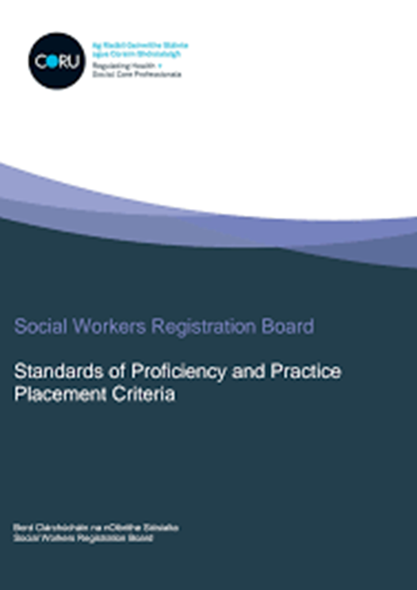

Requirements
Standards of Proficiency (CORU, 2019) require students to demonstrate ethical awareness/action in a number of areas
Be able to practise safely and effectively within the legal, ethical and practice boundaries of the profession
Understand what is required of them by the Registration Board and be familiar with the provisions of the current Code of Professional Conduct and Ethics for the profession issued by the Registration Board
Also requirements on for example -confidentiality, non-discriminatory and culturally sensitive practice, professional boundaries, commitment to social justice and human rights

Slide 4
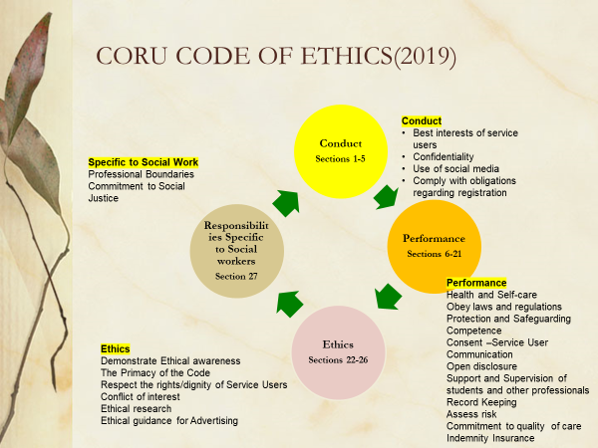

.

Slide 5
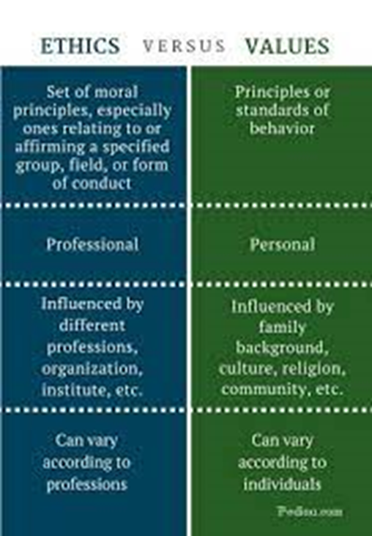
Ethics and Values
Ethics is the conscious reflection on our moral beliefs (Hinman, 2003).
Graduates will understand and recognise the impact of personal values and life experience on professional practice and be able to take responsibility and manage impact appropriately (Standards of Proficiency for Social Workers, 2019, p.10)
https://pediaa.com/difference-between-ethics-and-values/

Slide 6
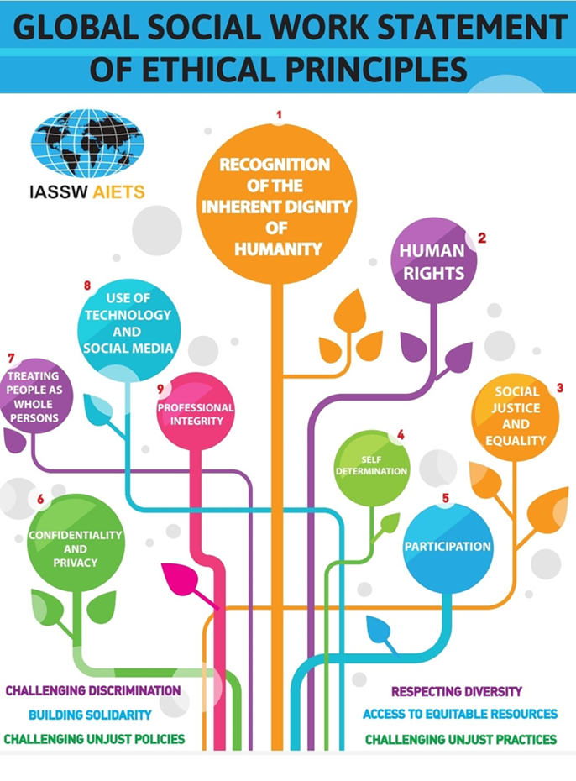
Values Personal and Professional
IFSW- Global Social Work Statement of Ethical Principles
The statement reflects both personal and professional values –they are related and indeed can complement and clash with each other
This Statement of Ethical Principles (hereafter referred to as the Statement) serves as an overarching framework for social workers to work towards the highest possible standards of professional integrity.
Implicit in our acceptance of this Statement as social work practitioners, educators, students, and researchers is our commitment to uphold the core values and principles of the social work profession as set out in this Statement.
https://www.ifsw.org/global-social-work-statement-of-ethical-principles/

Slide 7
Social Work Ethics
  Value base of the social work profession
  Ethical Dilemmas in Social Work
  Ethical Decision Making
  Ethical Standards and Risk Management
  Questions about the moral purpose of the profession
  (Reamer, 2014)

Slide 8

Ethical Dilemmas in Practice
Dunk-West (2013) maintains to practice in social work means engaging with ‘Ethical Dilemma/s’ – and for students, these can be experienced as ‘messy, complex and confusing – for example, the limits of a service user’s right to confidentiality and or self –determination.
For Banks (2001) Ethical dilemma/s involves making a choice between two equally unwelcome alternatives and it is not always clear which choice is correct.

Slide 9

Ethical Decision Making
Ethical decision-making is an important process in professional practice, but difficult and complex, because it has to take into account the various ethical issues arising from the conflicting values and interests of those involved in the process (e.g. client, social worker and agency). Forming judgments for such decision-making is an ability that can be developed through professional experience, yet can and should be first taught and learned in social work classes. (Papouli, 2016)
/

Slide 10
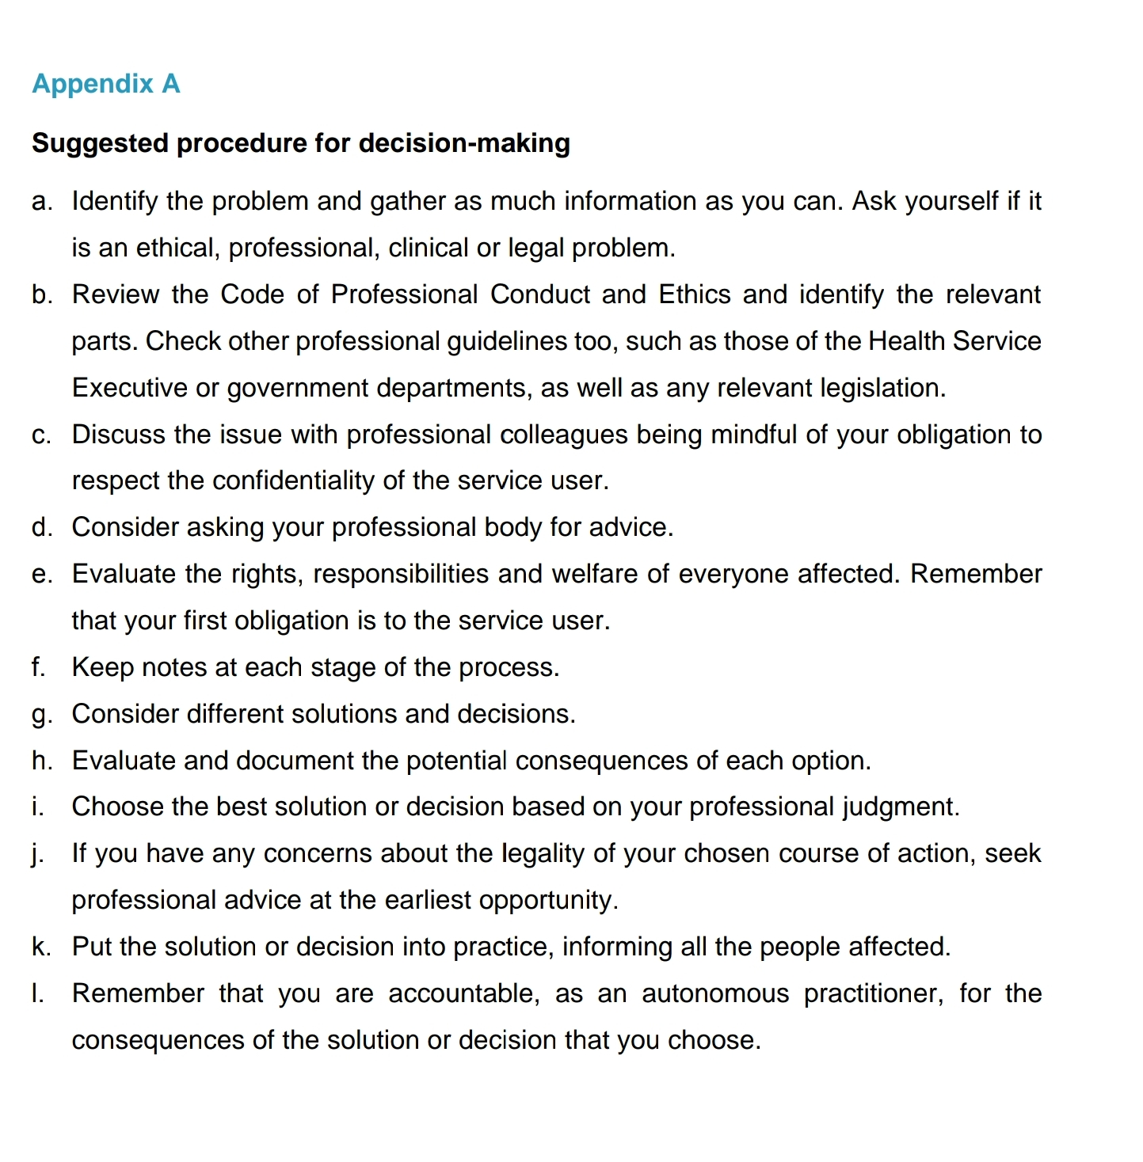

Frameworks for Ethical Decision Making-CORU
Social Workers Registration Board, Code of Professional Conduct and Ethics (2019, p.29).

Slide 11
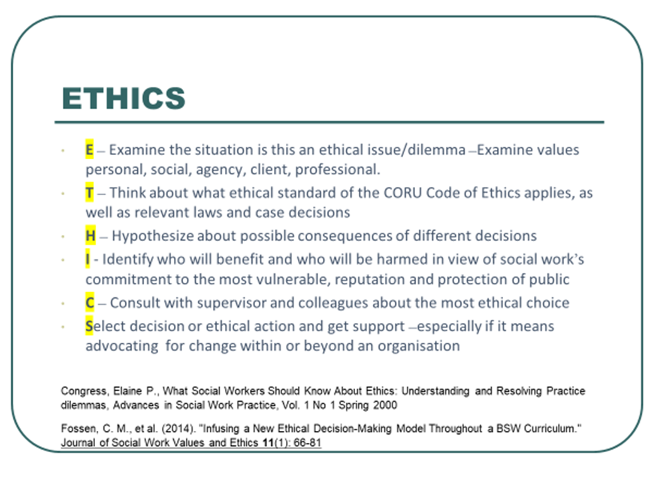
Frameworks for Ethical Decision Making-ETHICS

Slide 12
Supervision
Banks et al (2021) – refers the concept of ‘Slow Ethics’ – in essence taking time to stop, analyse, reflect and consider emotional responses in situations where ethics are under discussion. Slow Ethics is an appropriate model for supervision and encourages the Practice teacher to support students to engage with ethics, encouraging them to reflect on their responses, make links to CORU Standards of Proficiency 2019) and CORU Code of Ethics (2019)
We encourage you to draw on some of the resources covered in this presentation to support student learning. In the next stage we introduce a framework for supervision created by Banks et al (2021).

Slide 13
Ethical Vigilance Being alert and sensitive to ethical dimensions of practice. Especially when under pressure
Questions 1. What are the ethical issues in this situation? 2. Is there are danger of reacting to quickly because of work pressure
Framework for Supervision
Three Fold Framework (Banks et al,2021)
Ethical Vigilance
Ethical Reasoning
Ethical Logistics
Ethical Logistics – The process of acting on ethical judgements/decisions.
Questions
How can we carry out the right course of action?
How can we promote the dignity of Service users even if the decision involves a constraining of rights?
How is informed, involved in the decision
How is the decision recorded?
Ethical Reasoning –deliberating and exploring how to balance different needs, rights responsibilities and risks
Questions
What is the right approach or course of action in this situation?
2. How do we justify the decision
3. Can or is it possible to balance the rights and responsibilities of those involved?

Slide 14
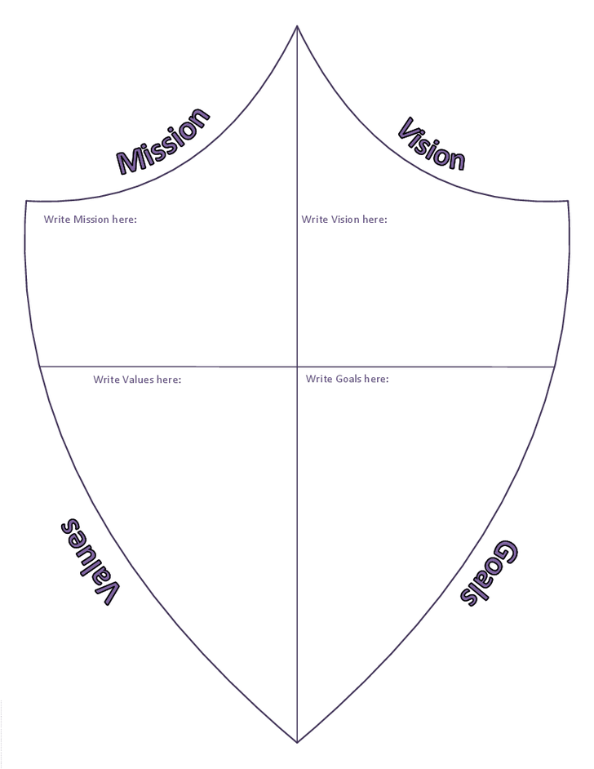

Resources to Learning –Values
https://www.viktorcessan.com/use-the-value-cards-exercise-to-help-your-teams-collaborate-better/

Slide 15
Resources to Learning –Ethics
Quiz to explore Ethical Style
The quiz reflects the work of Carol Gilligan on ethical development (In a Different Voice, 1982)
The purpose of the quiz is to explore the ethical perspectives of Justice and Care. These styles reflect the ethical schools of duty ethics (rules) and situation (context). The quiz reflects the concepts of ‘You must’ (Justice) and ‘You should (Care) in the CORU Code of Ethics (2019, p.5).
The quiz is a playful way to engage with ethics and indeed to make links with practice and the code of ethics
https://www.proprofs.com/quiz-school/personality/quizshow.php?title=nje5njyw&q=3
https://www-dev.masc.sc/SiteCollectionDocuments/Administration/ethic_style.pdf

Slide 16
Key readings / resources
For further information on Ethics , these readings and resources will be of interest:
  The Ethics Centre https://ethics.org.au/
  Banks et al (2021) Ethical Reflections In a Challenging Time (published by BASW) https://www.basw.co.uk/system/files/resources/ethical-reflections-in-challenging-times.pdf
  3. Banks S (2018) Practising professional ethical wisdom: the role of 'ethics work' in the social welfare field
  https://dro.dur.ac.uk/26381/1/26381.pdf?DDD34+dss0sjb+d700tmt
  4. An Introduction to Social Work –includes sections on Ethics and Values, Personal values, Social work values, Ethics and professionalism – free course offered by the Open University https://www.open.edu/openlearn/health-sports-psychology/social-care-social-work/an-introduction-social-work/content-section-2.3.3
  5. Irish Association of Social Workers Code of Ethics and Code of Practice –available from www.iasw.ie
)

Slide 17
References
Banks, S. (2012). Ethics and Values in Social Work. Basingstoke: Palgrave Macmillian
Banks et al (2021). Ethical Reflections in Challenging Times: A resource for Social work practitioners and educators. Birmingham: BASW.
Dunk –West, P (2013). How to Be A Social Worker. Basingstoke: Palgrave Macmillian
Papouli, E. (2016). Teaching and Learning for Ethical Practice in Social Work Education, in Routledge International Handbook of Social Work Education. London: Routledge
Reamer, F.G. (2014). A Roadmap For Social Work Ethics. Banks, S. Ethics Bristol, Policy Press

Slide 18
Where can I get more information?
Visit the National Practice Teaching in Social Work Initiative website for:
  Information on becoming a practice teacher: Socialworkadmin@mu.ie / Jean.byrnecummins@mu.ie
  More videos in this series
  Resources, tools and readings on practice teaching in social work
  https://ucc.ie/en/nptswi/

Slide 19
Website: https://ucc.ie/en/nptswi/
Contact us: swfieldwork@ucc.ie
Funded by the Department of Children, Equality, Disability, Integration and Youth (DCEDIY)

