Slide 1
Impact of EU Law on Irish Environmental Law:
Contemporary Developments
Áine Ryall
28 June 2019

Slide 2
Avenues by which to enforce EU law against Member States
1. Complain to the EU Commission
Commission can refer a Member State to the Court of Justice of the EU (CJEU)

Slide 3
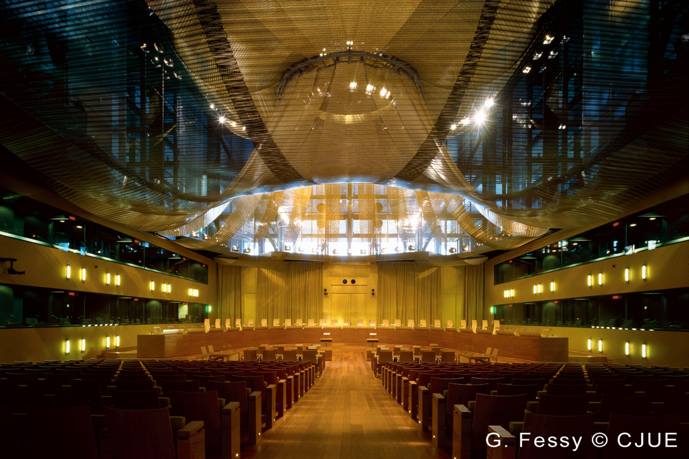
CJEU - Luxembourg

Slide 4
Avenues by which to enforce EU law against Member States
Case C-261/18 Commission v Ireland
Advocate General’s Opinion delivered
13 June 2019
Derrybrien wind farm

Slide 5
Avenues by which to enforce EU law against Member States
2. Call Member State to account at national level for an alleged breach of EU law
If a national authority fails to respond in a satisfactory manner, consider bringing proceedings in national courts to force compliance

Slide 6
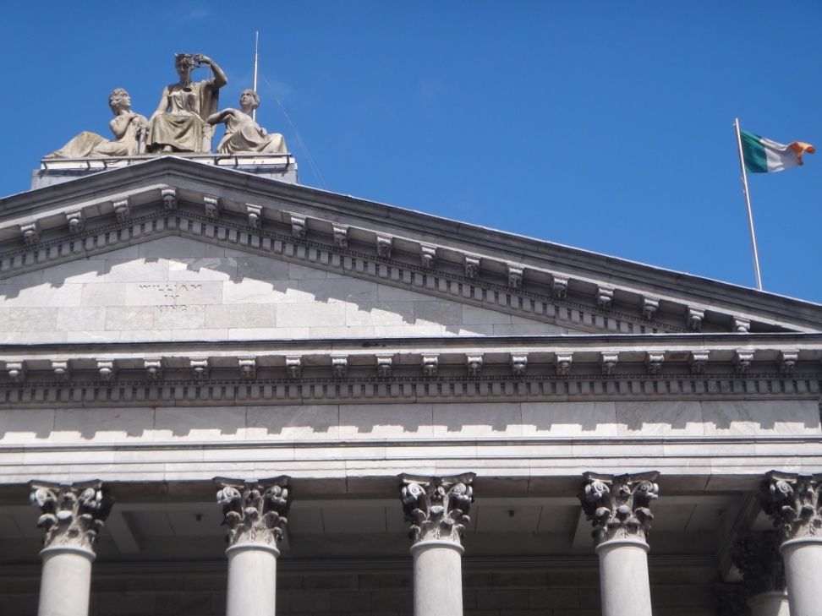
National Courts as EU Courts
Apply and enforce EU law in practice
Make a reference for a preliminary ruling to CJEU

Slide 7
National Courts as EU Courts
Case C-723/17 Craeynest
Judgment delivered 26 June 2019
Interpretation of Directive 2008/50/EC
on air quality

Slide 8
Key themes in the CJEU jurisprudence
Effective judicial protection for
EU (environmental) law rights
Role of the national courts in enforcing
those rights
Strong public interest in environmental protection

