Slide 1
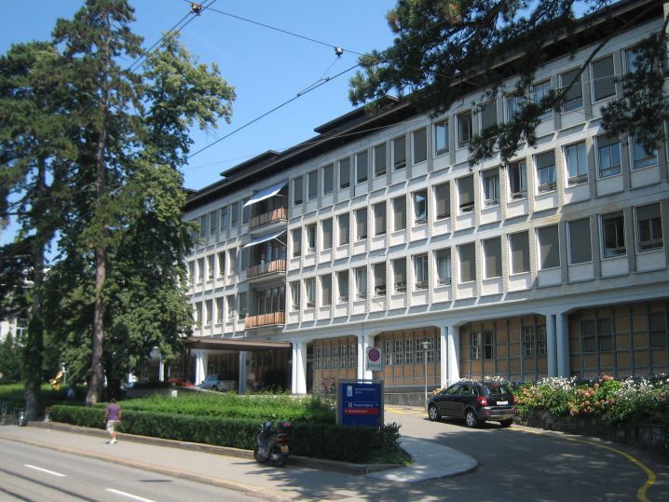
What is the heart failure phenotype and why is this important?
James Dollard
Consultant Cardiologist
General physician

Slide 2
What is heart failure?
Symptoms
Signs
Abnormal cardiac function as assessed by ECHO
Can be systolic
Diastolic
Both
Raised BNP

Slide 3
Left ventricular contraction (systole)
During LV systole the LV wall:
shortens
Thickens
Twists
INOTROPY

Slide 4
Left ventricular Relaxation (diastole)
The LV has to relax and expand RAPIDLY (essentially as quickly as it contracts)
LUSITROPY
Passive and active
ATP is used to hoover up calcium back into the SR
Nagueh et al, EHJ Card Imag 2016

Slide 5
Why is an ECHO essential?

Slide 6
Echo reports
What can I ignore?
What’s Important?
Anything that’s mild!
Mild MR or TR
PFO
Aortic Sclerosis
Most things on an ECHO are reported for future reference by the cardiologist and are not relevant!
LV function
Ejection Fraction
LVIDd (the diameter of the heart when it’s full)
LV wall thickness
Filling pressures
LA volume
Dilated IVC
Assessment of diastolic function
Anything severe!

Slide 7
What is the Ejection Fraction and why is it important?

