Slide 1
Is it or isn’t it heart failure
And does it matter anyway?
Joe Gallagher

Slide 2
How common?
GP with 2,000 patients
40-50 patients with heart failure
5 confirmed new cases each year

Slide 3
“Death on a Pale Horse” (1796) by Benjamin West, Detroit Institute of Arts

Slide 4
Does it matter?

Slide 6
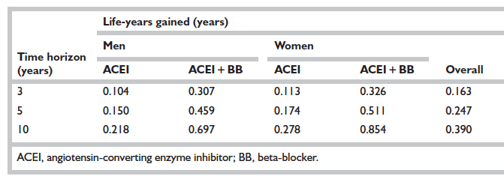
Life years gained from early application of therapy in HF-REF
A 6 month delay in diagnosis of heart failure leads to an increase of 23% in cases admitted during that time
Mant J, et al. Systematic review and individual patient data meta-analysis of diagnosis of heart failure, with modelling of implications of different diagnostic strategies in primary care. Health Technol Assess 2009;13(32).

Slide 7
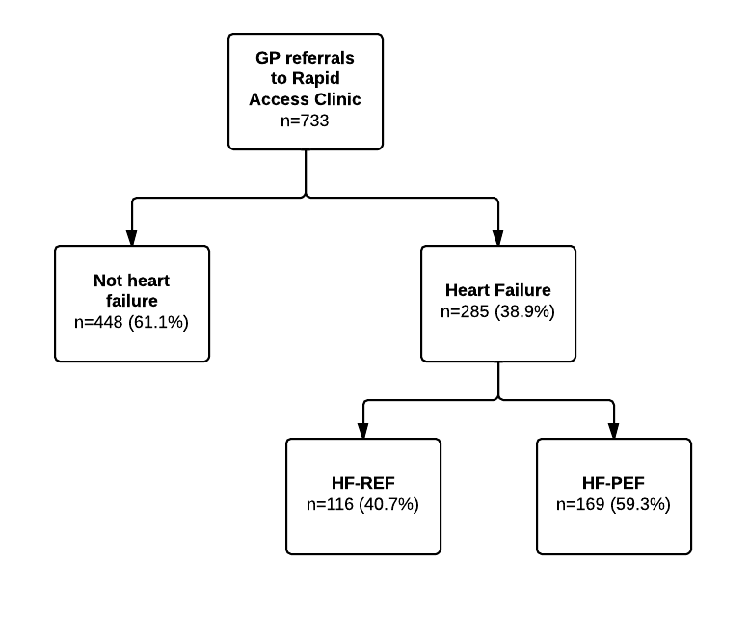
Rapid Access Clinic 2002-2012

Slide 8
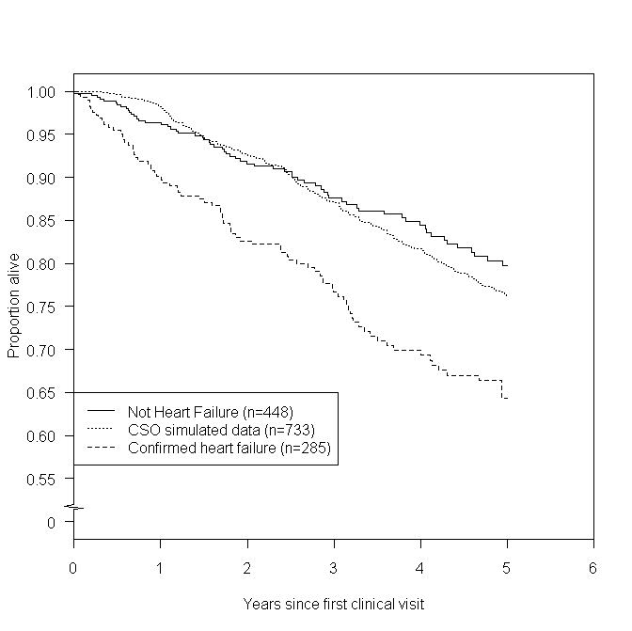
Survival in heart failure
Not Heart failure
General Popn.
Heart failure

Slide 9
Why?
Likely multifactorial
Early confirmed diagnosis
Early application of effective therapies
Promotion of self care
Structured care

Slide 10
Case
Your first patient this morning is Mrs B. She is a 79 year old woman who lives alone and has a history of hypertension and diabetes (diet controlled).
Her BP is 165/92, pulse 92 regular, chest and cardiovascular examination is normal. Ankle oedema noted.
She smokes 15/day.
She complains of breathlessness on walking up a slight hill or after 50 yards on the flat.
What investigations would be useful to find the cause?
Medications
Simvastatin 40mg nocte
Aspirin 75mg daily
Amlodipine 5mg daily

Slide 11
It’s all about perspective . . . .
The cardiologist
“Heart failure caused by aortic stenosis: does your stethoscope still work?”
The GP
“ Ever heard of COPD? (by the way: in the same thorax)”
The geriatrician
“You’re both wrong – it is frailty”

Slide 12
Case - Results
ECG: Sinus rhythm, left ventricular hypertrophy
Chest x-ray: Normal
Spirometry: FEV1/FVC = 0.5, FEV1 = 60% predicted
NTproBNP: 1,288pg/ml
Echocardiogram:
Ejection fraction 35% (Normal 50-70%. Mild mitral regurgitation. Regional wall motion abnormalities noted.

Slide 13
What are natriuretic peptides?
Respond to
Ischaemia
Pressure overload
Volume overload
Inflammation
Fibrosis
Protects the heart and vascular system against damage

Slide 14
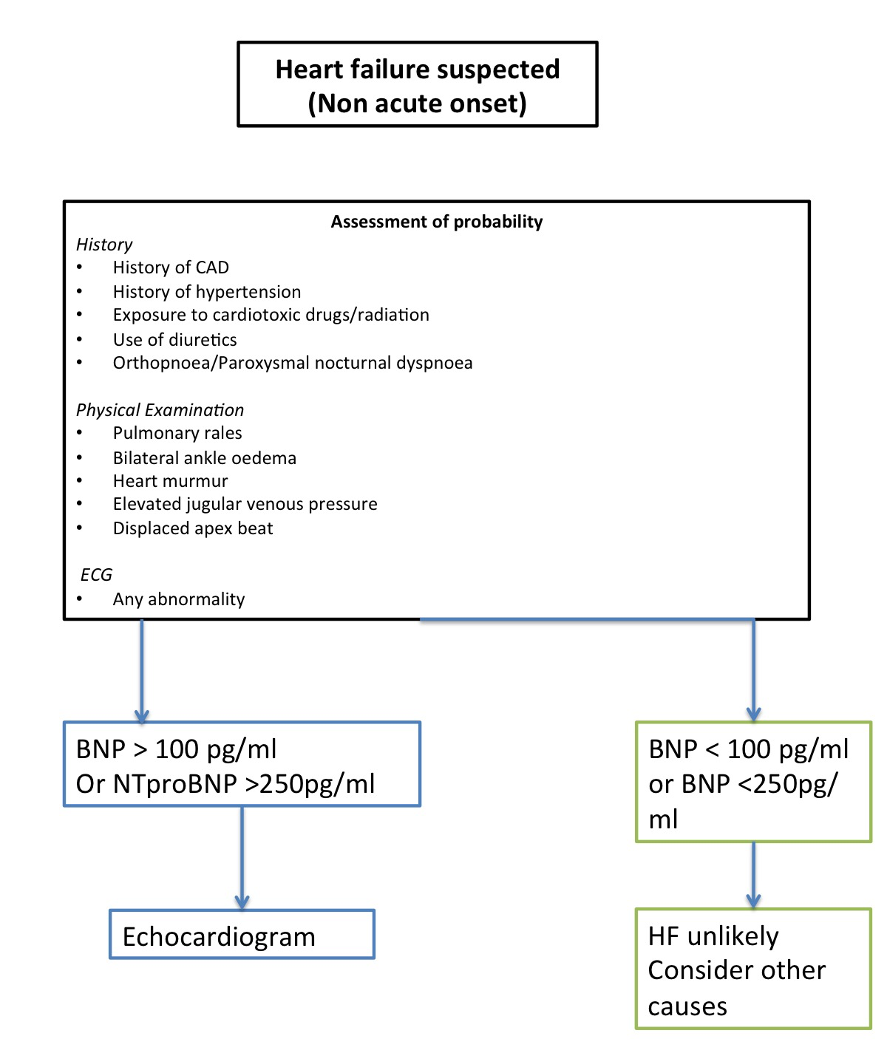

Slide 15
Causes of raised NT-pro-BNP : Heart Failure, Renal disease, Ischaemia, Ventricular dysfunction, increase with age
Things that cause reduction in NT-pro-BNP: Obesity, Diuretics, ACE inhibitors, Angiotensin receptor blockers (Sacubitril-valsartan can increase BNP)

Slide 16
Diagnosis
Heart failure with reduced ejection fraction (can’t pump) – systolic heart failure
Heart failure with preserved ejection fraction
(can’t draw blood into heart) – diastolic heart failure

Slide 17
Take home points
Have a high suspicion for heart failure in those with risk factors
Natriuretic peptides if normal exclude heart failure as cause
Natriuretic peptides if elevated might be heart failure
Still need an echocardiogram to confirm diagnosis and confirm ejection fraction (which helps guide treatment)
If no access to NP and high index of suspicion consider starting treatment with loop diuretic to assess effect and optimising CV management
Important also to identify an aetiology

