Slide 1
The Deteriorating Heart Failure Patient

Slide 2
At the end of a consultation John mentions that he has been becoming increasingly short of breath over the last week since he was at his nephew’s wedding. He is coughing more and has green sputum. He has to sleep on 4 pillows at night (usually two pillows) and his ankles are more swollen. He has no PND or chest pain.
What would you do?
Medications
aspirin 75mg
ramipril 2.5mg
bisoprolol 1.25mg
rosuvastatin 10mg
frusemide 40mg OD
eltroxin 100mcg OD
tiotropium inhaler OD
salbutamol inh. PRN

Slide 3
Is it heart failure?
Weight gain
Increase in Ntpro(BNP)
Orthopnoea/PND
If it is heart failure what is the precipitating cause?
Infection
Poor adherence to medications
Inappropriate medications e.g. NSAID
Arrhythmia e.g. atrial fibrillation
Ischaemia
Anaemia
Treat the cause and the fluid overload
Re-evaluate to ensure on optimal CV therapies

Slide 4
End of Life Care
Function
Function
High
High
Death
Death
Low
Low
Organ failure
Months or years
Weeks, months, years
Cancer
GP has 20
deaths per
list of 2000
patients per
year
Function
6
5
High
2
7
Death
Acute
Low
Many years
Dementia, frailty and decline
Notes:
These are how people die, nowadays
Out of 20 death, 5, 6, or 7. Which group would you? You may wish to be in 2..not realistic option
3 trajectories
Cancer has all the good stories
But focus

Slide 5
The Longer View
Recurrent episodes of decompensation within 6 months despite optimal tolerated therapy
Malignant arrhythmias
Need for frequent intravenous therapies
Chronic poor quality of life
Intractable symptoms,
Signs of cardiac cachexia

Slide 6
Dying from heart failure or with heart failure?
Netherlands
Ireland
Mean age 82.3 years
55.9% died at home or in nursing home
23% died from progressive heart failure
Mean age 80.1 years
55% died at home or in nursing home
15% died from heart failure

Slide 7
At lunchtime the palliative care nurse asks you to visit Mr R due to problems with his breathing. He is 76 years old and has a diagnosis of prostate cancer with metastases to his spine. He is now bedbound and has asked that he not be sent to hospital again.
He has a history of heart failure with an ejection fraction of 20% and had a biventricular pacemaker and ICD inserted 7 years ago.
He complains of increasing shortness of breath over the last week (breathless while getting dressed) and a dry cough. He sleeps almost sitting up and is waking at night short of breath. His pain is well controlled but he is quite distressed by his shortness of breath.
What issues need to be considered regarding his medications, treatment of symptoms and the devices he has in place?
Medications
MST 40mg BD
Sevredol 10mg for breakthrough pain
Diclofenac 100mg PR daily
Cyclizine 50mg TDS PRN
Ramipril 10mg OD
Bisoprolol 7.5mg OD
Warfarin as per INR
Atorvastatin 40mg nocte
Bumetamide 1mg BD
Digoxin 0.25mg daily

Slide 8
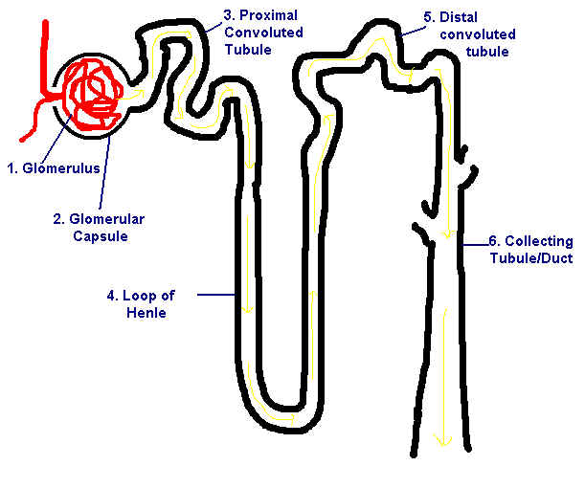
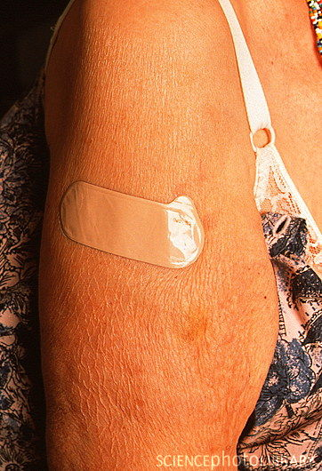
Thiazide
Loop Diuretic

Slide 9
Palliative Care
Dyspnoea
Increase dose of diuretic
Nitrate patches
Low dose oramorph - 2.5mg QDS PRN
Sublingual lorazepam 0.5-1mg QDS PRN
Home oxygen?
Parenteral diuretics –subcutaneous or intramuscular diuretics may be given.
What about those devices?
Don’t forget to consider deactivation of ICD’s
Pain - Avoid use of NSAID.
Nausea and vomiting – Cyclizine - may exacerbate heart failure
Domperidone - increased risk of serious ventricular arrhythmias or sudden cardiac death in patients >60 years or at daily oral doses >30 mg.
Medications to stop
Drugs which improve symptoms: Diuretics, ACE inhibitor, Beta blocker, ARB, Digoxin, nitrates, morphine

