Slide 1
Jim Corbett
Director
The Food Institute @ UCC

Slide 2
The UCC Food Institute
A one stop shop for all food-related research partners and schools within UCC.
Food technology
Food for Health
Food & the Consumer
Sustainable food production
Food Business
“to support the strategic development of Food at UCC and ensure that UCC is recognised nationally and internationally as a research and educational leader in Food”

Slide 3
Are Researchers Prepared for Addressing Societal Challenges ?

Slide 4
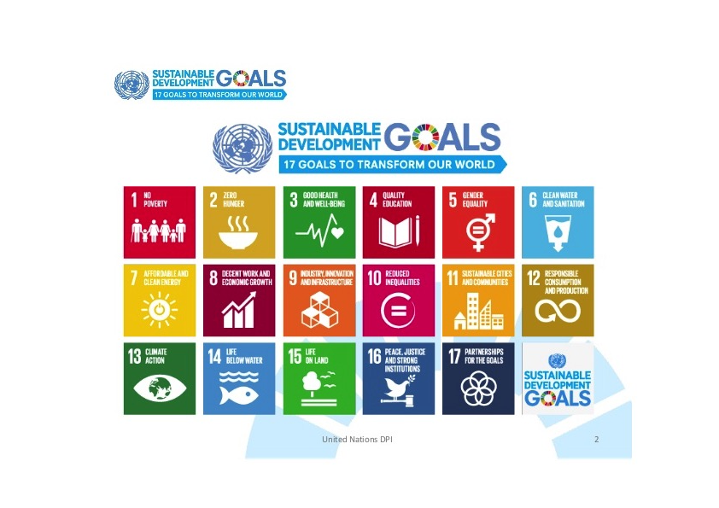

Slide 5
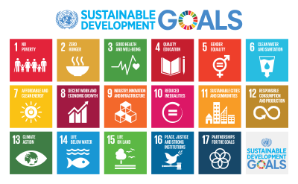


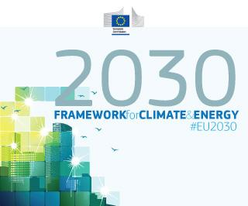
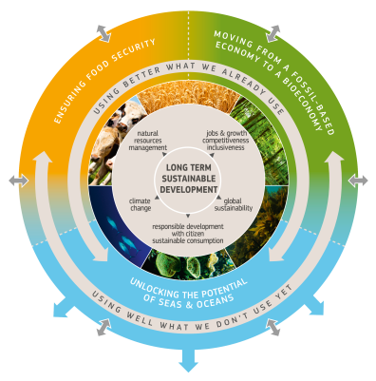
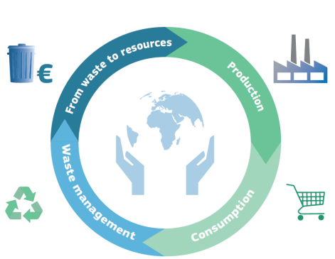


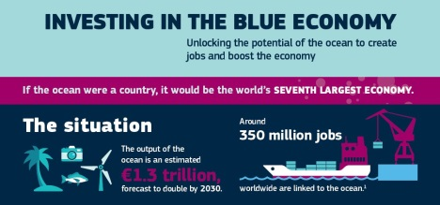

The policy context
Global commitments
European policies
CAP & EIP-AGRI
Climate & energy
Bioeconomy strategy
Circular economy
Integrated Maritime
and common fisheries
policies
Digital single
market

Slide 6
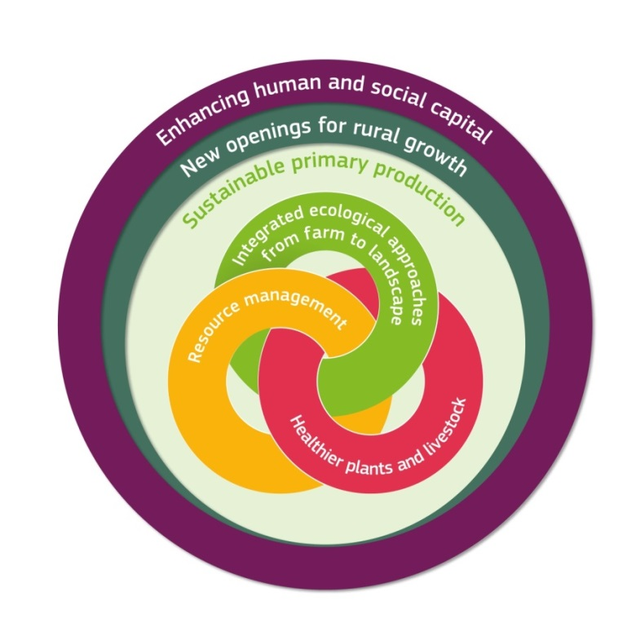
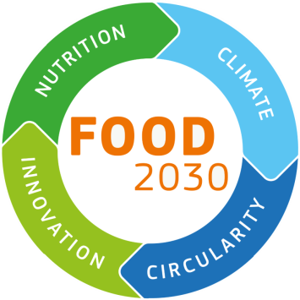
Underpinning EU R&I strategic approaches
Strategic approach to EU agricultural research and innovation
Food 2030 - Strategic approach to EU food & nutrition security
Bioeconomy strategy
(R&I component)

Slide 7
Societal challenge 2 contributions to focus areas
Building a low-carbon, climate resilient future
203 M€
Plants, proteins, climate-smart farming, soils, food systems, marine resources, wood value chains
Digitising and transforming European industry and services
107 M€
Personalised nutrition, Blue and food clouds, Aquaculture 4.0, Digital innovation hubs, digital integration platforms
Connecting economic and environmental gains – the Circular Economy
253 M€
Urban food systems, biowaste valorisation, bio-based plastics and fertilisers, bio-based models for rural communities

Slide 8
Foster functional ecosystems, sustainable food systems, and healthy lifestyles
Address climate change and resilience on land and sea
Boost major innovations on land and at sea → new products, value chains and markets
Develop smart, connected territories and value chains in rural and coastal areas
Make the transition towards a circular bioeconomy
5 priorities
Manage our resources wisely to nourish people sustainably
Understand, preserve and valorise oceans
Develop smarter, greener, circular rural economies
3 goals
Sustainable food security
Blue Growth
Rural Renaissance
Circular Bioeconomy
investment platform
3 calls + FI
Dynamic & innovative food and farming sectors
Resource & climate-smart eco-healthy food production and consumption
Productive, healthy, resilient seas and oceans
Sustainable aquatic resources for food and bio-based value chains
Strong blue economy
Sustainable growth based on circularity and connectedness
Enhanced innovation systems
Strong & attractive rural areas
De-risking investments in innovative technologies fostering industrial, rural and coastal development
Key impacts
Notes:
The Work programme 2018-2020 addresses 5 main challenges:
Climate adaptation and mitigation -
Food and nutrition security
Safeguard the natural resource base
Promote alternatives to fossil-based economies
Sustainable use marine resources
Focusing on 5 main cross-cutting priorities:
Foster functional ecosystems, sustainable food systems, and healthy lifestyles - Ensuring long-term food and nutrition security and sustainability of food systems requires sustainable management of land, soil, water and biodiversity as providers of terrestrial and aquatic ecosystem services. These services are key to sustainable primary production and are at the basis of the whole food chain, nutrition, lifestyle and health. The investments in R&I in this Work programme will future-proof our food systems to make them more sustainable, resilient, responsible, diverse, competitive and inclusive.
Address climate change and resilience on land and sea - Climate change is one of the biggest challenges Europe and the world are facing. The primary sectors covered by SC2 are among the most important sources of CO₂ emissions and are highly vulnerable to climate change. At the same time forests, soils and oceans are major carbon sequestration reservoirs. The R&I actions in this work programme will support meeting the ambitious climate targets while at the same time satisfying the needs for food, feed, bio-based products and energy for a global population projected to reach 10 billion by 2030.
Boost major innovations on land and at sea → new products, value chains and markets - Innovation is at the core of EU policies. Testing, demonstrating and scaling up new technologies and business models that create breakthrough innovations are crucial for ensuring long-term competiveness of the primary and secondary sectors covered by SC2. As scaling up of innovative new technologies represents a high commercial risk for private investors, public investment is essential in creating sustainable value chains, resulting in new jobs, products and services.
Develop smart, connected territories and value chains in rural and coastal areas - Helping the rural and coastal areas to meet the wide range of economic, environmental and social challenges of the 21st century is one of the key challenges for Europe. This priority addresses the territorial dimension of R&I activities in primary production, the food and bio-based industries, most of which are located in rural and coastal areas. R&I activities aim at better capitalisation of territorial assets, taking account of long term drivers to open new sustainable avenues for business, services and value chains in support of rural and coastal communities, promoting new partnerships between producers, processors, retailers and society.
Make the transition towards a circular bioeconomy - For a transition to a sustainable, low carbon and resource efficient bioeconomy, it is essential to implement the European Commission's Circular Economy Package. R&I actions across all SC2 sectors will support resource-efficient production and distribution systems, value-chains based on new and more efficient use of wastes, residues and by-products, as well as new business models that maintain and enhance the EU natural capital.
On the basis of these priorities, the SC2 WP 2018-20 has three main goals:
Manage our resources wisely to nourish people sustainably
Understand, preserve and valorise oceans
Develop smarter, younger, greener, circular rural economies
that will be achieved through 3 main calls: Sustainable Food Security, Blue Growth, Rural Renaissance and a Circular Bioeconomy Thematic Investment Platform.
Through coherent and focussed investment in R&I activities in these three calls, the SC2 WP2018-20 wants to achieve the following impacts:
Dynamic & innovative food and farming sectors for resource & climate-smart eco-healthy production and consumption,
Productive, healthy, resilient seas and oceans, sustainable aquatic resources for food and bio-based value chains and a strong blue economy
Sustainable growth based on circularity and connectedness, enhanced innovation systems for strong & attractive rural areas
De-risking investments in innovative technologies fostering industrial, rural and coastal development

Slide 9
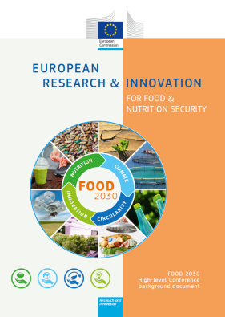
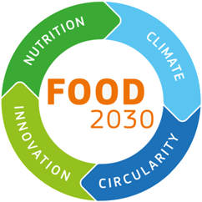
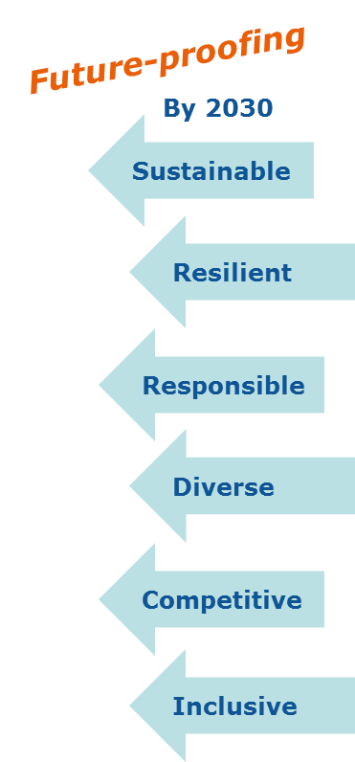
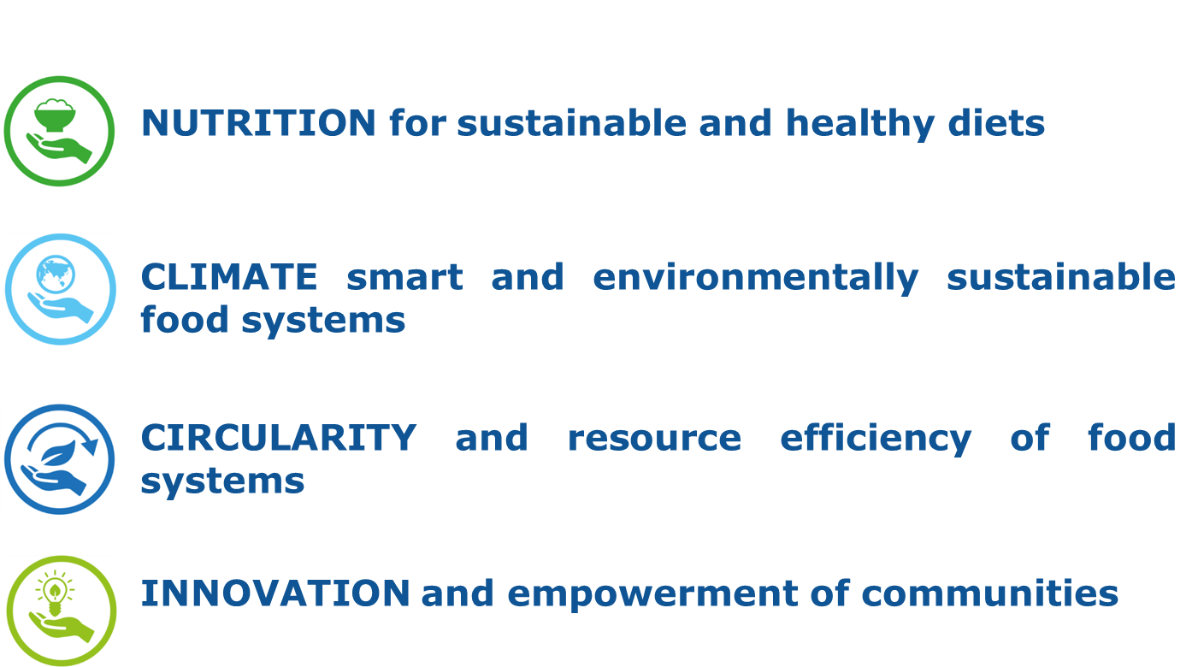
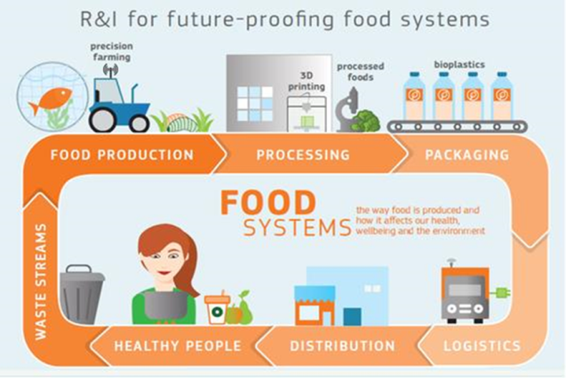

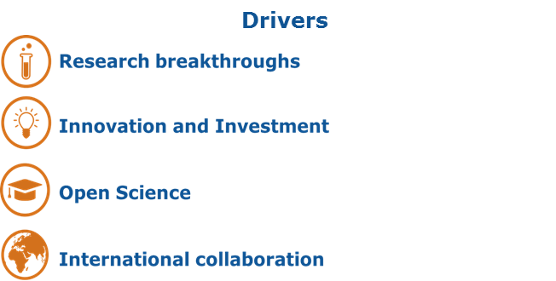

FOOD 2030
R&I for tomorrow's nutrition & food systems
Perfect Storm: climate change, population growth, resource scarcity, malnutrition, obesity & NCDs
Political opportunity: response to SDGs, COP21+, Junker priorities
Investment opportunity: EU underinvesting in food & agri R&I despite high returns on investment
Need for a systemic approach to future-proofing food systems via more impactful R&I

Slide 10
Horizon 2020 Societal Challenge 2 - €1.3 billion
- Food security
- Sustainable agriculture and forestry
- Marine, maritime and inland water research
- Bioeconomy

Slide 11
DAFM - Research & Innovation Supports & Activities
National
Food
Primary Production
Forestry
Thematic Network
Research +
Platform
Co-funding (EPA, SEAI, SFI)
Transnational
US-Ireland Research
ERA-NET funding
Joint Programming Initiatives
Healthy Diets for Healthy Lives
Agriculture, Food Security & Climate Change
EU
Horizon 2020
Societal Challenge 2
Biobased Industries JTI
EIP/AGRI
Digitalisation
Bioeconomy
OECD
Co-Operative Research Programme
Core Grant
Teagasc
Marine Institute
DAFM COMPETITIVE NATIONAL FUNDING PROGRAMMES
Notes:
Broken into two area – Core Grants and our own in-house Competitive program FIRM....
Ireland is striving to create a world-class research system that drives innovation and economic success.
DAFM plays an important role in this vision for the Agri-Food and Bioeconomy sector, by operating three 'public good' competitive agri-food research funding programmes namely the Food Institutional Research Measure (FIRM), theResearch Stimulus Fund (RSF) and the programme of Competitive Forestry Research for Development (COFORD).
FIRM: Primary funding mechanism for institutional food research which focuses on innovation, product development, safety, processing, functional ingredients, health and nutrition.
RSF: Support sustainably competitive agricultural practices & policies
Focus on modern animal / plant biosciences, agri- environment/sustainability, safety, agri-economics & finance.
CoFoRD: Support forest policy, sustainable forest management, use of forest products and provision of public goods

Slide 12



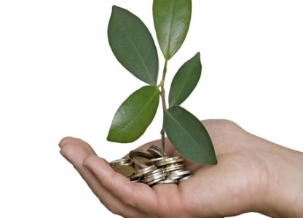
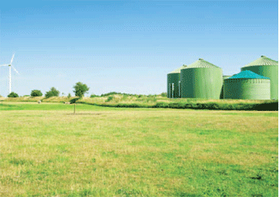
Why a national Policy Statement?
Why is the bioeconomy important?
Sustainable use of renewable biological resources
Decarbonisation / Changing Economic Model
Mitigation
Economic Opportunity / Rural Employment
A coordinated cross-sectoral approach will be required to make the transition to a low carbon and circular economy and society.

Slide 13
Are Researchers Prepared for Addressing Societal Challenges ?
What worked in the PAST may not work in the FUTURE
LIFELONG Learning – UCC CPD
Have a CAREER PLAN
Be prepared to TRAVEL
EQUIP yourself with the right Hard and Soft Skills
  Communications, Presentation skills
  Project Management
  People Skills, Teamwork
  Sales
  Finance

Slide 14
Are Researchers Prepared for Addressing Societal Challenges ?
Keep LEARNING and Keep SCORE
NETWORK
S.T.E.M. vs S.T.E.A.M.
INNOVATION

Slide 15
Are Researchers Prepared for Addressing Societal Challenges ?
What worked in the PAST will not work in the FUTURE
LIFELONG Learning – UCC CPD
Have a CAREER PLAN
EQUIP yourself with the right Hard and Soft Skills
  Communications, Presentation skills
  Project Management
  People Skills
  Sales
  Finance
Be prepared to TRAVEL
Keep LEARNING and Keep SCORE
NETWORK
S.T.E.M. vs S.T.E.A.M.
INNOVATION

Slide 16
Strategic Activity: Food 2030
Recipe for change: An agenda for a climate-smart and sustainable food system for a healthy Europe : report of the EC FOOD 2030 independent expert group
In this report, a group of European Commission (EC) appointed experts (including Professor Lorraine Brennan, UCD) recommend orientations for food and nutrition security research and innovation in the years to come. The report calls for a Research, Innovation and Investment Strategy (RI&IS) in line with the EC FOOD2030 initiative to deliver on four priorities: nutrition for sustainable and healthy diets; climate smart and environmentally sustainable food systems; circularity and resource efficiency of food systems; innovation and empowerment of communities. Using food systems thinking, the experts have reworked and integrated these priorities to develop a mission-type approach.

