Slide 1
Infection Prevention and Control
A Foundation Course
2015

Slide 2
Standard Precautions
Let’s play dress up!
Personal Protection Equipment and Standard Precautions. Donning and doffing
Jo O’Hora, IPCN – CUH
September 2015

Slide 3
Overview
PPE
  What is PPE?
  Types of PPE
  When do you use PPE?
  PPE for expanded precautions
  Sequence for putting on PPE
  Sequence for taking off PPE

Slide 4
Personal Protective Equipment (PPE)
Definition:
“specialized clothing or equipment worn by an employee for protection against infectious materials” (OSHA)

Slide 5
Factors Influencing PPE Selection
Type of exposure anticipated
  Splash/spray versus touch
  Category of isolation precautions
Durability and appropriateness for the task
Fit

Slide 6
Types of PPE Used in Healthcare Settings
Gloves – protect hands
Gowns/aprons – protect skin and/or clothing
Masks and respirators – protect mouth/nose
  Respirators – protect respiratory tract from airborne infectious agents
Goggles – protect eyes
Face shields – protect face, mouth, nose, and eyes

Slide 7
When to use PPE?
PPE creates a barrier between a potential infectious material and the healthcare worker
Intended to promote patient safety and increase the safety of the healthcare work environment
Risk Assessment!!!

Slide 8
STANDARD PRECAUTIONS
….infection control practices used to prevent transmission of diseases that can be acquired by contact with blood, body fluids, non-intact skin (including rashes), and mucous membranes……

Slide 9
PPE for Standard Precautions
Gloves – Touching, or where there is a risk touching, blood, body fluids, secretions, excretions, contaminated items; for touching mucus membranes and non-intact skin
Gowns/Aprons – Use during procedures and patient care activities when contact of clothing/ exposed skin with blood/body fluids, secretions, or excretions is anticipated
Mask and goggles or a face shield - Use during activities likely to generate splashes or sprays of blood, body fluids, secretions, or excretions

Slide 10
PPE for Expanded Precautions
Expanded Precautions include
  Contact Precautions
  Droplet Precautions
  Airborne Infection Isolation
  Combinations……..
Notes:
In some instances, healthcare personnel are required to wear PPE in addition to that recommended for Standard Precautions. The three Expanded Precaution categories (formerly called Transmission-Based Precautions) where this applies are Contact and Droplet Precautions and Airborne Infection Isolation.

Slide 11
Use of PPE for Expanded Precautions
Contact Precautions – Gown or apron and gloves for contact with patient or environment (e.g., medical equipment, environmental surfaces)
    In some instances these are required for entering patient’s environment
Droplet Precautions – Surgical masks within 3 feet of patient
Airborne Infection Isolation – Particulate respirator*
*Negative pressure isolation room also required
Notes:
Contact Precautions requires gloves and gown for contact with the patient and/or the environment of care; in some instances, use of this PPE is recommended for even entering the patient’s environment. Droplet Precautions requires the use of a surgical mask, and Airborne Infection Isolation requires that only a respirator be worn.

Slide 12

PPE Use in Healthcare Settings:
How to Safely Don, Use, and Remove PPE

Slide 13
Hand Hygiene
Social hand hygiene required for Standard Precautions and antiseptic hand hygiene for Expanded Precautions
Perform…
  Before donning gloves
  Immediately after removing gloves
  Between patient contacts
Decontaminate hands thoroughly using alcohol-based hand rub on physically clean hands or with soap and water
Notes:
Hand hygiene has been mentioned several time during this presentation. Hand hygiene is an essential infection control practice to protect patients, healthcare personnel and visitors and is required for both Standard and Expanded Precautions. Hand hygiene should be performed immediately after removing PPE, even during PPE changes and removal if necessary, and between patient contacts. Wash your hands thoroughly with soap and warm water or, if hands are not visibly soiled, use a alcohol-based hand rub.

Slide 14
Key Points About PPE
Don PPE before contact with the patient, generally before entering the room
Use carefully – don’t spread contamination
Remove and discard carefully, either at the doorway or immediately outside patient room; always remove respirator outside room
Immediately perform hand hygiene
Notes:
There are four key points to remember about PPE use. First, don it before you have any contact with the patient, generally before entering the room. Once you have PPE on, use it carefully to prevent spreading contamination. When you have completed your tasks, remove the PPE carefully and discard it in the receptacles provided. Then immediately perform hand hygiene before going on to the next patient.

Slide 15
Sequence* for Donning PPE
Gown / Apron first
Mask or respirator
Goggles or face shield
Gloves
*Combination of PPE will affect sequence – be practical
Notes:
The gown should be donned first. The mask or respirator should be put on next and properly adjusted to fit; remember to fit check the respirator. The goggles or face shield should be donned next and the gloves are donned last. Keep in mind, the combination of PPE used, and therefore the sequence for donning, will be determined by the precautions that need to be taken.

Slide 16

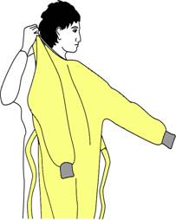
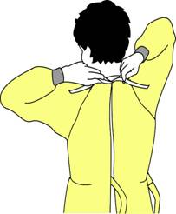
How to Don a Gown
Select appropriate type and size
Opening is in the back
Secure at neck and waist
If gown is too small, use two gowns
  Gown #1 ties in front
  Gown #2 ties in back
Notes:
To don a gown, first select the appropriate type for the task and the right size for you. The opening of the gown should be in the back; secure the gown at the neck and waist. If the gown is too small to fully cover your torso, use two gowns. Put on the first gown with the opening in front and the second gown over the first with the opening in the back.

Slide 17
Face Protection
Masks – protect nose and mouth
  Should fully cover nose and mouth and prevent fluid penetration
Goggles – protect eyes
  Should fit snuggly over and around eyes
  Personal glasses are not a substitute for goggles
  Antifog feature improves clarity
Notes:
A combination of PPE types is available to protect all or parts of the face from contact with potentially infectious material. The selection of facial PPE is determined by the isolation precautions required for the patient and/or the nature of the patient contact. This will be discussed later.
Masks should fully cover the nose and mouth and prevent fluid penetration. Masks should fit snuggly over the nose and mouth. For this reason, masks that have a flexible nose piece and can be secured to the head with string ties or elastic are preferable.
Goggles provide barrier protection for the eyes; personal prescription lenses do not provide optimal eye protection and should not be used as a substitute for goggles. Goggles should fit snuggly over and around the eyes or personal prescription lenses. Goggles with antifog features will help maintain clarity of vision.

Slide 18
Face Protection
Face shields – protect face, nose, mouth, and eyes
  Should cover forehead, extend below chin and wrap around side of face
Notes:
When skin protection, in addition to mouth, nose, and eye protection, is needed or desired, for example, when irrigating a wound or suctioning copious secretions, a face shield can be used as a substitute to wearing a mask or goggles. The face shield should cover the forehead, extend below the chin, and wrap around the side of the face.

Slide 19
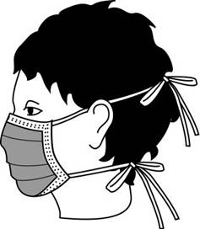
How to Don a Mask
Place over nose, mouth and chin
Fit flexible nose piece over nose bridge
Secure on head with ties or elastic
Adjust to fit
Notes:
Some masks are fastened with ties, others with elastic. If the mask has ties, place the mask over your mouth, nose and chin. Fit the flexible nose piece to the form of your nose bridge; tie the upper set at the back of your head and the lower set at the base of your neck.
If a mask has elastic head bands, separate the two bands, hold the mask in one hand and the bands in the other. Place and hold the mask over your nose, mouth, and chin, then stretch the bands over your head and secure them comfortably as shown; one band on the upper back of your head, the other below the ears at the base of the neck.
Adjust the mask to fit. Remember, you don’t want to be touching it during use so take the few seconds needed to make sure it is secure on your head and fits snuggly around your face so there are no gaps.

Slide 20
Respiratory Protection
Purpose – protect from inhalation of infectious aerosols (e.g., Mycobacterium tuberculosis)
PPE types for respiratory protection
  Particulate respirators
  Half- or full-face elastomeric respirators
  Powered air purifying respirators (PAPR)
  Fit testing…..
Notes:
PPE also is used to protect healthcare workers’ from hazardous or infectious aerosols, such as Mycobacterium tuberculosis. Respirators that filter the air before it is inhaled should be used for respiratory protection.
The most commonly used respirators in healthcare settings are the N95, N99, or N100 particulate respirators. The device has a sub-micron filter capable of excluding particles that are less than 5 microns in diameter.
Respirators are approved by the CDC’s National Institute for Occupational Safety and Health.
Like other PPE, the selection of a respirator type must consider the nature of the exposure and risk involved. For example, N95 particulate respirators might be worn by personnel entering the room of a patient with infectious tuberculosis. However, if a bronchoscopy is performed on the patient, the healthcare provider might wear a higher level of respiratory protection, such as a powered air-purifying respirator or PAPR.

Slide 21
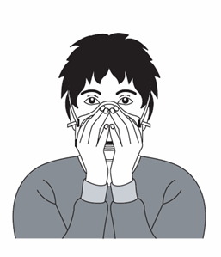
How to Don a Particulate Respirator
Select a fit tested respirator
Place over nose, mouth and chin
Fit flexible nose piece over nose bridge
Secure on head with elastic
Adjust to fit
Perform a fit check –
  Inhale – respirator should collapse
  Exhale – check for leakage around face
Notes:
The technique for donning a particulate respirator, such as an N95, N99 or N100, is similar to putting on a pre-formed mask with elastic head bands. Key differences, however, are 1) the need to first select a respirator for which you have been fit tested and 2) fit checking the device, as you have been instructed, before entering an area where there may be airborne infectious disease. Be sure to follow the manufacturer’s instructions for donning the device. In some instances, the manufacturer’s instructions may differ slightly from this presentation.
You may also be asked to wear an elastomeric or powered air purifying respirator, or PAPR. Guidance on how to use these devices is not included in this presentation. You will need instruction locally to properly use these devices.

Slide 22
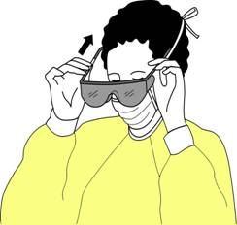
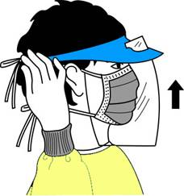
How to Don Eye and Face Protection
Position goggles over eyes and secure to the head using the ear pieces or headband
Position face shield over face and secure on brow with headband
Adjust to fit comfortably
Notes:
If eye protection is needed, either goggles or a face shield should be worn. Position either device over the face and/or eyes and secure to head using the attached ear pieces or head band. Adjust to fit comfortably. Goggles should feel snug but not tight.

Slide 23
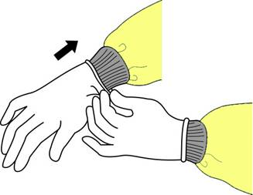
How to Don Gloves
Don gloves last
Select correct type and size
Perform hand hygiene
Insert hands into gloves
Extend gloves over isolation gown cuffs
Notes:
The last item of PPE to be donned is a pair of gloves. Be sure to select the type of glove needed for the task in the size that best fits you. Insert each hand into the appropriate glove and adjust as needed for comfort and dexterity. If you are wearing an isolation gown, tuck the gown cuffs securely under each glove. This provides a continuous barrier protection for your skin.

Slide 24
Do’s and Don’ts of Glove Use
Clean your hands before donning gloves
Work from “clean to dirty”
Limit opportunities for “touch contamination” - protect yourself, others, and the environment
  Don’t touch your face or adjust PPE with contaminated gloves
  Don’t touch environmental surfaces except as necessary during patient care
  Take gloves off after use and clean your hands
Notes:
Gloves protect you against contact with infectious materials. However, once contaminated, gloves can become a means for spreading infectious materials to yourself, other patients or environmental surfaces. Therefore, the way YOU use gloves can influence the risk of disease transmission in your healthcare setting. These are the most important do’s and don'ts of glove use.
Work from clean to dirty. This is a basic principle of infection control. In this instance it refers to touching clean body sites or surfaces before you touch dirty or heavily contaminated areas.
Limit opportunities for “touch contamination” - protect yourself, others and environmental surfaces. How many times have you seen someone adjust their glasses, rub their nose or touch their face with gloves that have been in contact with a patient? This is one example of “touch contamination” that can potentially expose oneself to infectious agents. Think about environmental surfaces too and avoid unnecessarily touching them with contaminated gloves. Surfaces such as light switches, door and cabinet knobs can become contaminated if touched by soiled gloves.

Slide 25
How to Safely Use Gloves
Keep gloved hands away from face
Avoid touching or adjusting other PPE
Remove gloves if they become torn; perform hand hygiene before donning new gloves
Limit surfaces and items touched
Notes:
In addition to wearing PPE, you should also use safe work practices. Avoid contaminating yourself by keeping your hands away from your face and not touching or adjusting PPE. Also, remove your gloves if they become torn and perform hand hygiene before putting on a new pair of gloves. You should also avoid spreading contamination by limiting surfaces and items touched with contaminated gloves.

Slide 26
PPE Use in Healthcare Settings:
How to Safely Remove PPE

Slide 27
The challenge.....
“Skin, Clothes Contaminated After Protective Gear Removed………
During the removal of personal protective equipment (PPE), the skin and clothing of healthcare workers can become contaminated… Fran Lowry : Society for Healthcare Epidemiology of America (SHEA) Spring 2015 Conference: Abstract 7160. Presented May 15, 2015.
“Virus Transfer from Personal Protective Equipment to Healthcare Employees’ Skin and Clothing…”
failure to properly use PPE was a risk factor for HCW infection
Lisa Casanova, Edie Alfano-Sobsey,William A. Rutala, David J. Weber, and Mark Sobsey

Slide 28
“Contaminated” and “Clean” Areas of PPE
Contaminated – outside front
    Areas of PPE that have or are likely to have been in contact with body sites, materials, or environmental surfaces where the infectious organism may reside
Clean – inside, outside back, ties on head and back
    Areas of PPE that are not likely to have been in contact with the infectious organism
Notes:
To remove PEP safely, you must first be able to identify what sites are considered “clean” and what are “contaminated.” In general, the outside front and sleeves of the isolation gown and outside front of the goggles, mask, respirator and face shield are considered “contaminated,” regardless of whether there is visible soil. Also, the outside of the gloves are contaminated.
The areas that are considered “clean” are the parts that will be touched when removing PPE. These include inside the gloves; inside and back of the gown, including the ties; and the ties, elastic, or ear pieces of the mask, goggles and face shield.

Slide 29
Sequence for Removing PPE
Remove Gloves first – and perform hand hygiene
Face shield or goggles
Gown
Mask or respirator

Slide 30
Where to Remove PPE
At doorway, before leaving patient room or in anteroom*
Remove respirator outside room, after door has been closed
* Ensure that hand hygiene facilities are available at the point needed, e.g., sink or alcohol-based hand rub
Notes:
The location for removing PPE will depend on the amount and type of PPE worn and the category of isolation a patient is on, if applicable. If only gloves are worn as PPE, it is safe to remove and discard them in the patient room. When a gown or full PPE is worn, PPE should be removed at the doorway or in an anteroom. Respirators should always be removed outside the patient room, after the door is closed. Hand hygiene should be performed after all PPE is removed.

Slide 31
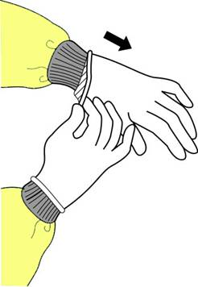
How to Remove Gloves - Step1
Grasp outside edge near wrist
Peel away from hand, turning glove inside-out
Hold in opposite gloved hand
Notes:
Using one gloved hand, grasp the outside of the opposite glove near the wrist. Pull and peel the glove away from the hand. The glove should now be turned inside-out, with the contaminated side now on the inside. Hold the removed glove in the opposite gloved hand.

Slide 32
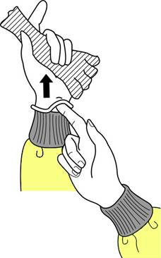
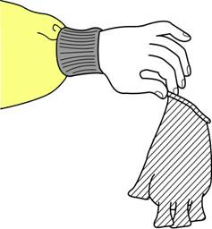
How to Remove Gloves – Step 2
Slide ungloved finger under the wrist of the remaining glove
Peel off from inside, creating a bag for both gloves
Discard
Notes:
Slide one or two fingers of the ungloved hand under the wrist of the remaining glove. Peel glove off from the inside, creating a bag for both gloves. Discard in waste container.

Slide 33

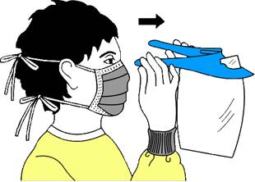
Remove Goggles or Face Shield
Grasp ear or head pieces with ungloved hands
Lift away from face
Place in designated receptacle for reprocessing or disposal
Notes:
Using ungloved hands, grasp the “clean” ear or head pieces and lift away from face. If goggle or face shield are reusable, place them in a designated receptacle for subsequent reprocessing. Otherwise, discard them in the waste receptacle.

Slide 34
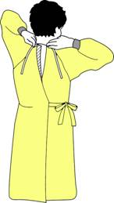
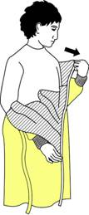
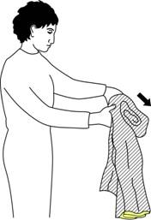
Removing Isolation Gown
Unfasten ties
Peel gown away from neck and shoulder
Turn contaminated outside toward the inside
Fold or roll into a bundle
Discard in Healthcare risk waste stream
Notes:
Unfasten the gown ties with the ungloved hands. Slip hands underneath the gown at the neck and shoulder, peel away from the shoulders. Slip the fingers of one hand under the cuff of the opposite arm. Pull the hand into the sleeve, grasping the gown from inside. Reach across and push the sleeve off the opposite arm. Fold the gown towards the inside and fold or roll into a bundle. (Only the “clean” part of the gown should be visible.) Discard into waste or linen container, as appropriate.

Slide 35
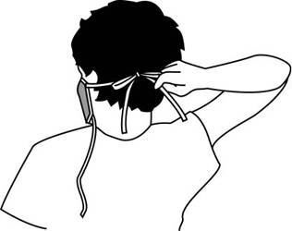
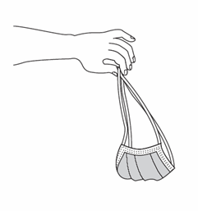
Removing a Mask
Untie the bottom, then top, tie
Remove from face
Discard
Notes:
The front of the mask is considered contaminated and should not be touched. Remove by handling only the ties or elastic bands starting with the bottom then top tie or band. Lift the mask or respirator away from the face and discard it into the designated waste receptacle.

Slide 36
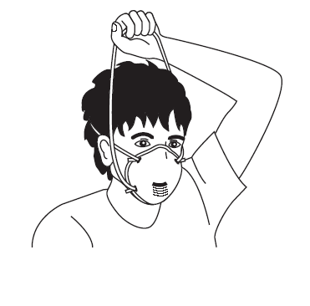
Removing a Particulate Respirator
Lift the bottom elastic over your head first
Then lift off the top elastic
Discard

Slide 37
Disposal of PPE
It is vital that PPE is disposed of correctly:
PPE from non-infectious patients can be disposed of in “offensive” waste - Domestic waste stream
PPE from patients who are infectious must go into clinical infectious waste streams - Yellow bin
PPE from cyto-toxic management must go into the cyto-toxic waste stream - Purple bin

Slide 38
Enhanced PPE
Enhanced PPE must be used with high-risk patients - e.g. ebola virus disease (EVD)
Expert guidance on ebola is continually being updated
A buddy is essential in high-risk care situations such as EVD
The most up-to-date guidance information on what PPE should be considered for use in caring for patients with suspected or confirmed ebola infection available on HPSC website
Consult local policies and procedures in their own organisations for further information.

Slide 39
Conclusion
PPE is part of Standard Precautions and part everyday healthcare
Minimises the risks of cross-contamination between patients and between patients and staff – protects you….
Donning and doffing PPE correctly protects you….
Hand hygiene remains the cornerstone of infection prevention and all health workers must be aware that wearing PPE does not replace the need to carry out safe, hand-hygiene practices and hand decontamination

