Slide 1





The Potential of the Gut Microbiome to Predict Persistent Postsurgical Pain-Paving the Way for Pain Prevention
Khaled Masaud¹, Raύl Cabrera Rubio^{2,3}, Paul D. Cotter^{2,3}, Niall O’Brien¹, Ronan Bluett¹, Clare Keaveney Jimenez¹, Mark Corrigan⁵, George Shorten¹, Siobhain M. O’ Mahony^{3,6}
¹Department of Anaesthesia and Intensive Care Medicine, Cork University Hospital and University College Cork, ²Teagasc Food Research Centre, Moorepark, Fermoy, County Cork, Ireland, ³APC Microbiome Ireland, University College Cork, ⁴Department of Clinical Neurophysiology Cork University Hospital, ⁵ Department of Surgery, Cork University Hospital and University College Cork, ⁶Department of Anatomy and Neuroscience University College Cork

Slide 2
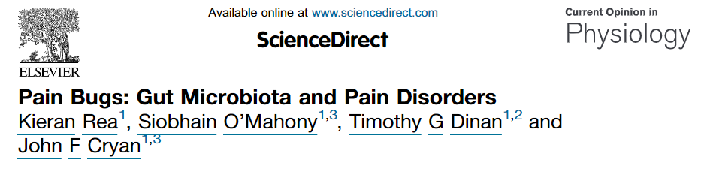
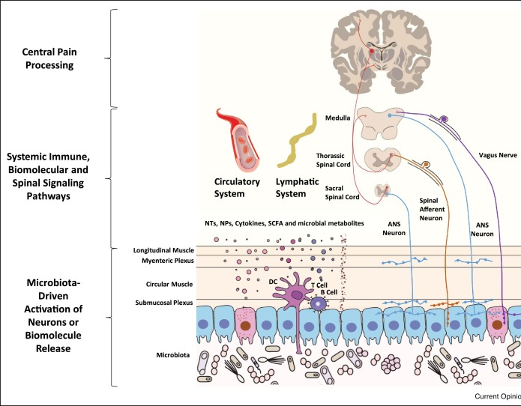
Microbiome-Gut-Brain Axis-Implications for Pain
Microbiome-all of the genetic material within a microbiota (the entire collection of microorganisms in a specific niche, such as the human gut
Bi-directional communication system between our microbiome and the central nervous system
  Visceral pain is associated with alterations in microbiome
  Some of the pathways and regulators of visceral pain are also critical in somatic pain
  Implications for somatic pain processing
Persistent postsurgical pain (PPSP) poses a significant health problem
  Women are more likely to develop PPSP with up to 50% of women undergoing mastectomy developing PPSP
Objective of the study
To determine if pre-operative gut microbiome composition and diversity is associated with the incidence and magnitude of PPSP, along with with psychological and mood parameters
  This may provide a targetable pre-operative predictive measure of PPSP
Notes:
The microbiome comprises all of the genetic material within a microbiota (the entire collection of microorganisms in a specific niche, such as the human gut).
A bi-directional communication high-way exists between the brain and the gut. The gut microbiota play essential roles in this communication. Other pathways that are involved include endocrine, immune, and neural (vagus and enteric nervous system). Harnessing such pathways may provide a novel approach to treat various disorders.
Some studies have shown association between visceral pain and the microbiome but very few studies have investigated somatic pain and the microbiome.
Some of the pathways and regulators of visceral pain are also critical in somatic pain. These include peripheral sensitization of primary sensory afferents, central sensitization, spinal ascending neurons and alteration of descending inhibitory pathways
Well documented in PPSP pain. (Burke and Shorten, 2009).
Explain PPSP….
Explain objective of the study….
This study if the first to investigate the potential of pre-operative gut microbiome composition and diversity and PPSP using state of the art microbiome analysis.

Slide 3
Recruitment
Inclusion & exclusion criteria check
Informed consent
Filled STAI,Cohen,PCS and Food Questionnaires
Enrolled after assessed for eligibility (n=68)
Declined to continue after consent (n=16)
Followed but did not provide stool sample (n=7)
Followed and provided Pre-operative stool sample on the day of surgery(n=45)
Surgery
WLE/Mastectomy and Axillary clearance or SLNB
Standardized Anesthesia and surgical technique
60 mins Post operative
Filled short form McGill
Post op pack ,STAI,Cohen,PCS, Pain diary and Mcgill forms
Shot gun sequencing
Taxonomic and Functional data of Microbiome generated and assessed in relation to Pain
1 wk to 12 wks Post operative
2 phone calls at 1 wk, 6 wks
At 12 wks Post operative
Reminder-forms by post; PPSP question as per criteria
Notes:
We hypothesize manipulation of gut microbiota (composition and diversity) in patients with somatic pain postoperatively may offer a means of providing analgesia.
Explain the significance of Shot Gun sequencing and what analysis was done.
This eliminated the biases of the PCR. This is the first study of its kind-most studies to date have used 16S ribosomal gene expression analysis. It allows assignment at a bacterial species level and also the functional capacity of the bacteria present.

Slide 4
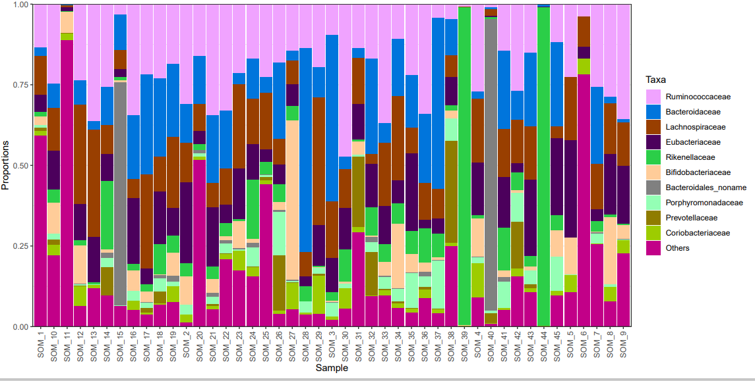
RESULTS: Taxonomic Analysis and a
Reduced Alpha Diversity Associated with Pain at 60 mins and 12 weeks post surgery
RS Species Number Shannon Simpson
Figure 1: Family taxonomic plot for all 45 samples
Figure 2: Reduced alpha diversity is associated with severe pain at 60 mins post surgery
RS Species Number Shannon Simpson
Figure 3: Reduced alpha diversity with severe pain 12 weeks post surgery
Notes:
Describe Taxonomic figure-variation in human population, most prevalent bacteria
Describe alpha diversity and what it means, that increased diversity is associated with health and a reduction is seen in disease states.
Describe that you see a reduction at 60 minutes and 12 weeks post surgery in those individuals that report severe pain using the McGill. This is at the family level.
We did no see a difference in those that reported PPSP

Slide 5
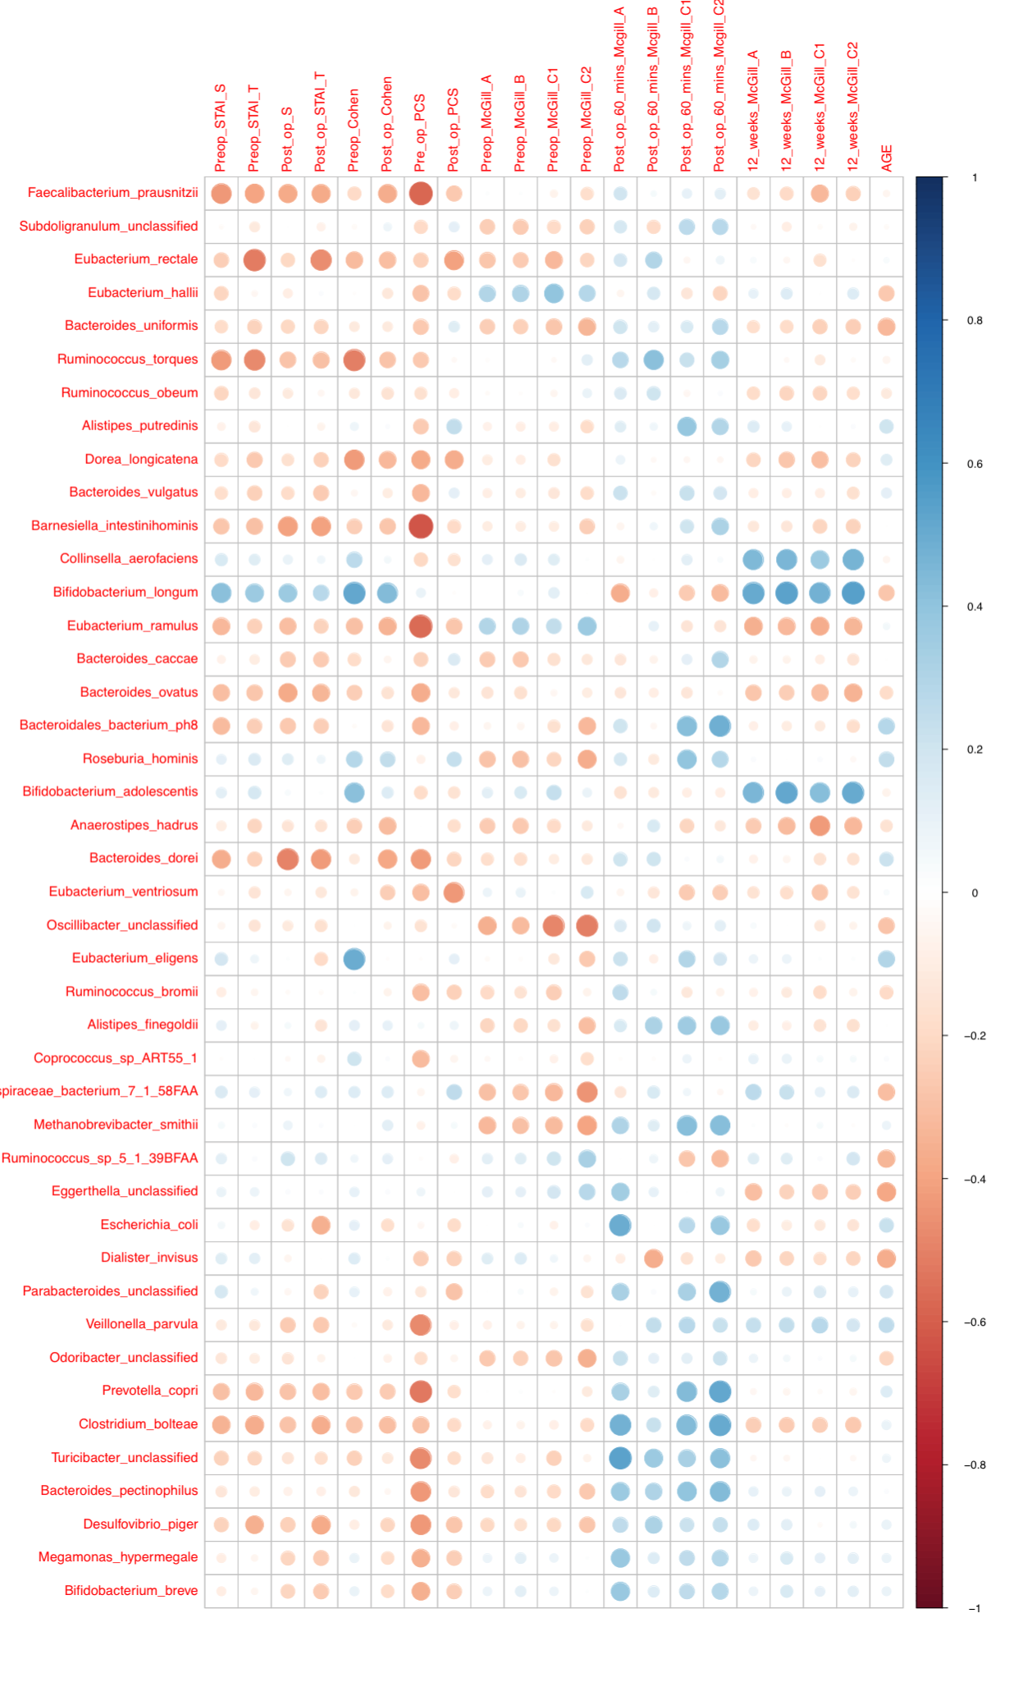
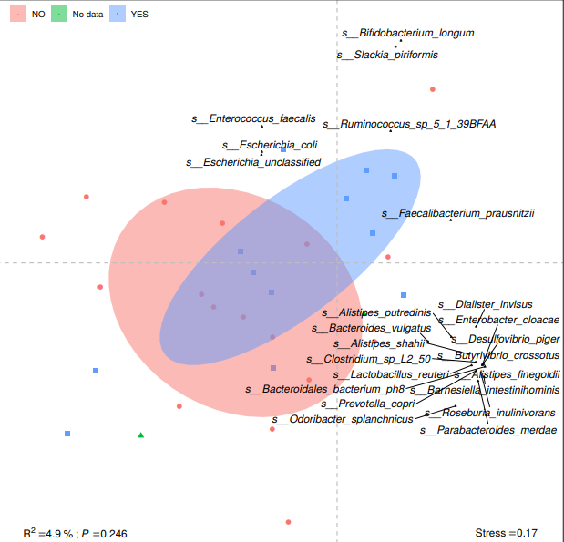
Correlations between specific bacteria and pain at 12 weeks post-surgery
Figure 5: Heatmap showing negative correlations between bacteria such as Faecalibacterium_prausnitzii and positive correlations with Collinsella_aerofaciens and pain at 12 weeks post-surgery”.
Figure 4: Biplot of the correlation between Faecalibacterium_prausnitzii and PPSP at 12 weeks
Notes:
Describe what these figures show-what they mean, then the actual bacteria-what is their role/function in pain

Slide 6
Conclusion and future research
Both acute and pain 3 months following surgery
  Inverse association between alpha diversity
  Correlations with specific organisms
This research highlights novel predictive strategies for PPSP
Pre-Habilitation might be possible
  Manipulation of the microbiota through probiotic/prebiotic/synbiotic administration
Probiotic Bifidobacterium breve NCIMB 702258-impacts on the endocannabinoid system-which interacts with the endogenous opiate system to induce analgesia (Patterson et al., 2017).
Foundation for further research on microbiome and somatic pain for a better understanding, management of pain and more desirable patient outcomes

Slide 7

