Slide 1
Scholars at Risk Network: Get Involved
Refugee Week
University College Cork
January 2019

Slide 2
SAR’s Mission
Scholars at Risk is an international network of institutions and individuals whose mission it is to protect scholars and promote academic freedom.
Scholars at Risk is a global movement to protect everyone’s freedom to think, question, and share ideas

Slide 3
https://www.scholarsatrisk.org/resources/free-to-think-2018-video/

Slide 4
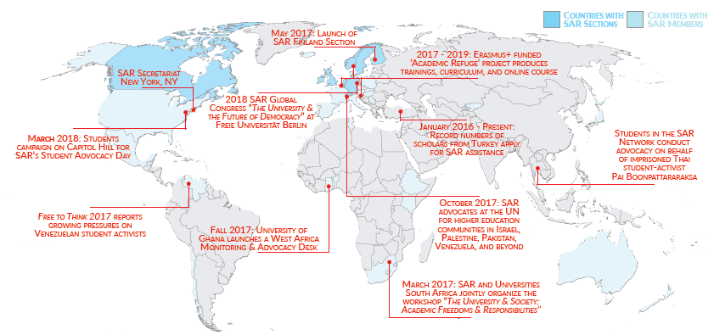
The SAR network
Over 500 institutions in 39 countries, including ‘sections’ in Canada, Ireland, Netherlands & Belgium (with UAF), Norway, Sweden, Switzerland, United Kingdom (with CARA), Germany, and Finland.
Scholars at Risk is a global movement to protect everyone’s freedom to think, question, and share ideas

Slide 5
Scholars at Risk National Sections in Europe
National networks of higher education institutions dedicated to supporting threatened scholars and promoting academic freedom.
CARA-SAR UK Universities Network with CARA (2006)
SAR-UAF Netherlands & Belgium Network (2009)
SAR-Ireland section with Universities Ireland (2009)
SAR- Norway section (2011)
SAR-Switzerland section (2014)
SAR-Sweden section (2016)
SAR-Germany section with Alexander von Humboldt Foundation (2016)
SAR-Finland section with UNIFI Universities Finland (2017)
SAR Europe – Hosted at Maynooth University (2018)
Notes:
UAF – Foundation for Refugee Students
CARA – Council for at Risk Academics

Slide 6
Getting involved: Concrete next steps
Subscribe to receive SAR emails
Join the SAR network
Invite a speaker through the SAR Speaker Series
Consider hosting threatened scholars (some of whom are students)
Participate in SAR’s academic freedom monitoring project as a researcher – Students can do this!
Advocate on behalf of a scholar in prison (e.g. through the student advocacy seminar)
Participate in SAR alerts/campaigns
Send representatives to SAR workshops/trainings and 2020 Global Congress
Join efforts to build a SAR Greece section

Slide 7
Activities
As SAR members, university leadership, staff, faculty, and students have the opportunity to actively engage in:
Protection hosting threatened scholars for temporary academic visits referring scholars to the network for assistance | Advocacy offering Student Advocacy Seminars to teach real-world advocacy skills supporting scholars in prison by writing letters of appeal work with the SAR Academic Freedom Monitoring Project | Learning attending SAR conferences and workshops inviting SAR scholars to share their stories on campus joining research groups looking at pressing issues facing international higher education

Slide 8
Facts & Figures
Since founding in 2000, over 4,000 applications for assistance
From September 2017 to end August 2018, over 500 applications; 124 placements
Current rate of 40 to 50 applications per month; 26 scholars on list currently seeking positions
Top sources of applications: Turkey, Syria, Iran, Iraq, Yemen
Over 850 applications from Turkey alone since Jan 2016
SAR Monitoring Project F2T (2018): 294 attacks in 47 countries
Scholars in Prison: SAR is tracking and conducting advocacy on behalf of 49 scholars and students imprisoned or otherwise threatened around the world.

Slide 9
Scholar disciplines
From September 2017 to the end of August 2018, SAR received over 500 applications for assistance and arranged 124 placements for scholars from a wide variety of disciplines.

Slide 10
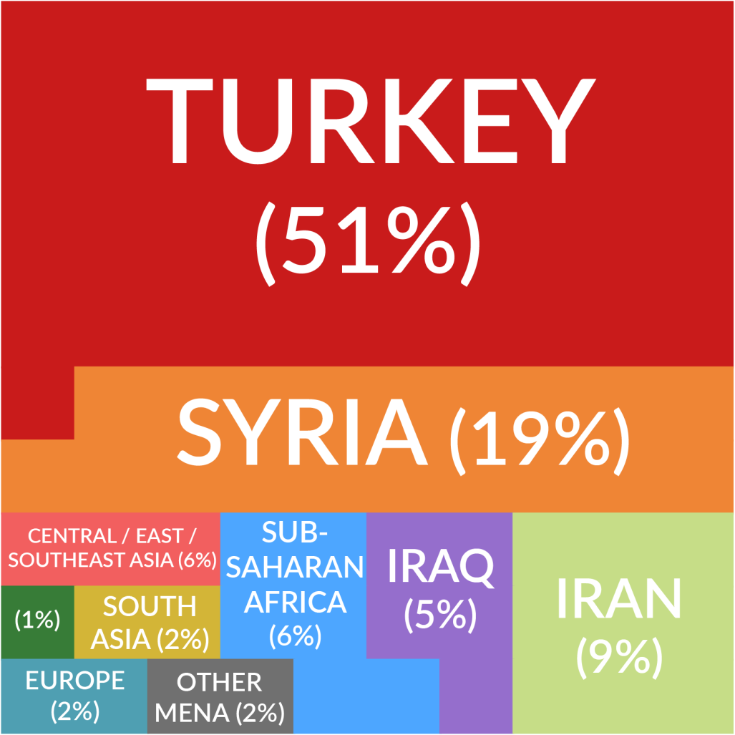
Scholar Countries of Origin
SAR currently provides assistance to threatened scholars from over 25 countries around the world.
Notes:
We work with scholars from over 25 countries, but the majority of the applications we receive come from Syria, Iran, Iraq and Turkey. I should note that the infographic here is slightly out of date, now, given the gravity of the recent crisis in Turkey.
As of September 30, 2017, we have received applications from 676 scholars in Turkey, more than any other country in SAR’s history. To further exemplify how this has shifted in the recent past, for the first 15 years of SAR’s work, we had only received 23 applications from Turkey. For further reference, we have receives 303 apps from Syria to date, less than half of the number we have received from Turkey.
Turkey: TOTAL TO DATE
676
TOTAL from Jan 2016
653
TOTAL since July 16 attempted coup (TURK591)
594
TOTAL FY17
438

Slide 11
Protection
SAR informs the network of scholars facing threats and works with the scholars and host institutions through every step of the process.
Scholars apply for assistance | Hosting | Transition | Safe return
 | Advice & other assistance |  | New opportunities
Notes:
On the protection team, we work directly with the scholars who face threats in their country of origin, and we connect with universities in our network to create short term temporary academic positions so that these scholars can continue their academic work in safety.
When a scholar applies for assistance, our team reviews each individual’s academic and risk backgrounds to determine whether they are a scholar, and an individual who has faced risk, and then we explore whether there may be available opportunities within our network. To do so, we look at academic materials such as CVs, publications, letters of reference, and more. We also ask that each applicant provides a first person account of risk along with any corroborating materials to demonstrate their experiences. We simultaneously conduct research on the country context to best understand one’s experience, both on a personal level, and on a general, situational level.
If after reviewing these materials, and being in conversation with the scholar and experts in the field, we determine that we can accept a case for assistance, then, we offer a variety of support. This ranges from outreach within our network to create temporary visits to offering career services support such as materials review, interview prep, letters of support in favor of independent open call applications, and in person trainings.
Nature of SAR placements—SAR placements are intended to be temporary and range from several months to 2 years, with the average being 1 year. SAR is not a grant giving organization, and rather the universities in our network generally identify the funding to make these positions possible. We stay in touch with scholars before, during, and after an academic visit to make sure they are able to make the most of their time at a host university, and to plan for next steps.

Slide 12
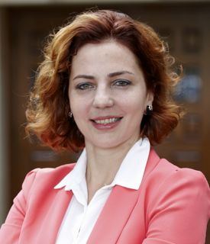
Example
SAR-assisted scholar
Dr. Anna Dolidze
International Law
Home country: Georgia
Risks: Intimidation, surveillance, and arrest in retaliation for her open criticism of policies relating to the operation and independence of the Georgian judiciary
SAR Network positions: NYU Law School, USA and Western University, Canada
Where is she now? In 2015, Dr. Dolidze
returned to Georgia to begin an appointment as Deputy Defense Minister. In June 2016, she was appointed the chief legal adviser to the President of Georgia.

Slide 13
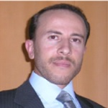
Example
SAR-assisted scholar
Dr. Kassem AlSayed Mahmoud
Food Science
Home country: Syria
Risks: Targeted by the government for defecting from compulsory military service
SAR Network position: Ghent University, Belgium, arranged with the UAF-SAR Netherlands & Belgium Section
Where is he now? Dr. AlSayed is working as a postdoctoral researcher in Belgium and dreaming of returning to his homeland.

Slide 14
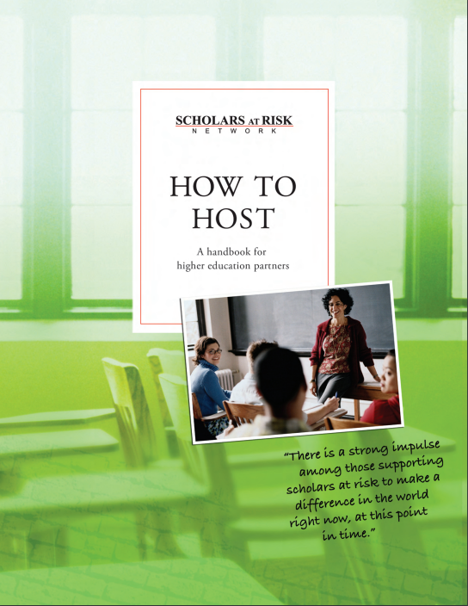
information & Advice

Slide 15
Advocacy: Academic Freedom Monitoring Project & Free to Think 2018
Key Findings
Ongoing, violent attacks on higher education communities around the world
Targeted attacks on scholars and students in Iran
Mass detention of Uyghur scholars and students in China
Violent repression of organized student expression
Sweeping actions against higher education communities in Turkey
Restrictions on scholarly travel
Shrinking campus space for free, open inquiry in the United States
Threats to institutional autonomy in Central and Eastern Europe

Slide 16
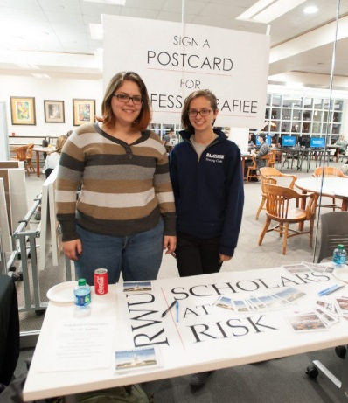
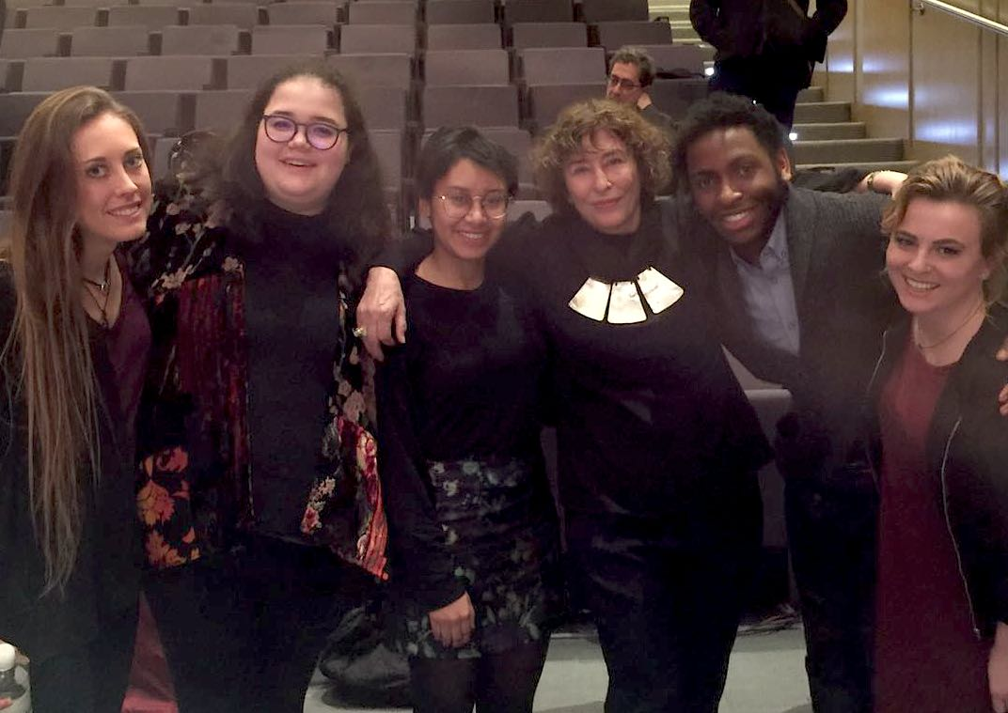
Advocacy: Student Seminars & Legal Clinics
Faculty-led human rights research and advocacy at SAR member institutions
Campaigns for Scholars-in-Prison cases
Research for SAR’s Academic Freedom Monitoring Project
Reports and submissions for national and international advocacy

Slide 17
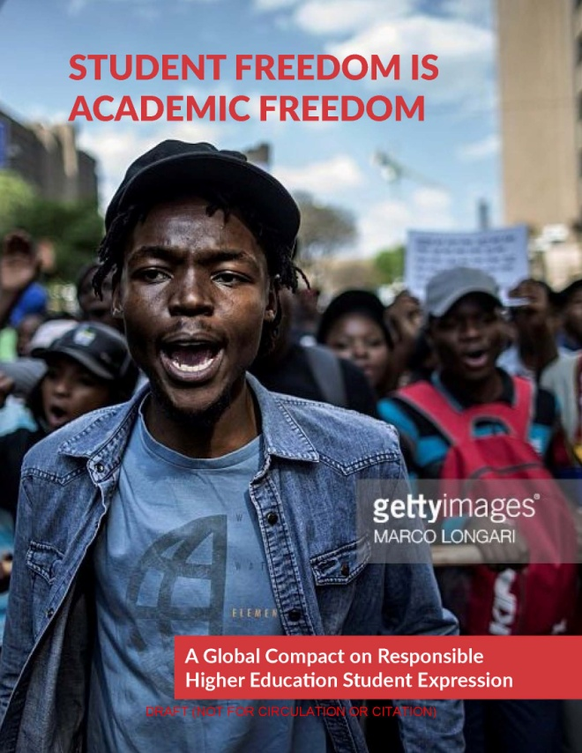
Learning: Promoting Higher Ed Values & Protecting Student Expression
SAR convenes faculty, students and professionals to join working groups on critical issues facing higher education, including how institutions promote core higher education values on campus and the protection of organized student expression from violent threats.
SAR-coordinated working groups & related workshops
Values discussion guides & toolkits
MOOC (2018-19 via Erasmus+ grant)
Inviting case examples, participation, event co-organizers

Slide 18
‘Academic Refuge’ Project
Erasmus+ Strategic Partnership
(with associate partners EUA and EAIE)
2017: Develop curriculum and implement two-part training on (a) welcoming refugees and threatened academics to campus and (b) promoting higher education values
2018: MOOC: The Global University, Academic Freedom and Higher Education Values
2019: Electronic Handbook on Putting Higher Education Values into Practice
Notes:
European Association for International Education

Slide 19
MAYNOOTH UNIVERSITY AND SAR
Maynooth University is a sustaining member of Scholars at Risk.
Has hosted scholars from Iran and Iraq
“Academic Freedom in Turbulent Times. Conference with special guests Prof Homa Hoodfar, Concordia University, Montreal; Dr Jamil Khader, Dean of Research, Bethlehem University,
Scholars At Risk Speaker Series tour of Ireland, Maynooth University invited a scholar from Pakistan to campus to give a talk on her work.
The students of Maynooth University’s School of Law have participated in Scholars at Risk’s legal clinics, researching and writing reports on attacks on higher education communities throughout the world as part SAR’s Academic Freedom Monitoring project.

Slide 20
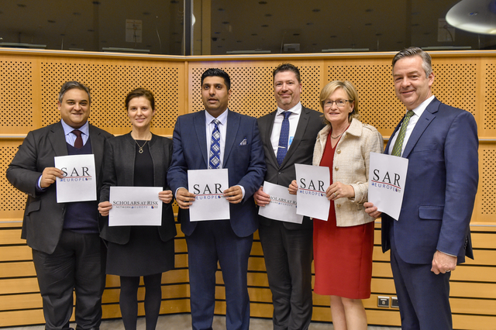
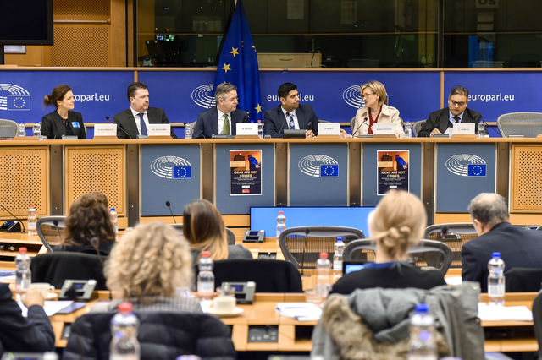
Scholars at Risk is a global movement to protect everyone’s freedom to think, question, and share ideas

Slide 21
SAR Europe
European office of SAR
Hosted by Maynooth University
Launched in Nov 2018 at European Parliament
Formalize SAR’s ongoing work in Europe (since 2001, over 300 HEIs in Europe)
Build greater staff capacity in Europe
Increase cooperation between SAR sections across Europe
Increase participation of HEIs in Central, Eastern and Southern Europe in SAR-related activities
Scholars at Risk is a global movement to protect everyone’s freedom to think, question, and share ideas

Slide 22
Thank you!
get connected:
www.scholarsatrisk.org
scholarsatrisk@nyu.edu
facebook.com/scholarsatrisk
twitter.com/scholarsatrisk
Notes:
Potential discussion questions:
What are the main or most difficult values or ethical challenges encountered in establishing international partnerships among higher education institutions?
Can you share any real-life examples of situations in which you faced values-related challenges in establishing an international partnership?
How might values principles be implemented in concrete practice—for example by their inclusion in a partnership agreement or other instrument or process among higher education institutions?--to help higher education partners share, examine and mediate these challenges?

