Slide 1
Data submissions
Research Quality Review
2015
Research Quality Review Steering Committee

Slide 2
the Research Quality Review will necessitate the preparation and submission of a range of data on the part of all disciplines in the review
the Steering Committee has taken an number of steps to facilitate the preparation of these data
this presentation explains the format to which the data should conform
a Google Drive folder will be used for the final submission
the deadline for submissions will be 30 January 2014

Slide 3
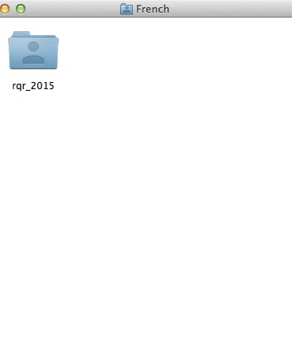
Preparing your data
a master folder will be provided in Google Drive for each discipline to be reviewed (here, French is used as an example)
this folder will in turn be located in a directory containing data for all of the disciplines in the relevant panel
a dedicated folder — labelled rqr_2015 — has been provided to facilitate you in preparing your data in advance of final submission

Slide 4
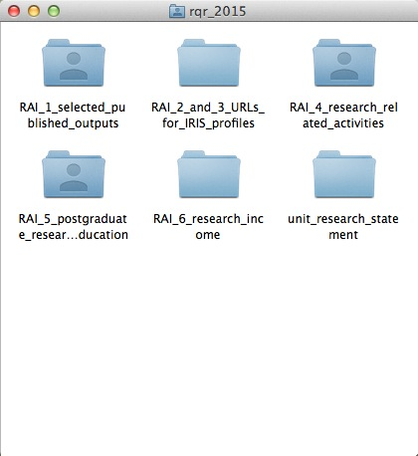
What’s in the data folder?
your folder is organised according to the data required for each Research Activity Indicator
each unit submission will be accompanied by a research statement, for which a dedicated folder is provided
this model folder is provided to facilitate you in assembling your data locally well in advance of the final deadline for submissions

Slide 5
Your research statement
a pro-forma template will be provided for preparation of your research statement
this template will help to identify the information required to support evaluation of each of the Research Activity Indicators
pro-forma templates will also be provided for the submission of supporting information where relevant

Slide 6
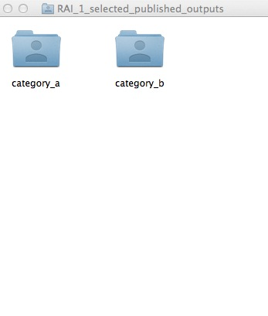
RAI 1: five selected pieces
each member of staff will select five research publications for peer review
folders will be provided for staff included for review in Category A or Category B (see Guidelines)
these folders will be used to assemble PDFs of submitted publications wherever possible
reviewers will have read-only access to these folders for purposes of the review

Slide 7
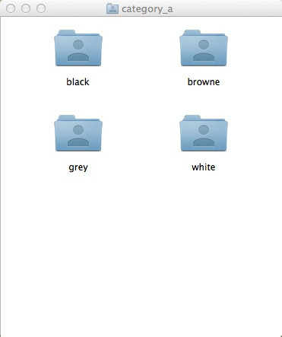
RAI 1: individual folders
a folder may be created for each member of staff in Category A and Category B
it is proposed that one member of staff in each unit be nominated to coordinate the preparation of data
each of the five publications submitted for review will be accompanied by a pro-forma cover sheet

Slide 8
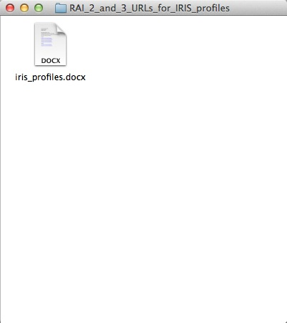
RAI 2 and 3: IRIS profiles
a single folder is to be used to assemble the data required for RAIs 2 — Total published output since 2008 — and 3— Peer esteem
external peer reviewers will assess these RAIs using IRIS profiles
what is required here is simply a list of IRIS profiles for all staff

Slide 9
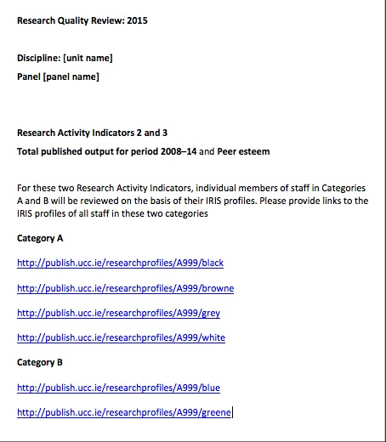
RAI 2 and 3: IRIS profiles
you may use the pro-forma template provided to include links to IRIS profiles for individual members of staff
it is important to ensure that all IRIS profiles are complete and up to date
please organise your return to include staff in Categories A and B

Slide 10
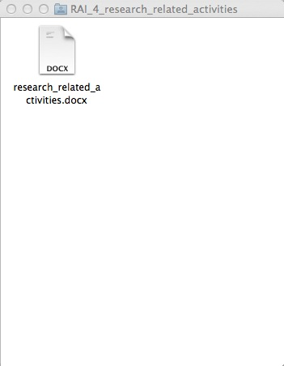
RAI 4: research activities
your research-related activities should be described in the relevant section of your overall Research statement
you will also be provided with a pro-forma template in the dedicated folder for this RAI
this file should be used to provide any supporting documentation for this RAI (subject to a maximum limit of twenty pages)

Slide 11
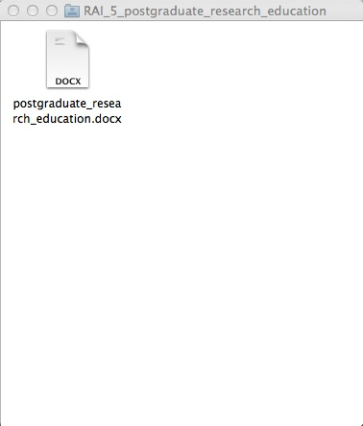
RAI 5: postgraduate
support of postgraduate education should also be described in the relevant section of your overall Research statement
here again, you will also be provided with a pro-forma template in the dedicated folder for this RAI
this file should be used to provide any supporting documentation for this RAI (subject to a maximum limit of twenty pages)

Slide 12
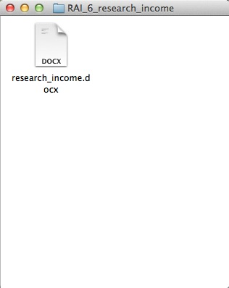
RAI 6: research income
separate guidance will be provided in due course on the preparation of data for this RAI
here again, you will also be provided with a pro-forma template in the dedicated folder for this RAI
this file should be used as advised n due course to document research income in the review period

Slide 13
a copy of the proposed master folder has been sent to all staff in an update email on the RQR on 29 September
the Steering Committee proposes that you make an early start on assembling the data, using the folders and templates provided
Panel Chairs, Vice-Chairs and External Reviewers will be provided with read-only access to the relevant discipline folders
you will receive advice in January 2015 on the procedure for uploading data to Google Drive

Slide 14
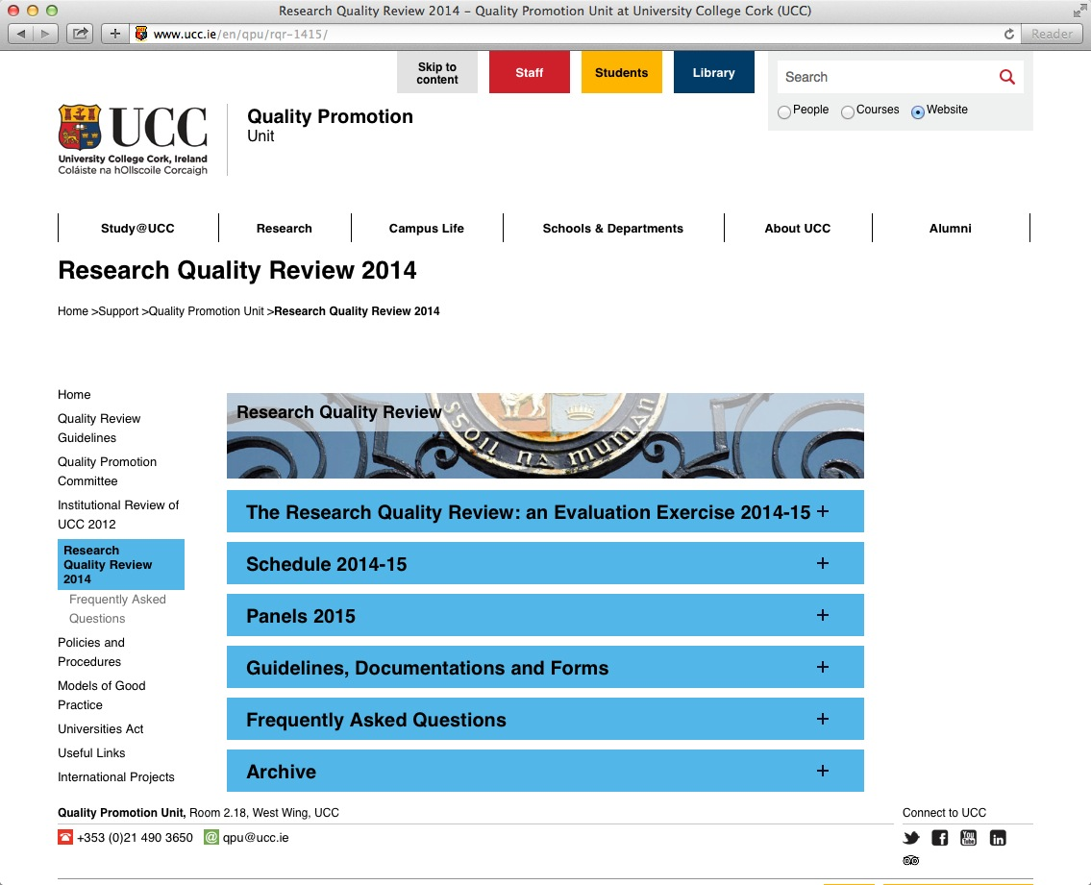
For further information, please visit the website of the Quality Promotion Unit:
http://www.ucc.ie/en/qpu/rqr-1415/

