Slide 1
Career Planning for Researchers Sourcing and Accessing non academic jobs
Mary McCarthy UCC Career Services

Slide 2
OVERVIEW – TOUCHPOINTS
10 Steps to employment
The PhD Professional -Where Am I now ? Skills for the 21st Century workplace
Finding a direction and sector that suits you
Non academic jobs for PhDs - 10 most common careers
Online Presence, Networking -Where to look – Where are jobs advertised- “unearthing jobs – the hidden market of jobs
-Preparing your personal Profile
Building connections and networks
Creating a Career Plan

Slide 3
Career Planning Things you can do now
..

Slide 4
You are in the driving seat
Step 1
Create the best CV possible – have it reviewed, change for each opportunity
You need one detailed generic CV
You will edit and TARGET for each application
Helpful Tools
https://www.ucc.ie/en/media/support/careers/CVGuideforPhDandPostdoctoralResearchers.pdf ( CV Guide)
CareerSet link

Slide 5
..
Step 2
Build Career Intelligence - Know Yourself , relevant organisations , Roles and professional work sectors
Know yourself
Review and reflect on interests, innate strengths/ attributes, skills and values
Research Organisations and Roles of interest-
Build Career Intelligence
Note the skillset/competencies and experiences required –
Note the close matches and the skills gaps
Helpful Resources
Hallowell Career Orientation
Scheins Career Anchors
Take Psychometric Profiling Assessments – Profiling for Success - https://www.ucc.ie/en/careers/areyouacurrentstudent/advice/profilingforsuccess/
Personality Types indicator ( 16 personalities) and Values

Slide 6
Step 4
Be inspired and informed by PhDs /PosDocs who have successfully transitioned to nonacademic careers who have gone before you
–Make connections and network –
Learn from others about their career journey ( conduct Informational Interviews)
Helpful resource
UCC Linkedin Alumni Networking Guide and apply to your search
Step 5
Create your PROFILE and BUILD A NETWORK
Make your self known to potential employers and professionals-
Develop your online presence –
Create, build and expand your network of contacts
Helpful resource
- LinkedIn Profiling workbook

Slide 7
..
Step 6
Be Aware of current growth sectors
Helpful resources
http://www.skillsireland.ie/
Labour Market trends links attached
Step 7
Be Interview Ready – Have an Elevator Speech prepared- Know your Competencies and Skills- Be Able to demonstrate them with STAR Technique
Helpful resource
Shortlistme
https://www.ucc.ie/en/careers/areyouacurrentstudent/applicationstoolkit/prepareforyourinterview/shortlistmetool/
Step 8
Contact Recruitment agencies ,register / job posts/ opportunities ,conduct weekly online jobs research . Identify organisations/companies of interest and relevance
Helpful resource

Slide 8
..
Step 9
Be adaptable and open minded- Embrace the Unexpected - Consider a nonlinear Career path to get started –Career development is a journey not a one -off job offer
Step 10
Add to your skills portfolio, acquire micro credentials through online short learning courses
Popular courses
Project Management, Data Analytics, Python………

Slide 9
CareerSet A useful Digital CV Review Tool Learn how to target your CV to specific reguirements
..

Slide 10
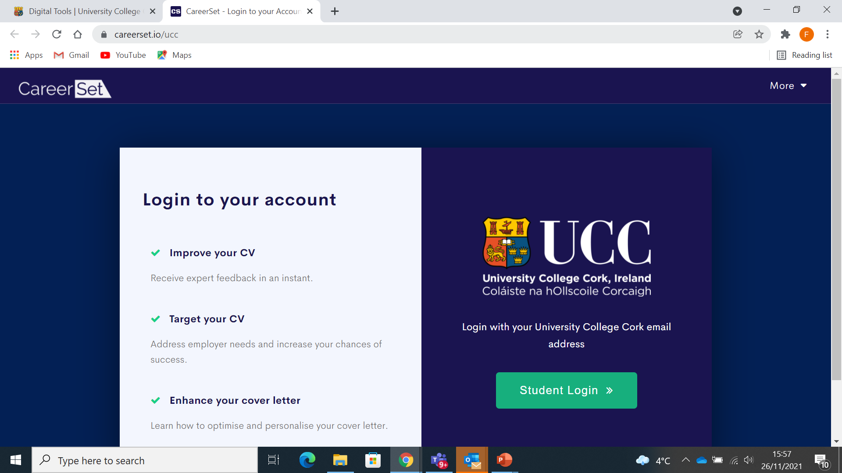

Slide 11
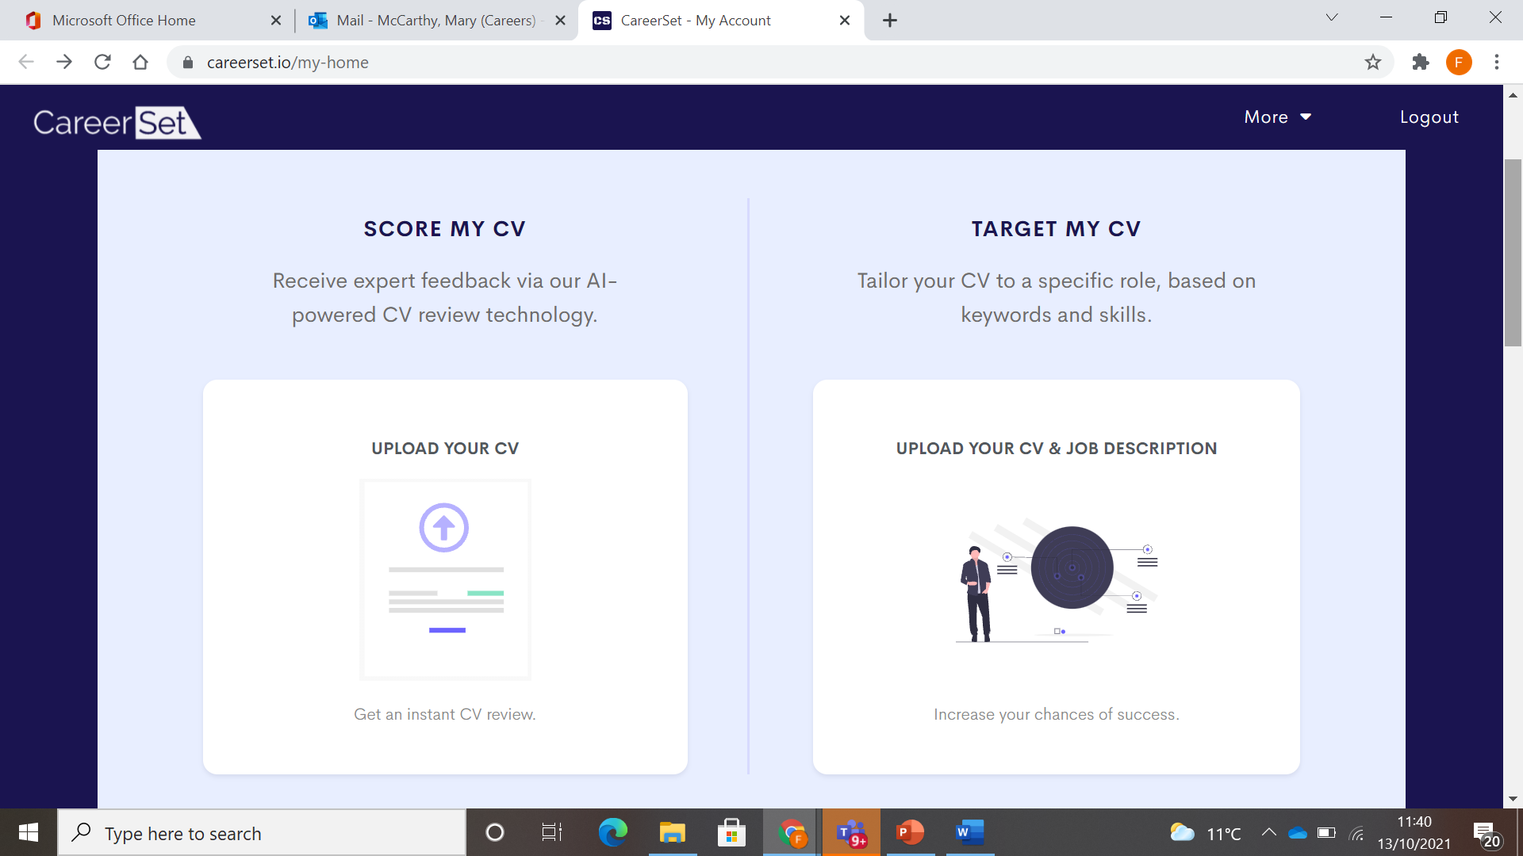

Slide 12
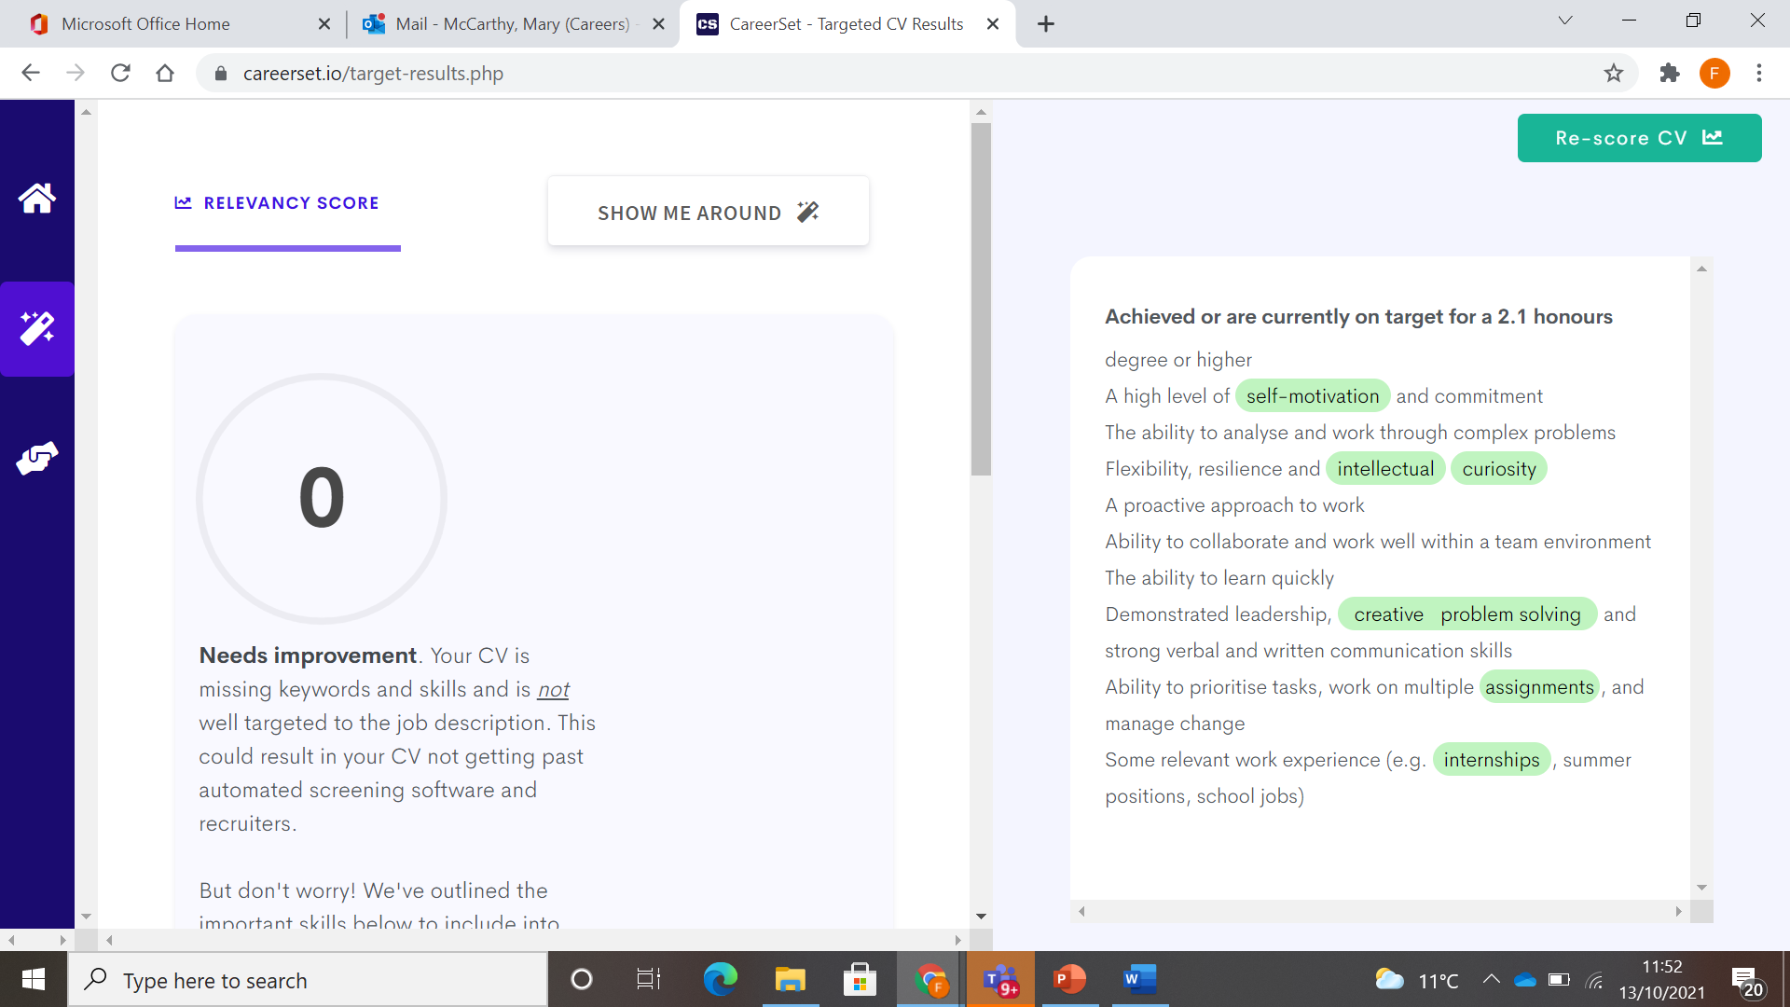

Slide 13
Adopt a Planned Happenstance Mindset A Powerful and effective method to build your Career
Planned Happenstance can be framed as this-
The ability to create chance events that turn into actual opportunities. It's a method that can help you capitalize on events that occur or that you can create to occur in your life.
4 core steps
Clarify ideas: Follow your curiosity and identify your interests
Remove perceived blocks: Wonder “how can I” rather than “I can’t because…”
Expect the unexpected: Be prepared for chance opportunities, such as unexpected phone calls, chance encounters, impromptu conversations and new experiences
Take action: Learn, develop skills, remain open and follow up on chance events
Notes:
Mary

Slide 14
The Role of Happenstance in careers
Curiosity invites you to explore learning opportunities
Persistence helps you to deal with obstacles/challenges
Flexibility equips you to adapt to changing circumstances and events
Optimism equips you to maximise benefits from unplanned events
Risk-taking permits you to be willing to step into new experiences and uncertainty

Slide 15
The PhD professional- What attracts employers ?
Core skills that PhDs bring to the workplace
Identify the top three
-
-
-
https://www.linkedin.com/pulse/9-skills-phds-have-others-dont-isaiah-hankel-ph-d-/

Slide 16
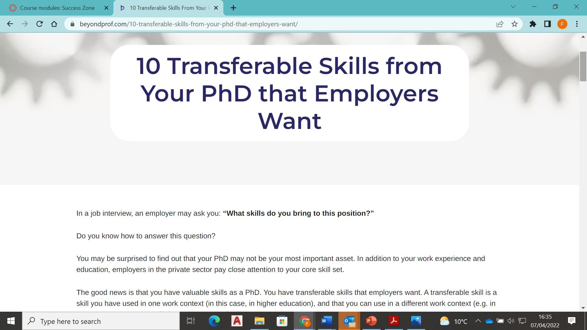
https://beyondprof.com/10-transferable-skills-from-your-phd-that-employers-want/

Slide 17
PhD Skills -Your Skillset
Written Communication
Years of practice writing papers, your thesis, conference abstracts, journal manuscripts, and of course your dissertation.
Research and Data Analysis *******
Research skills are valuable even in many fields outside of academia.
You are able to determine the best approach to a question, find relevant data, design a way to analyze it, understand a large amount of data, and then synthesize your findings. You even know how to use research to persuade others and defend your conclusions.
Communication - Presenting
PhDS get more public speaking opportunities than most. Through conference talks, poster presentations, and teaching, you will learn Ability to present complex information and ideas in accessible, understandable ways.
Project Management *************
A PhD is an exercise in project management. You to design a project, make a realistic timeline, overcome setbacks, and manage stakeholders. You also have to manage long-term projects at the same time as short-term goals

Slide 18
Skills gained from a PhD
Critical Thinking
You are mind is trained to approach problems systematically, see the links between ideas, evaluate arguments, and analyse information to come up with your own conclusions. Every sector and industry can benefit from someone who knows “how to think”.
Collaboration
Your Phd is your project-Post doc Research is collaborative you have to negotiate, work with others on a regular / day to day basis.
The ability and willingness to work effectively in teams, build positive relationships often across multiple disciplines is a premium requirement and asset across all sectors.

Slide 19
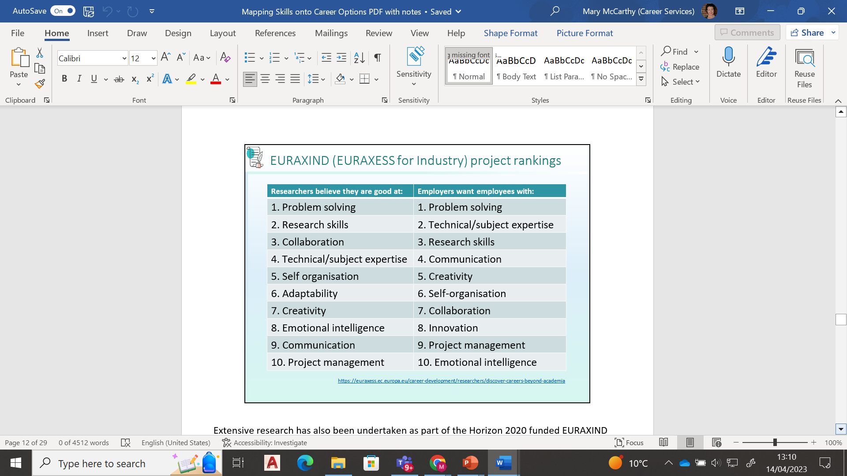

Slide 20
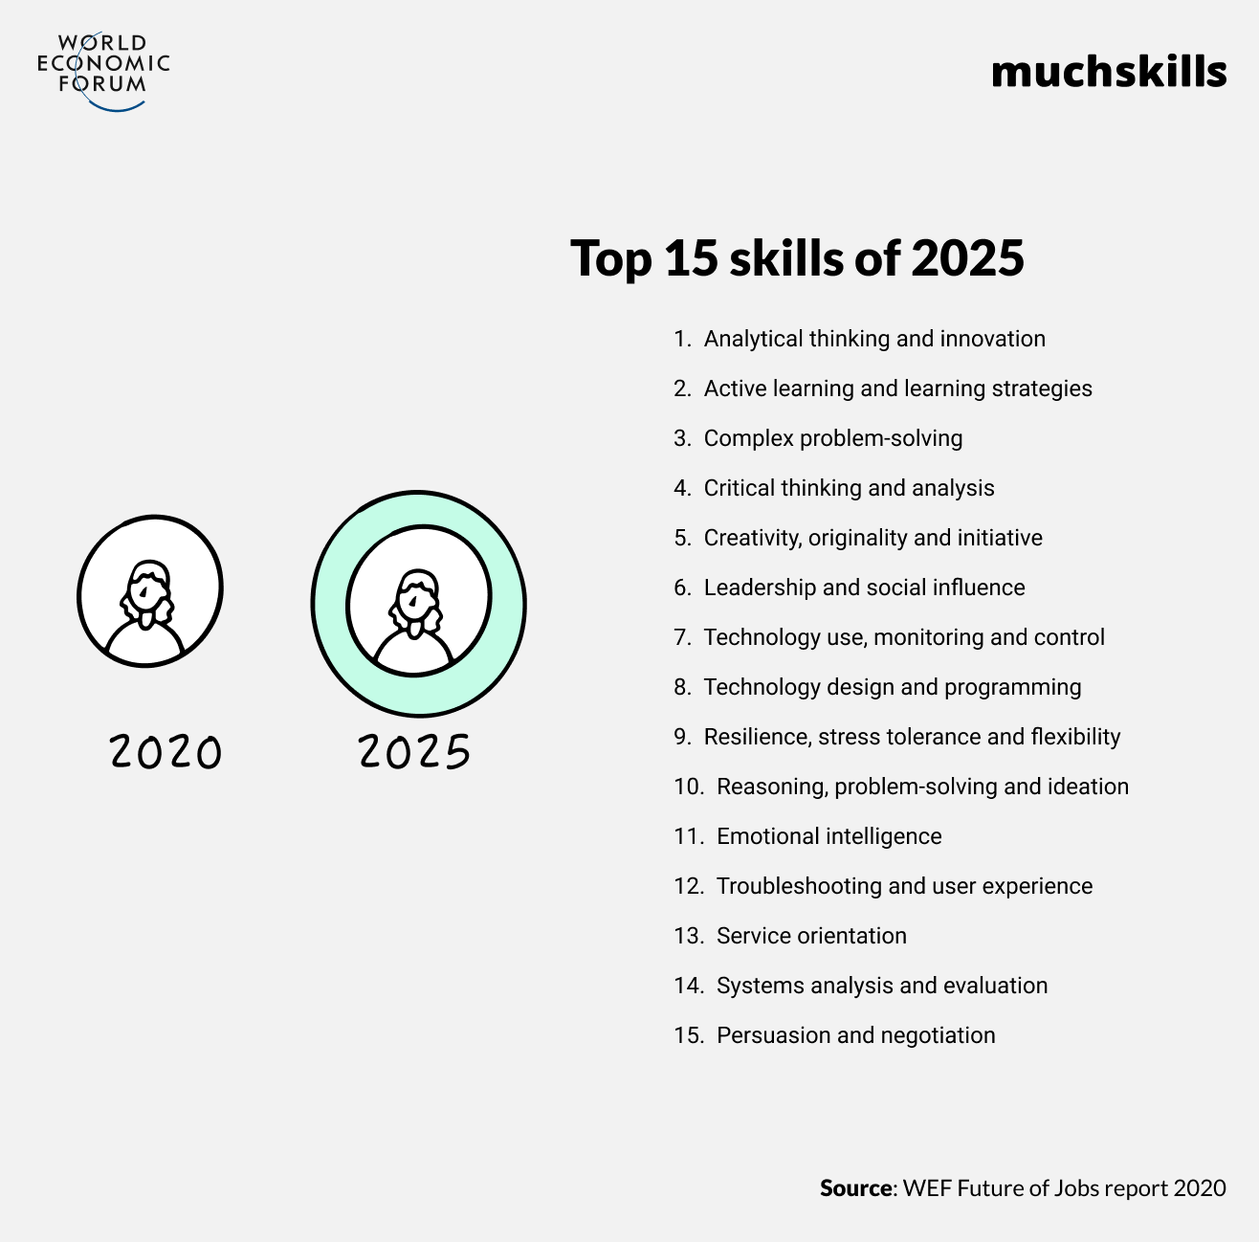

Slide 21
How Skills develop

Slide 22
Career Planning
Can you define your skills?
Can you define your strengths so that you could promote these to an employer?
Can you define your values (what’s important?)
Can you identify areas for your own personal and career development?
Tools -Skills Audit- SCOT ANALYSIS-

Slide 23
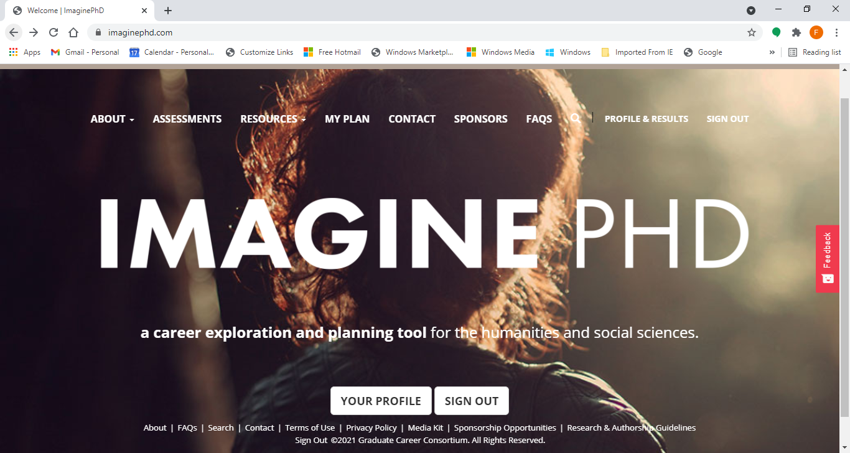

Slide 24
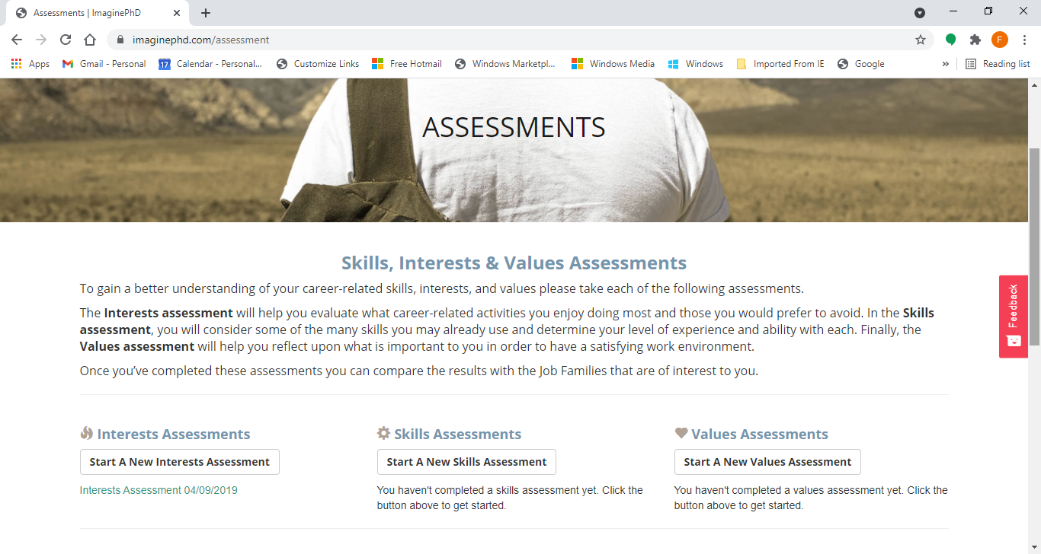

Slide 25
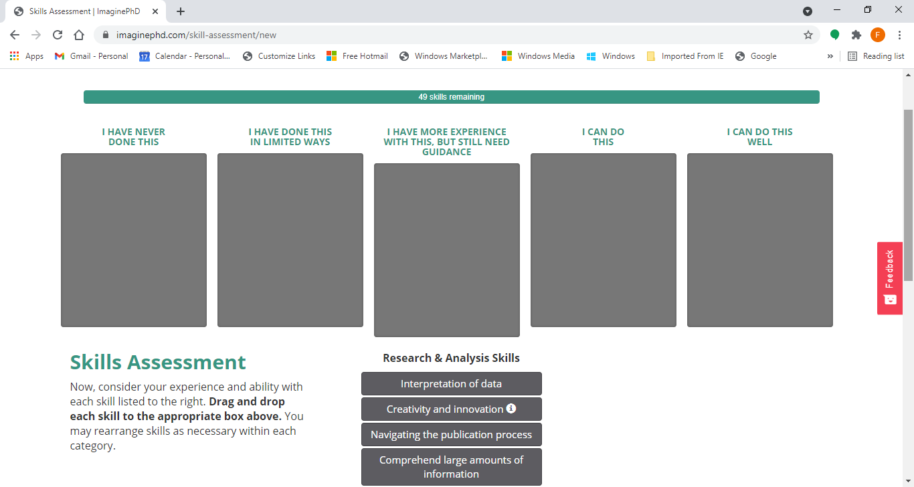

Slide 26
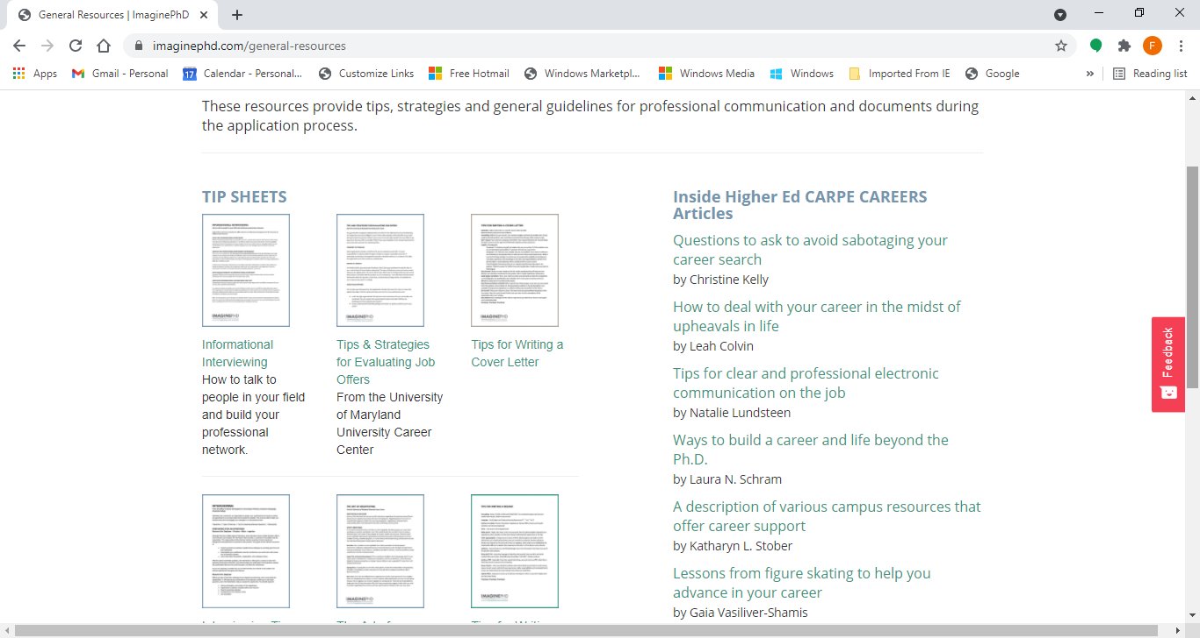

Slide 27
SCOT ANALYSIS
Strengths (Internal) What do I do well? What are the things that I am naturally good at doing? What Skills and knowledge have I developed from my academic experience? | Challenges (Internal) What am not happy with? What might stand in my way ? What can I improve on?
Opportunities (External Environment) Who can help me? What Information resources are helpful ? What can help me? | Threats and Obstacles (External Environment) Are there challenges/ obstacles ? How can I resolve to these?
Notes:
Take 7-8 minutes minutes to complete the SCOT Analysis in as much detail as possible

Slide 28
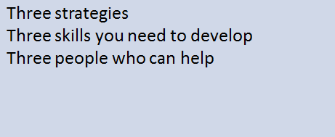
CAREER PLANNING involves…….

Slide 29
Brainstorm
Identify 5 priorities for you in a career
Identify your top 3 skills
3 minutes written exercise

Slide 30
Finding a direction and sector that suits you
Helpful things to consider
Helpful questions to ask when considering entirely new career sectors
What interests me ?
What do I regularly read and keep informed about ?
Are there sectors that link with personal interests ?
What are the growth sectors ?
How do they link to my skills?
Tools
Personality Types Indicator
Hallowell Job Fit ( attached)

Slide 31
Ascending Motto: Climb as high as you can Method: Gain promotion and advancement Desires: Money, status, responsibility, power Dreads: Getting stuck at a level below my potential Question: How quickly can I get there? | Growing Motto: Become a more rounded person Method: Take on roles that allow development Desires: Self actualisation, wisdom, competence Dreads: Staying the same person Question: How will this change me?
Securing Motto: Stay safe Method: Manage risks, hedge your bets Desires: Stability, employability, continuity Dreads: Losing my job, changing my lifestyle Question: How can I keep things going? | Relating Motto: Be somewhere you belong Method: Focus on nurturing important relationships Desires: Community, family, being valued Dreads: Being isolated, not fitting in, conflict Question: Who do I connect with?
Learning Motto: Follow your passion Method: Find opportunities to pursue your interests Desires: Education, subject focus, new ideas Dreads: Rehashing the same knowledge Question: How can I explore this topic further? | Exploring Motto: Keep trying new things Method: Always looking for intriguing new opportunities Desires: Variety, new challenges, the unexpected Dreads: Getting stuck repeating the same old actions Question: Where could this take me next?
Notes:
What types do you identify most with ? Select 4 that are the strongest influencers on your experience of Career

Slide 32
Choosing Motto: Be in control Method: Take charge whenever you can Desires: Autonomy, independence, decision making Dreads: Having to answer to someone else Question: How can I do it my way? | Auditioning Motto: My time will come Method: Get your talents noticed by someone Desires: Recognition, nurturing, reward Dreads: Being overlooked Question: Who will give me my big chance?
Investing Motto: It will be worth it in the end Method: Work hard to lay a foundation for the future Desires: Building resources, enabling the dream Dreads: Not making it by wasting time Question: What will it take to get there? | Fulfilling Motto: Live up to your promise Method: Accept challenging goals and push yourself Desires: Achievement, being worthy, fulfilling duty Dreads: Giving up on the mission Question: How can I achieve my purpose?
Defining Motto: What you do is who you are Method: Seek clearly defined roles Desires: Sense of identity, status, respect Dreads: Undermining or devaluing of role Question: What does it say about me? | Expressing Motto: Articulate your individuality Method: Pursue opportunities allowing self-expression Desires: Being creative, being oneself, being authentic Dreads: Having to conform Question: Can I be myself?

Slide 33
How are your thoughts influencing your career?
Select the 2 strongest Career approaches that influence your experience and approach to your Career.
Select the most influencing 2 career mottos and 2 desires.
Write them out.
How do your influencing career mottos and desires support your personal and professional career development ?
Do they impact it in a positive way ? Do they stand in your way ?
Do they need re-evaluation?
Take 5 minutes to reflect and write.

Slide 34
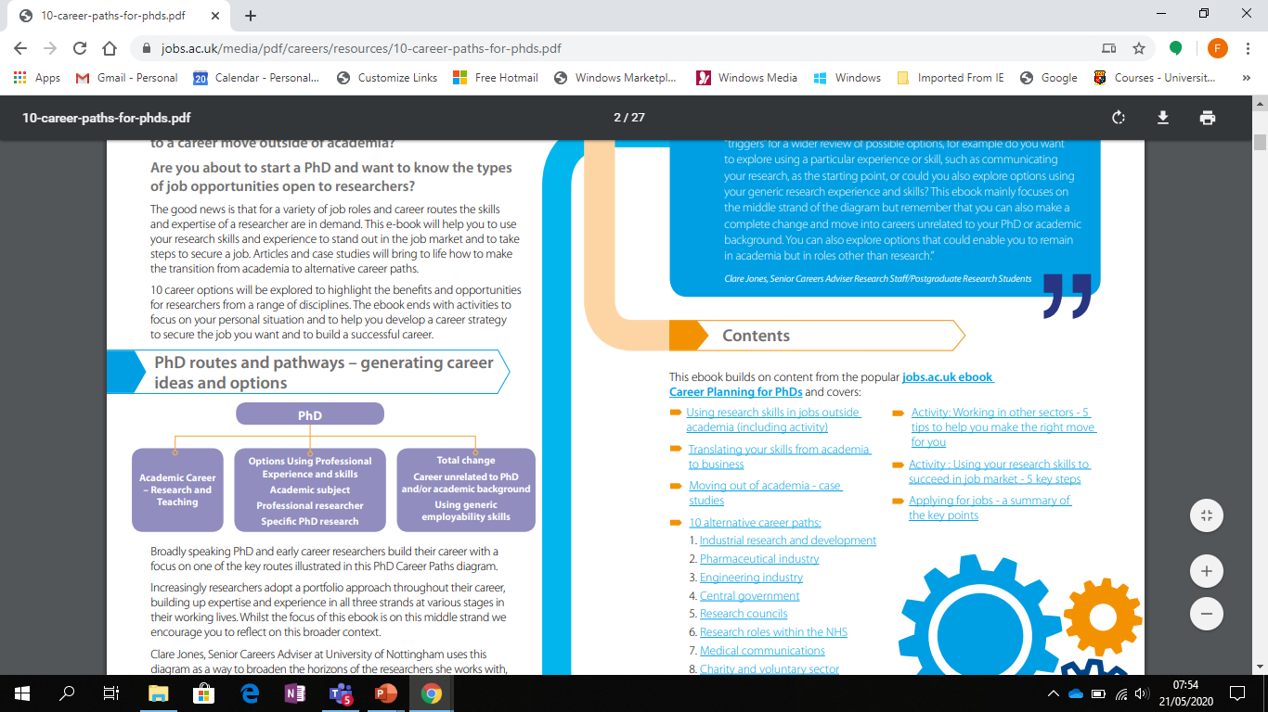
Non academic jobs for PhDs - 10 most common careers https://career-advice.jobs.ac.uk/phd-studentship/10-career-paths-for-phds/******** ( Useful Career Resource Guide )

Slide 35
Where do PhDs go?
HEA Graduate Outcomes Survey
CSO Higher Education Outcomes
https://www.cso.ie/en/csolatestnews/presspages/2018/highereducationoutcomes-graduatesof2010-2014/
http://hea.ie/assets/uploads/2019/02/HEA-Graduate-Outcomes-Survey.pdf

Slide 36
Two-thirds of PhD graduates find employment in Ireland (HEA Survey )
61% PhDs are in science, technology, engineering and maths (STEM) subjects, with a total of 61pc of all students studying STEM.
21% Natural sciences, mathematics and statistics (NMS) make up of all PhD students, while health and welfare make up
19% Engineering, construction and manufacturing (ECM) count for 14% ECM of all PhD students.
12% Social sciences, journalism, Arts and Humanities.
67% end up in employment in Ireland after their studies.

Slide 37
HEA Employment Survey
65% of PhD graduates work in non-market services: defined as ‘health services, civil and public services, education, and social services’.
40% of PhD graduates work in higher education
100%of all agriculture, forestry, fisheries and veterinary students end up in employment in Ireland
72% of NMS students are in employment,
21% of Arts and Humanities PhD graduates were on the hunt for a job.
STEM graduates 30% of Engineering Construction Management graduates and 28% of Natural Sciences Maths Statistics graduates are employed by manufacturing industries.
36% (ECM)and 37%(NMS) are employed in non-market services.

Slide 38
Non-Academic Career routes of PhDs in Ireland
National Policy /Public Sector Organisations *
ESRI
EPA
Public Jobs- Civil Service
-Enterprise Ireland
-Industrial Development Agency
-Inter trade Ireland
-Irish Research council
-Public procurement of Innovation
-Quality Standards Organization
-HIQA
Higher Education Administration
Consultancy *
Nonproﬁts- NGO
Financial and Business Advisory Services
Secondary School Teaching
Publishing
E Learning
Cultural and Historical Organisations
Start ups - enterprises

Slide 39
CSO Data- Career Destinations of PhDs in Ireland https://www.cso.ie/en/releasesandpublications/ep/p-cp10esil/p10esil/tl/

Slide 40
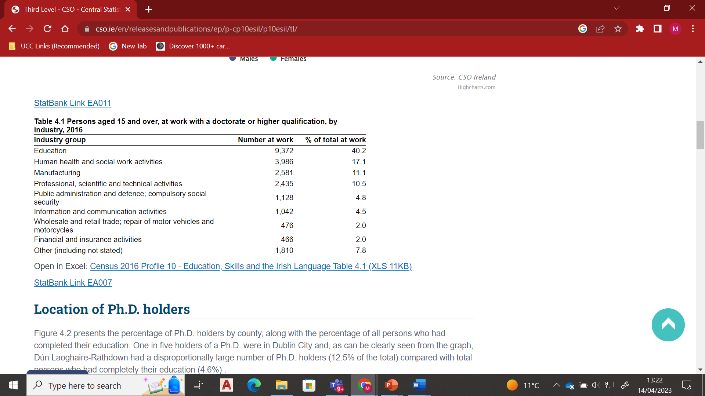

Slide 41
Growth areas
Big Data
Data security/ Cyber security
Finance- Financial Technology
ICT –Digital Technologies
AI
Life Sciences- Bio Pharma-Bio Tech
Sustainable Business practices/Sustainable production
Environmental protection/ conservation
Consultancy
Renewables
Supply Chain Logistics
https://www.bartrawealthadvisors.com/ireland-job-market-which-professional-sectors-are-in-high-demand/

Slide 42
Consulting at a glance -What they look for
Problem Solving and Analysis - Thinking/ Learning/Cognition
The nature of consulting projects is to solve a problem the client is facing- solution and strategy must be built on sound analysis
You demonstrate strong intellectual abilities to solve complex problems
Personal impact.
You demonstrate a track record of dedication and commitment to achieving high standards and outcomes in most projects you undertook in the past.
You have had a strong personal impact on most projects and group tasks you are part of.
Entrepreneurial drive.
This means you should have a track record of launching new initiatives. You are not satisfied with doing things the traditional way and like innovating.

Slide 43
What they look for
Emotional Intelligence ( An ability to build positive , sustainable relationships )
-Highly regarded in consulting for multiple reasons.
-The work is client facing and so being able to build strong working relationships is important, senior partners and directors need to be confident that you are ‘safe’ to put in front of a client.
-You will often work on small teams (3 or 4 people) and potentially work away with that team meaning you not only work together but socialise together.
Leadership potential and ability
This means you've shown you can influence / motivate and lead groups of people in the past either in a work /extracurricular context

Slide 44
Deloitte
People who are analytical, confident, self-aware, results orientated and want to develop leadership skills early in their career. We encourage applications from a wide range of disciplines including business, engineering, maths, science, law, technology and arts, amongst others. Our success consistently lies in the fact that we recruit people who look at complex issues through a different lens. Other requirements include:
Achieved or are currently on target for a 2.1 honours degree or higher
A high level of self-motivation and commitment
The ability to analyse and work through complex problems
Flexibility, resilience and intellectual curiosity
A proactive approach to work
Ability to collaborate and work well within a team environment
The ability to learn quickly
Demonstrated leadership, creative problem solving and strong verbal and written communication skills
Ability to prioritise tasks, work on multiple assignments, and manage change
Some relevant work experience (e.g. internships, summer positions, school jobs)

Slide 45
Accenture
We’re looking for people with intellectual curiosity and an entrepreneurial spirit, who can build relationships, lead others and who aren’t afraid to question the norm.
Set yourself apart by demonstrating the following skills and attributes:
Effective communication
Relationship building
Problem solving
Creativity
High learning agility
Adaptability
Taking initiative
Results-focused

Slide 46
McKinsey
We hire exceptional people from many different educational and professional backgrounds who are eager to learn and share their knowledge with others.
We look for people who excel at problem solving, show great potential for leadership and have a record of achievement at university, at work and in their personal lives.
Personal Impact
Working with clients on their toughest issues requires the involvement and support of many individuals. Interacting effectively with people, sometimes in challenging situations, is key to creating positive, enduring change.
Entrepreneurial Drive
Overcoming obstacles and achieving goals requires an innovative mindset, an openness to new approaches, and a continuous quest for learning and growth.

Slide 47
Consulting Careers –Everything you need to know
https://lincoln.ie/what-to-expect-from-consulting-in-ireland/
https://www.pwc.ie/services/consulting/strategy.html
https://www.cmc-global.org/content/institute-management-consultants-and-advisers-ireland
List of consulting firms in Dublin
https://www.consultingcase101.com/list-of-consulting-firms-in-dublin-ireland/
https://www.mckinsey.com/ie
https://www.linkedin.com/jobs/strategy-consulting-jobs/?originalSubdomain=ie
https://www.consultancy.uk/firms
https://www.insidecareers.co.uk/professions/management-consultancy/
https://www.consulting.com/types-of-consulting-careers
https://www.consulting.com/types-of-consulting-careers (6.5 min video)
https://info.lse.ac.uk/current-students/careers/resources/employment-sectors/consultancy

Slide 49
Buildyour “ Career Intelligence “ research the amazing world of work, sectors , jobs and possibilities – Be Inspired
Recovering Academic https://podcasts.apple.com/ie/podcast/recovering-academic/id1146802786 Beyond the Lab https://podcasts.apple.com/ie/podcast/vanderbilt-beyond-the-lab-podcast/id1329787147 PhD in Progress Your Education Your Life Your Career https://podcasts.apple.com/ie/podcast/phd-in-progress-podcast-education-career-life/id858594298 The Career Farm - Grow your own Career https://podcasts.apple.com/ie/podcast/the-career-farm-grow-your-own-career-with-jane-barrett/id929948746
10 Good Minutes Career Advice from Young professionals
https://podcasts.apple.com/ie/podcast/10gm-career-advice/id297143488 Squiggly Careers https://podcasts.apple.com/ie/podcast/squiggly-careers/id1202842065
Career Decisions https://podcasts.apple.com/ie/podcast/career-decisions/id1484099776 PhD Career Stories https://podcasts.apple.com/ie/podcast/phd-career-stories/id1150156933 Cheeky Scientist Radio https://podcasts.apple.com/ie/podcast/cheeky-scientist-radio/id1183346190

Slide 50
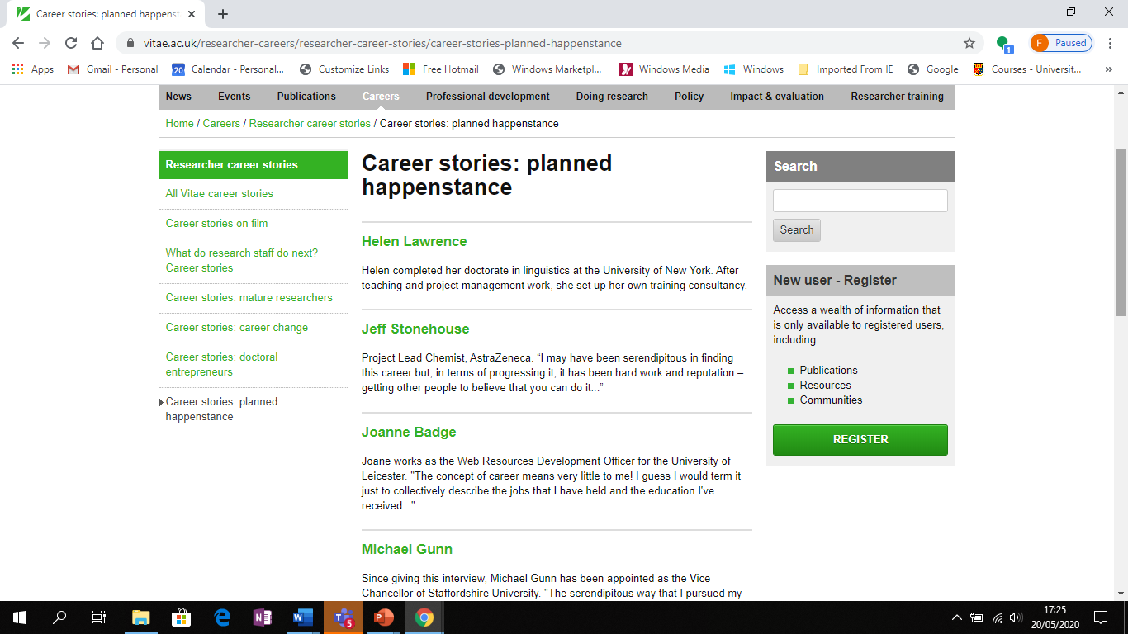
PhD Career Stories
https://www.vitae.ac.uk/researcher-careers/researcher-career-stories/career-stories-planned-happenstance

Slide 51
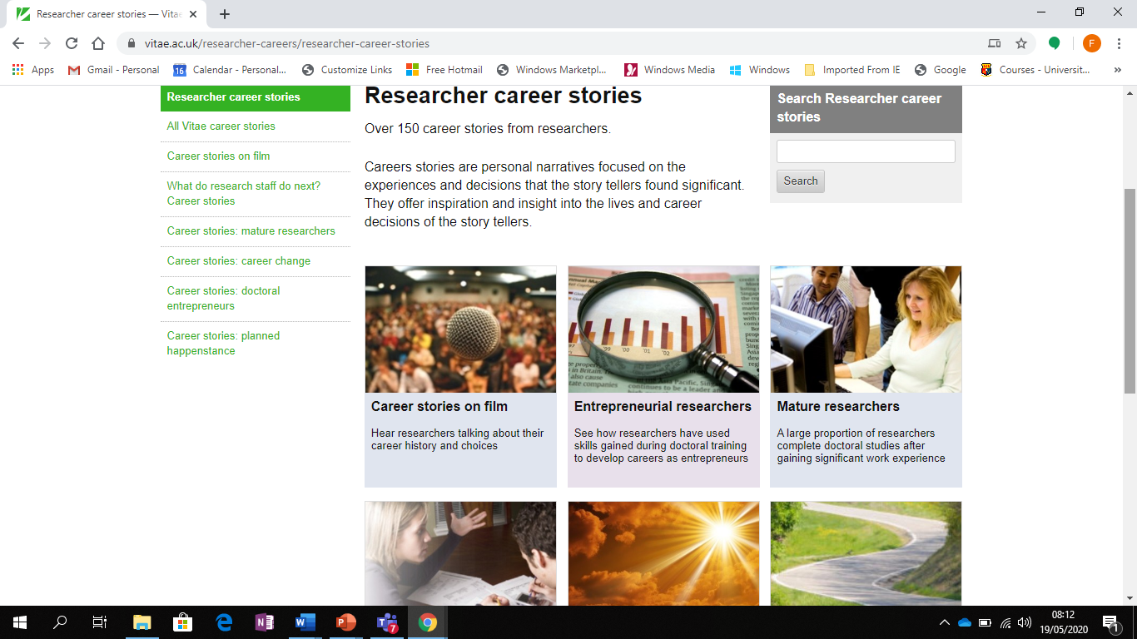

Slide 52
https://gradireland.com/gradstories/research

Slide 53
https://www.findaphd.com/guides/phd-non-academic-careers

Slide 54
Where to look – Where are jobs advertised- “unearthing jobs – the hidden market of jobs
LinkedIn ********
Recruitment Agencies
Referrals
Networking

Slide 55
Creative Job Searching
Creative Job Searching is systematic approach to finding a job
It’s a pro-active approach rather than a re-active approach
Incorporating elements :
Researching information on: occupations/employers/job opportunities
Developing a network of contacts, through work shadowing, volunteering, work experience, networking events, employer engagement events etc.
Maximising your online profile to encourage recruiters and employers to recruit you.
Making focused speculative applications to employers to Access the “Hidden Jobs Market”
Notes:
Reactive – applying for advertised jobs
Proactive – can complimete reactive job searching
Research is important.
Networking helps you access people and opportunities – work shadowing/volunteering etct.
Maximising your online profie – your brand you are putting out there. How you can attract recruiters as well you using it to network
Speculative jobs market.
Things being suggested are some ways to supplement that you can chose from – decide whats right for you. What can I time for. Its up to you to make a plan.
They are just suggestions at this point. No expectation do them all and possible a way to start an action plan.

Slide 56
“Hidden Jobs Market”
Research shows that up to 70% of jobs are not advertised
Why?
Costs money
Attracts too many applications
CVs on file already
Open Jobs Market
Hidden Jobs Market
Notes:
56
The 'Iceberg' Principle illustrates the hidden job market. The proportions will alter depending on the sector but advertised vacancies make up a small proportion of opportunities and the boundaries of the hidden job market are indefinite:
Proportions of the triangle will vary depending on the sector

Slide 57
What is Networking?
Networking
Networking is the development of mutually beneficial relationships... before you need them!
Notes:
Before you need them part is really important. Before you start recruitment process
Understanding the nature of the business/sector/lingo

Slide 58
3 Elements of Networking
Strategic:
WHO needs to be in my network?
Tactical:
HOW will I integrate the right people?
Online:
HOW can I network online?
Notes:
Strategic – you don’t want to connect with everyone – target who you want to engage with. Use your time wisely. Who is most important
Tactical – How will you do it.

Slide 59
Strategic Networking (Who)
Who needs to be in your network?
What does your Networking look like now?
How would you like your Network to Look?
Notes:
Who do you need to add to your network. Like anything, its about planning.
Join some online organisations and target those who are relevant and make sense to you. Job relevant contacts – see next slide

Slide 60
Networking Building Relationships with Potential job relevant contacts
Who are Job Relevant Connections?
Referees
Company Representatives
Alumni working in target sectors /roles
Professionals in your field
Recruitment Consultants
Peers, Friends, Family, Colleagues
Notes:
Makes notes of events
Connect with them with a nice note
Connect with people who are past alumni that you would like to aspire to. Get advice and tips how to secure a role.
Professionals in your field – Build your connections, just like other social media, you will get visibility to news in that area and there is opportunity for you to contribute.

Slide 61
Networking Tactics
Join groups and networks both online and offline
Join or Engage with relevant professional industry and business networks
Attend events, participate and be visible
Interview people in careers of interest
Research and send speculative applications
Create a positive relevant online presence
At events:
Research the speakers and list of attendees
Prepare an Elevator Pitch (90 second introduction)
Prepare questions to ask
Connect online after the event
Notes:
Education, experience, unique selling points, where you want to go. Needs to be rehearsed. What are you pitching.

Slide 62
Networking Tactics
Begin Conducting Regular Informational Interviews
An informational interview involves talking with people who are currently working in an organisation or career of interest to gain a better understanding of an role or industry — and to build a network of contacts.

Slide 63
Advantages of Informational Interviews
A new professional relationship in a career area of interest
Information on roles and careers you didn’t know existed
An opportunity to meet people who may forward you job leads in the future
First hand relevant information about working in a particular industry, field or profession
The culture and atmosphere in an organisation
Tips and insider knowledge on how to prepare and land your first career position

Slide 64
Tactical Networking Checklist 1
Name of Top 50 Target Connection | When will you contact them? | By which method? | What mutual contact will help open the door?
1. Name/Title
2. Name/Title
3. Name/Title
4. Name/Title
5. Name/Title

Slide 65
Tactical Networking Checklist 2
Professional and Industry Networks or Societies or Associations | Professional and Industry Events | Voluntary Roles in Charities, Clubs or Professional Societies | Professional Working in Your Dream Role, Company or Sector
Name 3 networks you will join: 1. 2. 3. | Name 3 events you will attend: 1. 2. 3. | Name 3 voluntary roles you will apply for: 1. 2. 3. | Name 3 people that you will contact for an informational interview: 1. 2. 3.

Slide 66
Optimise Your Online Networking
Develop your profile – essential before you start networking
Understand the platforms – the audience, tone, etiquette of
Grow your connections – your access to other connections depends on this.
Join an online community/group – great way to interact with people in a specialist area.
Notes:
VO: How do you make the most of your online networking and really optimise your efforts? We’ve already mentioned the importance of developing your profile.
It’s also important to really get to know and understand the different social media platforms, their audience, their purpose and the etiquette required for the tone of the platform. While Instagram is for more creative expression and a unique insight into what motivates you, LinkedIn is a very professional platform, so the tone in what you post or comment on is quite different.
Once you have developed your profile it’s important to start growing your connections, particularly for LinkedIn this is essential. What you can see in your news feed and the profiles that are visible to you depend on your number of connections.
There is also great value in joining online communities and groups. You can find dedicated websites for special interest groups or on social media websites like Facebook and LinkedIn. Many of these communities offer things like forums, podcasts or even offline events. Once you’ve been accepted in a group become a valuable member. Don’t simply read what’s going on, you need to get involved with the discussion.

Slide 67
Optimise Your Online Networking contd.
Be active - comment, like, interact and contribute.
It’s not all one-way - give more than you receive, share an article.
Be professional – you’re not interacting with your friends on Facebook, it’s professional interaction not personal.
Notes:
VO: How else can you optimise your online networking?
It’s really important to be active on these platforms, you need to comment on posts and share articles, interact with people and where possible contribute to the discussion.
It’s not all one way, it’s important to offer something of value, such as a link to a relevant article, likes on a post, don’t just ask for recommendations or information. The general rule with online networking is to give more than you receive.
It’s also really important to be professional and polite when you are interacting online, don’t use slang or text writing, use professional communication. Don’t make the mistake of interacting how you would on Facebook on LinkedIn, FB is for more personal interactions, birthdays, family photos etc. LinkedIn is more professional.

Slide 68
Research & Networking Using LinkedIn
Research an industry or a particular company
Get career advice from experienced professionals in the industry, possible mentorship opportunities
Talk to recently employed graduates in an industry or specific company
Get advice from students who graduated with your degree
Get advice from a graduate who found a job during a challenging job market
Notes:
You can use LinkedIn to;
network and research an industry area, to find out about job opportunities, what types of roles are available in an organisation, who do they hire etc. maybe you hadn't been targeting this industry previously but you're now broadening your job search.
Get career advice from experienced professionals in the industry which may lead to mentorship opportunities.
You might want to research a particular company, you’ve heard that they are doing well, expanding, hiring or their in an industry that is stable and you want to find out more.
Maybe you want to get advice from students who graduated with your degree, how did they get into their first graduate job, what worked for them, do they know of any opportunities coming up, are there any specific recruitment agencies that their company works with, what was the interview process like for them, do they have any insight into what the company is really looking for in a graduate, any interview tips.
You might want to get advice from a graduate who found a job during a challenging job market
Get advice and feedback on specific masters and postgraduate programmes, that you are considering. Would graduates who completed them, recommend them. Are there other masters they would recommend instead for their industry area.

Slide 69
Demo – LinkedIn Alumni Tool

Slide 70
Optimise Your LinkedIn Profile – for Recruiters
Photo, background banner, headline
Open to work – photo filter and recruiter section
Summary/About section – keywords
Look at others in the industry
Connect
Engage
Publish
Perfect your profile

Slide 71
Your online professional presence
Keep your LinkedIn /Twitter Profile active
Respond to/ Share posts
Check in regularly
It reflects professional energy, enthusiasm, active interest
Notes:
Share LinkedIn profiling worksheet on screen and make available by email

Slide 72
Tips for Job Searching
Share links with what you read concerning your industry or profession
Comment on the current affairs or hot topics of your industry or profession
Re-tweet either of the above from people that you follow
Let the world know if you are attending a professional event…and share the link!
Reach out to your industry peers, potential mentors, and thought leaders…you will be surprised how easy it is to communicate with and potentially develop relationships with people that you’ve never met on Twitter
Search for hash tags and keywords relevant to your chosen career area, read up and share as much content as you can. Basically, if you want a career in a certain field, you'll need to prove that you know your stuff and that you're constantly learning.
Once you have identified some key people, Twitter makes it easy for you to find more people to follow. Click on the “who to follow” tab and you will get a list of people and institutions followed by the people you already follow.

Slide 73
Tips for Job Searching
Desperate to work for a certain company? Follow them on Twitter. Many companies use Twitter as a first port of call to advertise their vacancies.
Use that Twitter bio to sell yourself. That little space should be your sales pitch, and its often the deciding factor for whether people will follow you or not. Give them a reason to follow you.
Communicate! Chat to other people, use it as a networking tool and share other peoples content. You never know what opportunities you could pick up from these new contacts.
Got a blog or website? Tweet your latest posts (2-3 times a day to catch different time zones). Your followers can then easily access your About Me and Hire Me pages.
Don't over share. Twitter is social, but a potential employer can see what you're saying, and many employers now do a social media search before inviting candidates to interview. Try to keep your hangover/relationship/bored statuses to Facebook when possible.
Try a Twitter job search engine, like TwitJobSearch.com, which can help you find the latest jobs that agencies and employers have tweeted about.

Slide 74
Online Networking: Panopto Presentation
https://ucc.cloud.panopto.eu/Panopto/Pages/Viewer.aspx?id=1688badf-ee62-462e-90c0-ac7f01290104
Guide to the LinkedIn
Alumni Tool
https://www.ucc.ie/en/media/support/careers/UCCAlumniLinkedinforCareerResearch(1).pdf

Slide 75
Perfect Your LinkedIn Profile: Panopto Presentation
https://ucc.cloud.panopto.eu/Panopto/Pages/Viewer.aspx?id=8c6f69c6-b2c0-415d-a36a-ac5c01386dc6

Slide 76
PhD Jobs - a week in the life at a glance
LinkedIn -63 listed jobs for Phds (Ireland
963 Europe
Indeed- 54 PhD roles
Jobs.ie
CareerJet – 58 jobs

Slide 77
..
https://www.universityvacancies.com/
https://www.nijobs.com/Phd-Jobs
https://www.publicjobs.ie/en/graduate-opportunities
https://www.irishjobs.ie/
https://ie.indeed.com/PhD-Ireland-
https://www.careerjet.ie/phd-graduate-jobs.html

Slide 78
LinkedIn Groups
Each Group has:
Members – i.e. potential contacts for YOU
Discussion Board
Promotions
Job Vacancies
Contribute to Discussions – be SEEN online by industry players
Ask for advice

Slide 79
The Art of Action Thinking
How can I be more responsive and seize opportunities ?
What can I do to be more proactive and move forward ?
Are they're novel ways of creating my own career path /opportunities ?
How am I going to continue to learn, network and develop new skills
How will I stay responsive to changing needs ?
Notes:
End with this slide

Slide 80
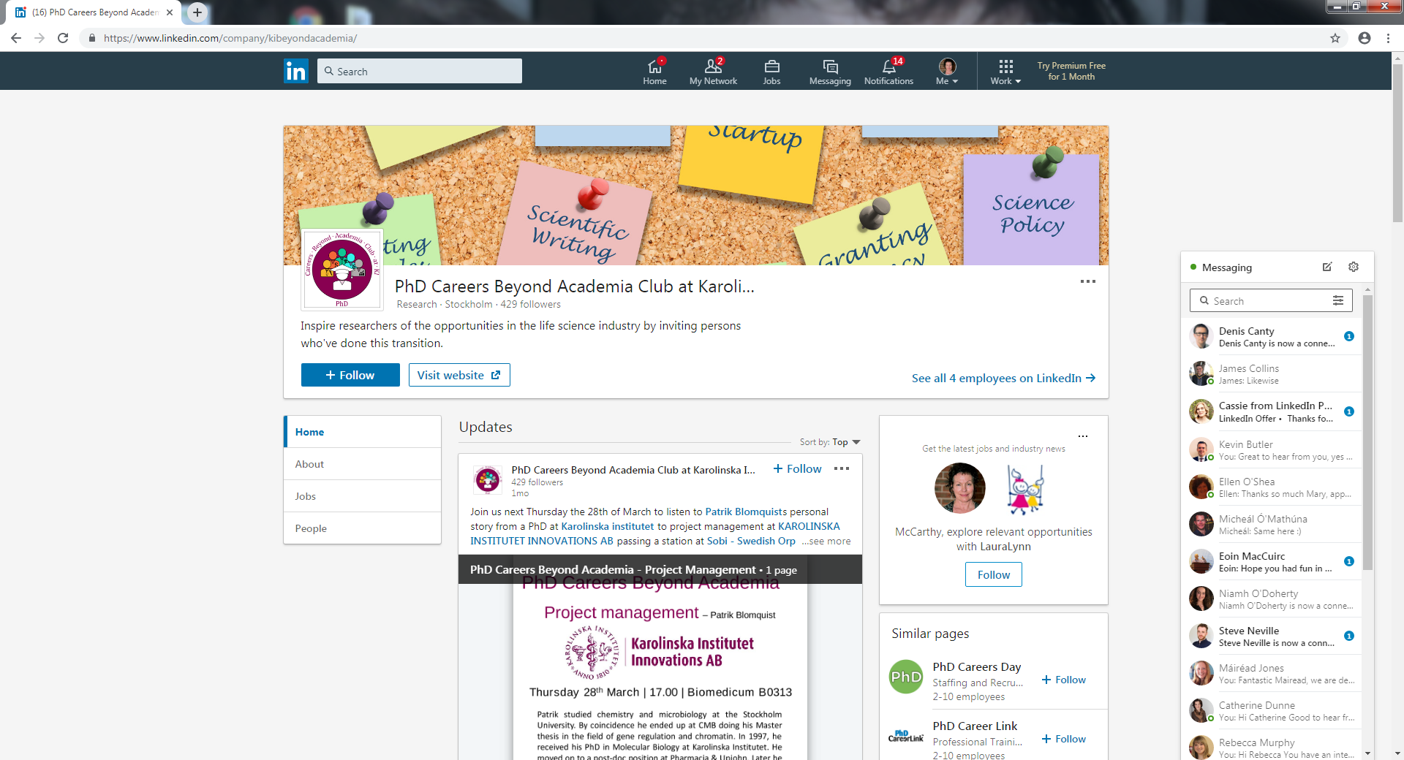

Slide 81
Useful follow up resources
PhD Careers outside of Academia
https://www.jobs.ac.uk/media/pdf/ca
https://www.jobs.ac.uk/media/pdf/careers/resources/10-career-paths-for-phds.pdf
https://career-advice.jobs.ac.uk/resources/jobs-ac-uk-live-qa-alternative-career-pathways-after-your-phd
https://www.findaphd.com/advice/doing/phd-non-academic-careers.aspx
https://www.linkedin.com/pulse/most-direct-path-huge-job-offers-3-foundations-phds-hankel-ph-d-/
https://www.linkedin.com/company/kibeyondacademia/
https://academicpositions.com/career-advice/the-7-essential-transferable-skills-all-phds-have
https://www.themuse.com/advice/3-things-phd-need-to-know-get-job-outside-academia ***
https://www.enago.com/academy/you-have-a-phd-what-next/

Slide 82
Useful follow up resources
https://versatilephd.com/phd-career-finder/
https://www.imaginephd.com/
https://www.insidehighered.com/blogs/gradhacker/exploring-alternative-academic-careers
https://www.vitae.ac.uk/researcher-careers/researcher-career-stories
https://www.academictransfer.com/en/blog/six-career-paths-for-phd-graduates/

Slide 83
Podcasts
https://beyondprof.com/podcast/

Slide 84
