Slide 1
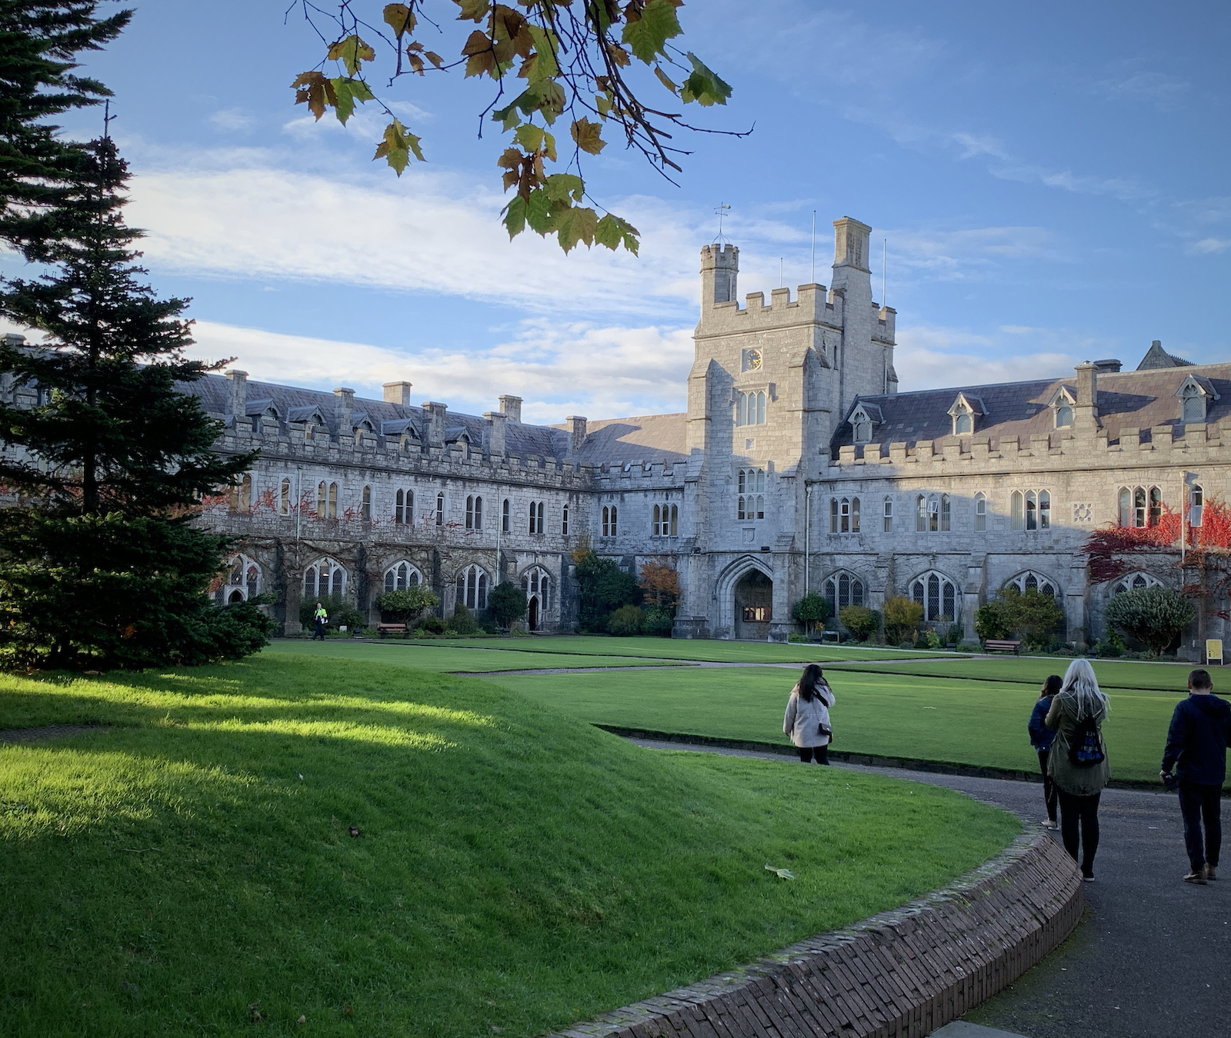
Progression Across the Merit Bar Briefing
Prof Stephen Byrne
Deputy President & Registrar
Angela O’Donovan
Manager HR Strategy & OD 10th/ 13th/ 19th May 2022

Slide 2
UCC 2022 Actions relating to Academic Progression
UCC 2022 - Delivering a Connected University
Pillar 4 Actions:
4.1.1 Conduct a rapid review of the architecture of the existing promotions schemes to ensure that they are aligned appropriately with UCC’s strategic goals and priorities, linked to performance. Streamline the processes for applicants and panel members alike.
4.1.2: Develop a clear regular timetable for a new promotions system based on both competitive and threshold progression, for staff who demonstrate sustained excellence.
4.1.3: UCC will establish a timeline and budgetary provision for a progression across the Bar programme.
4.1.4: In tandem with promotional opportunities, we will review and implement provision of academic titles in line with national and international best practice.

Slide 3
The Revised Progression Across the Merit Bar Scheme: Key Changes
Consistency in approach across progression & promotion schemes;
Streamlined processes;
Clearer and more appropriate criteria, structured in a manner that aids the candidate in evidencing and the Board in marking;
Introduction of the 2 stage application process across the three schemes (Stage 1 – Expression of Interest Stage and Stage 2 Full Application Stage);
Devolution of Stage 1 of the schemes to Colleges;
Incorporation of disciplinary norms via College input into the process;
Removal of references
Enhanced College participation in PAMB & promotion decision making inclusive of nomination of external reviewers;
Consideration of Statutory Leave, Personal Circumstance/ COVID impact;
Enhanced Feedback process.

Slide 4
PAMB – A Two Stage Process

Slide 5
PAMB Boards
College Level Board Stage 1 Expression of Interest
Head of College
School Heads
Research & Innovation representative from the College*
Learning & Teaching representative from the College*
LPEB member in attendance
Gender an Quorum requirements
Additional – None College Applicant/ UMT Representative provision
*if none available R&I and L&T offices nomination.
University Board Stage 2 Full Application
Lecturer Progression & Establishment Board (LPEB)
Chaired by the Deputy President and Registrar
Gender an Quorum requirements

Slide 6
Eligibility Criteria
As at the closing date for applications in a given call:
- All Lecturers at or above the Qualifying Point (in this call this is the top five points) in the salary scale for
Lecturer, holding a current appointment at UCC;
- Doctorate from a recognised institution (or equivalent evidence of high-level research achievement);
- Completed probation in post at UCC;
- Have at least three years continuous service as a Lecturer, two of which are in UCC.

Slide 7
Paperwork

Slide 8
Assessment Criteria Criteria Areas and Sub-categories at Stage 2

Slide 9
Evidencing Criteria
When making an application for PAMB Applicants should supply supporting evidence demonstrating their level of achievement across the range of areas set out in the PAMB Policy.
Applicants need to present a prima facie case for progression.
To establish a prima facie case for progression. Candidates must satisfy all of the essential criteria as set out in Appendix 1 of the Policy. For Stage 2, in addition to the essential criteria, evidence consistent performance in the criteria outside of the essential criteria.
It is recognised, however, that not all the activities and responsibilities in each section listed will be fulfilled by every applicant. Applicants should therefore articulate, supported by appropriate evidence, where they consider their major and minor contributions lie in each of the three Criteria Categories set out in the application.
In order to progress across the Merit Bar, successful candidates will be expected to achieve at least a ‘good’ level of performance under all three criteria categories: Learning and Teaching, Research and Innovation, and Contribution to Academic Citizenship and Engagement.

Slide 10
Terminology
Exemplary - A candidate shows contributions and achievements of outstanding quality and breadth across all criteria in a sustained and regular manner.
Good - A candidate shows regular contributions and achievements of good quality and breadth by satisfying all essential criteria and evidencing consistent performance in the criteria outside those listed as essential criteria.
Developing - A candidate satisfies all of the essential criteria but does not demonstrate a sustained or regular achievement in the criteria outside the listed essential criteria . Some evidence of consistent achievement reflective of a growing or emerging profile of achievement.
Premature Application - A candidate who does not satisfy all of the essential criteria at Stage One or who does not demonstrate evidence of achievement and/ or a consistency of achievement in criteria outside the essential criteria at Stage Two.

Slide 11
Statutory Leave
In this Scheme, “Statutory Leave” refers to maternity leave, paternity leave, parental or adoption leave, carer’s leave and/or any other protected leave which may be provided for in legislation enacted by the State from time to time.
In assessing a candidate’s merit relative to their opportunity to accrue that merit at shortlisting stage, consideration shall be given to the impact of Statutory Leave when assessing those essential criteria listed in Appendix 1 which are denoted with an asterisk *.
At full application stage, the impact of Statutory Leave will be considered when determining an appropriate level attained (Exemplary, Good, Developing, Premature Application) under those criteria listed in Appendix 2 which are denoted with an asterisk *.

Slide 13
Supporting Guidelines

Slide 14
Feedback At Stage 1 and Stage 2
Unsuccessful applicants at Stage 1 receive written feedback from the College Level Board with the option of requesting an in-person feedback session with their:
Head of College as Chair of the College Level Board and
Head of School.
Unsuccessful applicants at Stage 2 have the option to avail of an in person feedback session.
Requests for in person feedback (Stage 2) shall be submitted to the Secretary of the LPEB within 20 business days of results of the outcome of the candidate’s full application being notified to the candidate.
Deputy President and Registrar (Chair of the LPEB for the purposes of assessing applications under this Policy),
their Head of College and
their Head of School.

Slide 15
Making an Application
The closing date for Stage 1 applications is 14th June, 2022 at 12 noon. This is a strict cut-off – ensure you leave time to navigate the system.
Please note if you ‘submit’ you cannot ‘un-submit’
Please note that the Policy and relevant paperwork for Progression Across the Merit Bar can be located at https://my.corehr.com/pls/coreportal_uccp/ or https://www.ucc.ie/en/hr/progression/
Applications for both stages will be made via Employee Self Service (ESS).
Please note there is a separate application per College on ESS. Please ensure you apply for the relevant College. Where you have a joint appointment across the Colleges, please make contact so it can be clarified which College you will apply under.
Applications for accelerated progression are not permissible under this call.

Slide 16
Projected Timelines
Stage 1
College Level Board Shortlisting meeting
Notification of unsuccessful applicants
Notification of shortlisted applicants
Stage 2
Meeting of Lecturer Progression & Establishment Board
Notification of Outcomes
Deadline for submitting an application (via ESS to your College Level Board) is the 14th June 2022
Summer 2022
Notification from shortlisting & supply of feedback. There is no appeal at the Expression of Interest/Shortlisting stage.
Issuing of invitation to apply to Stage 2 – Full Application – Autumn
Deadline for submitting a Stage 2 application (via ESS to the LPEB) - TBC at time of notification but at least 2 months (as per Policy) from notification of invitation to apply to Stage 2.
Meeting to consider applications submitted to Stage 2.
Formal notification of successful applicants following approval by the President and supply of written feedback including their overall rating across the three broad criteria areas assessed.
A Progression takes effect from the first day of the next month, following the approval of the President.

Slide 17
Projected Schedule of PAMB/ Academic Promotions

