Slide 1
Private Enforcement of EU Environmental Law
Fred Logue – FP Logue Solicitors
Matt Witt CC BY-SA 3.0

Slide 3
Outline of talk
Basic principles of EU law
Direct effect
Primacy
Procedural autonomy
Equivalence/Effectiveness
Fundamental rights
Environmental Procedural Rights
Access to Information
Public Participation
Access to justice
Enforcement in practice

Slide 4
Stephencdickson CC BY-SA 4.0
THE COMMUNITY CONSTITUTES A NEW LEGAL ORDER OF INTERNATIONAL LAW FOR THE BENEFIT OF WHICH THE STATES HAVE LIMITED THEIR SOVEREIGN RIGHTS, ALBEIT WITHIN LIMITED FIELDS, AND THE SUBJECTS OF WHICH COMPRISE NOT ONLY MEMBER STATES BUT ALSO THEIR NATIONALS . INDEPENDENTLY OF THE LEGISLATION OF MEMBER STATES, COMMUNITY LAW THEREFORE NOT ONLY IMPOSES OBLIGATIONS ON INDIVIDUALS BUT IS ALSO INTENDED TO CONFER UPON THEM RIGHTS WHICH BECOME PART OF THEIR LEGAL HERITAGE
Van Gend en Loos (case 26-62)

Slide 5
The reception, within the laws of each member-State, of provisions having a Community source, and more particularly of the terms and of the spirit of the Treaty, has as a corollary the impossibility, for the member-State, to give preference to a unilateral and subsequent measure against a legal order accepted by them on a basis of reciprocity. [...]
It follows from all these observations that the law stemming from the treaty, an independent source of law, could not, because of its special and original nature, be overridden by domestic legal provisions, however framed, without being deprived of its character as community law and without the legal basis of the community itself being called into question
Costa v ENEL (case 6-64)

Slide 6
Procedural autonomy/Equivalence and Effectiveness
THE PROCEDURAL CONDITIONS GOVERNING THE[EU LAW] ACTION MAY NOT BE LESS FAVOURABLE THAN THOSE RELATING TO SIMILAR ACTIONS OF A DOMESTIC NATURE
Case 33/76 Rewe
ANY REQUIREMENT OF PROOF WHICH HAS THE EFFECT OF MAKING IT VIRTUALLY IMPOSSIBLE OR EXCESSIVELY DIFFICULT TO SECURE THE REPAYMENT OF CHARGES LEVIED CONTRARY TO COMMUNITY LAW WOULD BE INCOMPATIBLE WITH COMMUNITY LAW
Case 199/82 Amministrazione delle Finanze dello Stato

Slide 7
Effectiveness cont
Duty of sincere cooperation article 4(3) TEU
MS must take any appropriate measure, general or particular, to ensure fulfilment of obligations under the Treaties or resulting from acts of the EU Institutions
Effective legal protection in the fields covered by EU law - Article 19(1) TEU

Slide 8
Effectiveness - courts
NATIONAL COURTS MUST PROTECT RIGHTS CONFERRED BY PROVISIONS OF THE COMMUNITY LEGAL ORDER AND THAT IT IS NOT NECESSARY FOR SUCH COURTS TO REQUEST OR AWAIT THE ACTUAL SETTING ASIDE BY THE NATIONAL AUTHORITIES EMPOWERED SO TO ACT OF ANY NATIONAL MEASURES WHICH MIGHT IMPEDE THE DIRECT AND IMMEDIATE APPLICATION OF COMMUNITY RULES .
Simmenthal (Case 406/77)

Slide 9
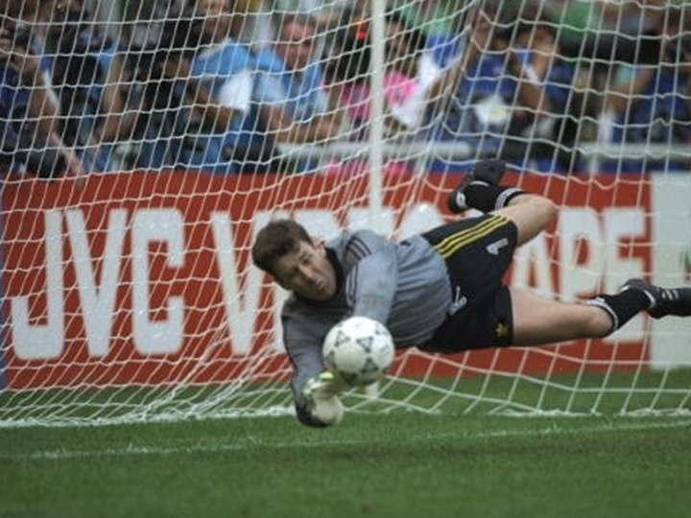
Effectiveness – public authorities
It follows that when the conditions under which the Court has held that individuals may rely on the provisions of a directive before the national courts are met, all organs of the administration, including decentralized authorities such as municipalities, are obliged to apply those provisions
…
[and] are under the same obligation as a national court to … refrain from applying provisions of national law which conflict with them.
Fratelli Costanzo (Case 103/88)

Slide 10
Effectiveness – what it means
Accordingly, any provision of a national legal system and any legislative, administrative or judicial practice which might impair the effectiveness of EU law by withholding from the national court having jurisdiction to apply such law the power to do everything necessary at the moment of its application to disregard national legislative provisions which might prevent directly applicable EU rules from having full force and effect are incompatible with the requirements which are the very essence of EU law
As the Court has repeatedly held, that duty to disapply national legislation that is contrary to EU law is owed not only by national courts, but also by all organs of the State — including administrative authorities — called upon, within the exercise of their respective powers, to apply EU law
WRC (Case C-378/17)

Slide 11
Lisbon Treaty - 2009
Integrated fundamental rights and freedoms into EU law

Slide 12
Hierarchy of public participation
Policies/Legislation
Plans/Programmes
Activities/
Projects
Democratic Process
Strategic Environmental
Assessment (SEA)
Appropriate
Assessment
Environmental Impact
Assessment (EIA)

Slide 13
Public Participation
Notice
(Meta Data)
Δt
Written observations/hearing
Taking Due Account
Prompt Notice of decision
Information about the project
Information requested from public authorities

Slide 14
SEA Directive
Assessment of strategic options including zero option
Mandatory for
plans/programmes that are prepared for agriculture, forestry, fisheries, energy, industry, transport, waste/ water management, telecommunications, tourism, town & country planning or land use and which set the framework for future development consent of projects listed in the EIA Directive; or
Which require appropriate assessment required under the Habitats Directive
"environmental assessment" shall mean the preparation of an environmental report, the carrying out of consultations, the taking into account of the environmental report and the results of the consultations in decision-making and the provision of information on the decision
Monitoring to identify at an early stage unforeseen adverse effects so that remedial action can be undertaken

Slide 15
EIA – Directive 2011/92/EU as amended
Before development consent is given projects likely to have significant effects on the environment are made subject to … an assessment with regard to their effects on the environment
Identify, describe and assess

Slide 16
Access to Justice
Right to challenge the substantive and procedural legality of any decisions, acts or omissions
Procedural – has correct procedure been applied?
Substantive – has substantive law been complied with
Facts
Merits
Limited review possible where competent authority has discretion

Slide 17
Substantive legality: Irish v EU Law
Irish – Irrationality - O’Keeffe ([1993] 1 IR 39)
Irrationality – no relevant material – breach of common sense and reason
Implies a very wide discretion in almost every case
Deference to (expert?) administrative authority - Court has no special skill or competence
“limited and rare” for court to intervene
Court cannot intervene even where it finds the case against the decision was much stronger than the case for.

Slide 18
Substantive legality: Irish v EU Law
EU Law – Sincere cooperation/effective legal protection/Effectiveness (AG opinion in Craeynest C-723/17)
MS must impose same standard of review as CJEU does on acts of EU institutions
Verifying whether authorities have manifestly exceeded their discretion
Cannot substitute its assessment of scientific or technical facts
Administrative authority must examine carefully and impartially all aspects and give reasons so court can verify factual and legal elements
Broad discretion more limited where fundamental rights or other factors are at stake bearing in mind principle of proportionality

Slide 19
Examples of limited discretion
Limited discretion depending on context
Habitats Directive – agreement only where significant effects on European sites can be ruled out based on scientific certainty
Human health – air quality
Right to a healthy environment?

Slide 20
Air Quality – AG Kokott in Craeynest
[It] is for the competent authorities to convince the courts in particular by presenting substantiated arguments. … The other party is free to counter such claims with its own scientifically substantiated arguments. Of course, it is also conceivable for the court to have recourse to independent experts in order to find support in appraising such a scientific dispute.
If the authorities are unable to convince the Court, they must at least undertake additional investigations, for example by taking further measurements or applying other models of the development of ambient air quality.
If the national courts have powers to impose orders, they may order such further investigations. If, however, the courts are permitted only to annul administrative decisions, there must be an obligation on the authorities to draw the necessary conclusions from such annulment and the grounds of the decision.

Slide 21
Don’t listen to me. Listen to the scientists

Slide 22
Functions of litigation
Ensures administrative decision making progressively improves
Marginal developments are more risky/expensive
Development on or near protected habitats needs more assessment
Possibility of litigation acts as a deterrent to poor or marginal applications
Helps ensure competent authorities focus on getting the decision right

Slide 23
Practicalities – A decision has been made

Slide 24
Practicalities
Set up a company – a CLG
Start planning early (too late when a decision has been made)
Start fundraising early
Use social media/press

Slide 25
The inspector’s report

Slide 26
Consulting the file

Slide 27
Working with your lawyer
How hard can it be? A particular set of skills
Yes it is a terrible decision but is it lawful? Most normal people don’t think like lawyers.
A lot of decisions fall because our legislation is terrible
Planning Act/Regulation > 1000 pages
Gaps between EU and national law
Complexity means developer/authority often gets it wrong
EU law obligations often overlooked
We collect killer points and are usually on the look out for the “right” case

Slide 28
What are my chances?

