Slide 1
Understanding Proposal Writing
Online Sessions for Research Staff 2024
Dr Paolo Saporito
EU Research Officer
psaporito@ucc.ie
5th April 2024

Slide 2
Key suggestions
Know your funding body
Customize your writing style
Manage your time strategically

Slide 3
#1: Know your funding body

Slide 4
#1: Know your funding body
Do
Use funding search platforms (i.e. Research Professional)
Read support documentation (i.e. Call Programme, Guide for Applicants)
Don’t
Use same proposal for different funding bodies
Overlook relevant policies
Check funders’ website
Understand funders’ mission and remit
Reach out to a Research Officer for advice
Underestimate differences between programmes
Go in solo mode

Slide 5
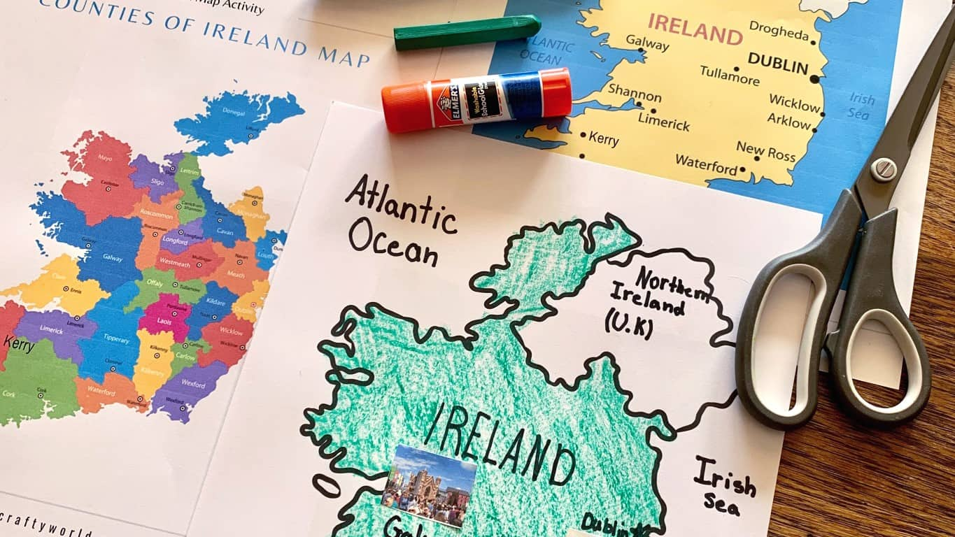
#1: Know your funding body
IRC vs MSCA Postdoctoral Fellowship

Slide 6
#2: Customize your writing style
Excellence
Idea
Implementation
Methodology
Impact
Results
What?
Why?
Who?
When?
How?
What?
Who?
How?
Why?
Background/Rationale
Aim & Objectives
Progress beyond State of the Art
Research activities
Methods
Actors/Partners
Outcomes and their relevance
Stakeholder benefit
Measuring Impact

Slide 7
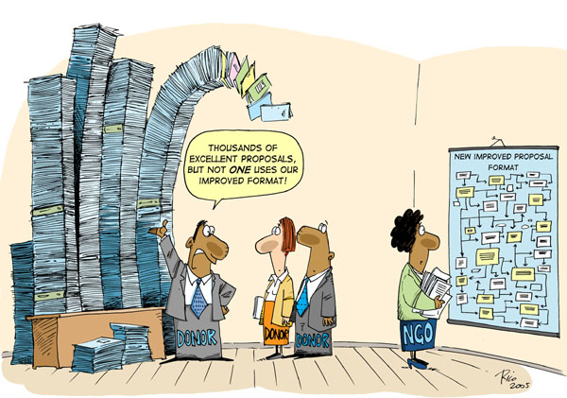
#2: Customize your writing style
Do
Respect page limits & formatting rules
Make it easy to remember
Don’t
Use abbreviations, acronyms, jargon
General references to policies
Be specific, but keep it simple and clear
Answer the questions
Keep guidelines handy & refer to relevant policies
Concentrate on a specific section (i.e. science) → every section counts
Make assumptions or take info for granted
Use diagrams and chart
Use academic English (you are not writing a paper!)

Slide 8
#3: Manage your time strategically
Do
Plan ahead
Don’t
Leave it to the last minute
Start writing immediately
CV development (in some cases)
Identify funding pipelines
Take the time to understand the funder and the call

Slide 9
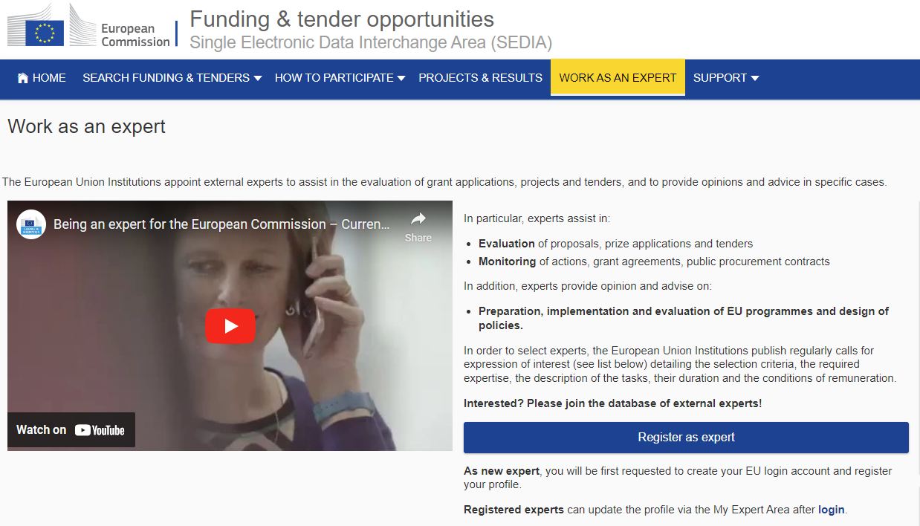
Research Skills Training Programme 2024
The Evaluation of Funding Proposals under Horizon Europe: Perspectives from Evaluators
Register as an expert!

Slide 10
UCC Research – EU Funding Team
Our Team | Research | University College Cork (ucc.ie)
Nóirín Uí Bhreithiúnaigh Team Manager (currently on leave) | n.uibhreithiunaigh@ucc.ie | Queries re funding Info sessions & training events 1-to-1 proposal assistance & review Pre-award admin support
Niamh Mundow ERC, EIC | niamh.mundow@ucc.ie
Fiona Riordan Cluster 1 & 3, COST | fiona.riordan@ucc.ie
Richard Scriven Cluster 2 & 4 | richard.scriven@ucc.ie
Eoin Gunnigle Cluster 5 & 6, WIDERA | eoin.gunnigle@ucc.ie
Paolo Saporito MSCA, Interreg | psaporito@ucc.ie

Slide 11
UCC Research – National & International Funding Team
Our Team | Research | University College Cork (ucc.ie)
Amanda Forde SFI | a.forde@ucc.ie | Queries re funding Info sessions & training events 1-to-1 proposal assistance & review Pre-award admin support
Cara Hueston National & International (i.e. IRC, HRB, Wellcome Trust) | chueston@ucc.ie
Raghuram Badmi National & International (i.e. DFM, Teagasc, SEAI, EPA) | rbadmi@ucc.ie

